Slide 1
SAMMI:
A Spatially-Aware Multi-Mobile Interface for Analytic Map Navigation Tasks
Khalad Hasan, David Ahlström, Pourang Irani

Slide 2
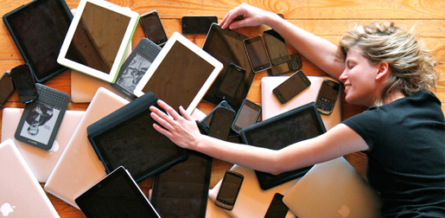

Slide 3
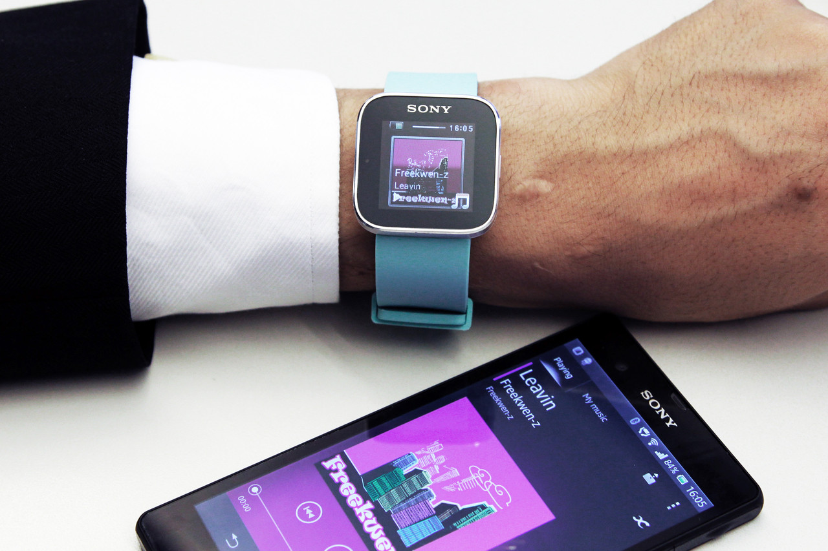

Slide 4
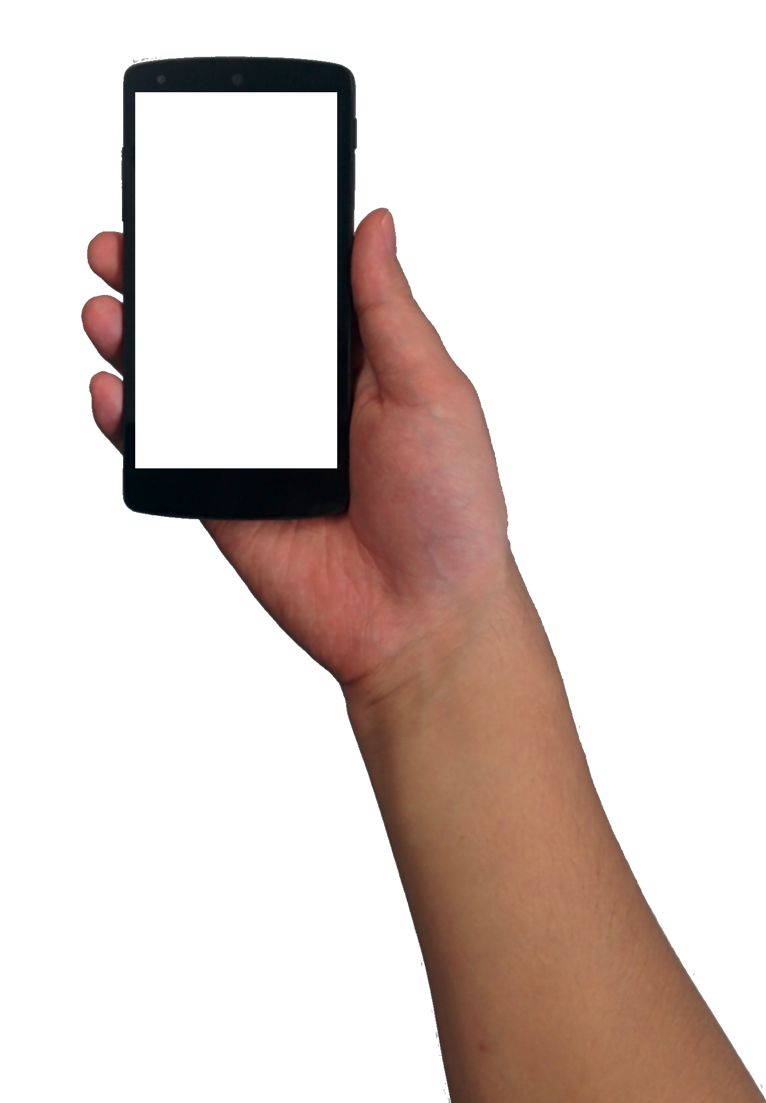
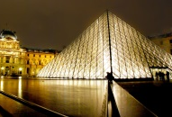
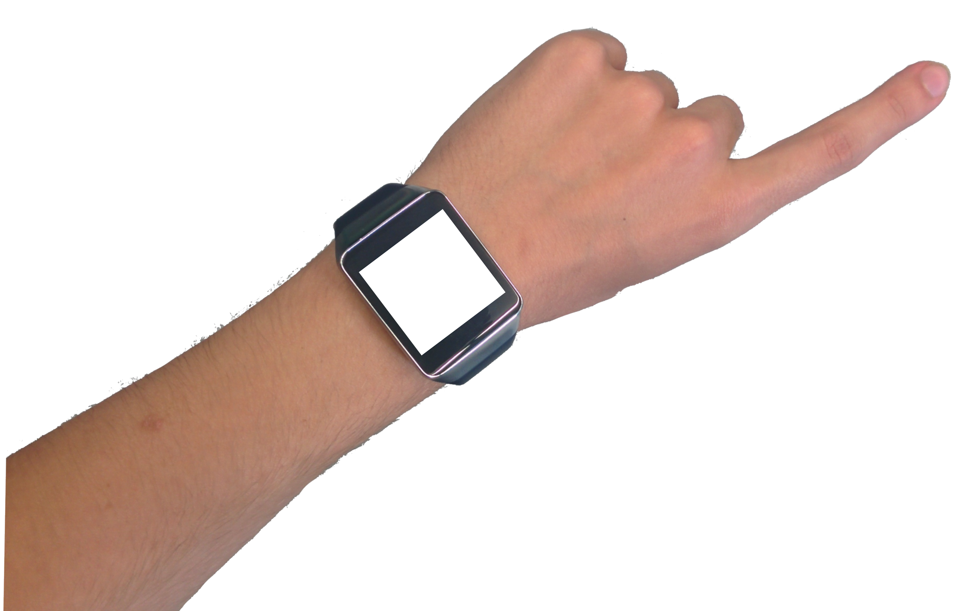
Louvre Museum
Arc de Triomphe
SAMMI: Spatially-Aware Multi-Mobile Interface

Slide 5
Contributions
SAMMI
Design space exploration
Complex analytic tasks

Slide 6
Related
work

Slide 7
Stitching
Pass-then-around
Hinckley et al., 2004
Lucero et al., 2011

Slide 8
Duet
Chen et al., 2014

Slide 9
Spatially aware navigation
1993 – Fitzmaurice
Peephole interfaces
Around-device pointing
2002 – Tsang et al.
2003 – Yee
2006 – Mehra et al.
2006 – Olwal
2007 – Rohs et al.
2008 – Rohs & Oulasvirta
2008 – Cao et al.
2010 – Henze & Boll
2011 – Huber et al.
2012 – Pahud et al.
2014 – Spindler et al.
2014 – Kerber et al.
1998 – Sibert et al.
2008 – Forlines
2011 – Ens et al.
2013 – Jota
2013 – Hasan
2015 – Hasan

Slide 10
Design space exploration
Session A
Usage mode
Feedback type
Session B
Selection technique
Anchor placement

Slide 11
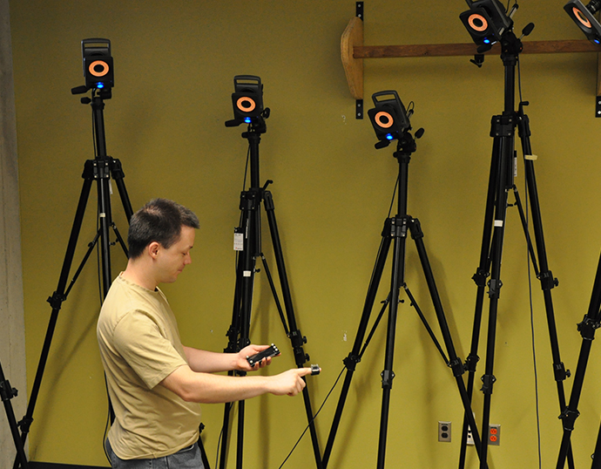

Slide 12
Design space exploration
Session A
Usage mode
Feedback type
Session B
Selection technique
Anchor placement

Slide 13
Wrist

Slide 14
Hold

Slide 15
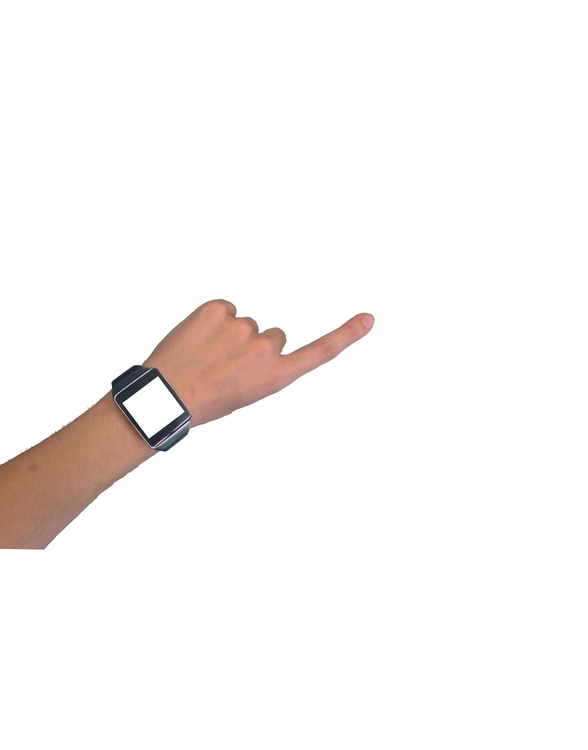
Index

Slide 16
Design space exploration
Session A
Usage mode
Feedback type
Session B
Selection technique
Anchor placement

Slide 17
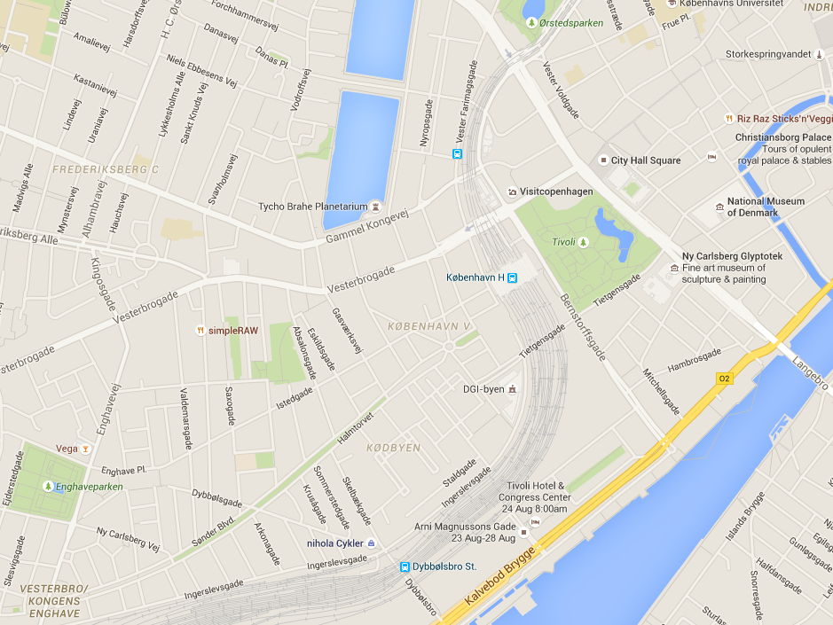
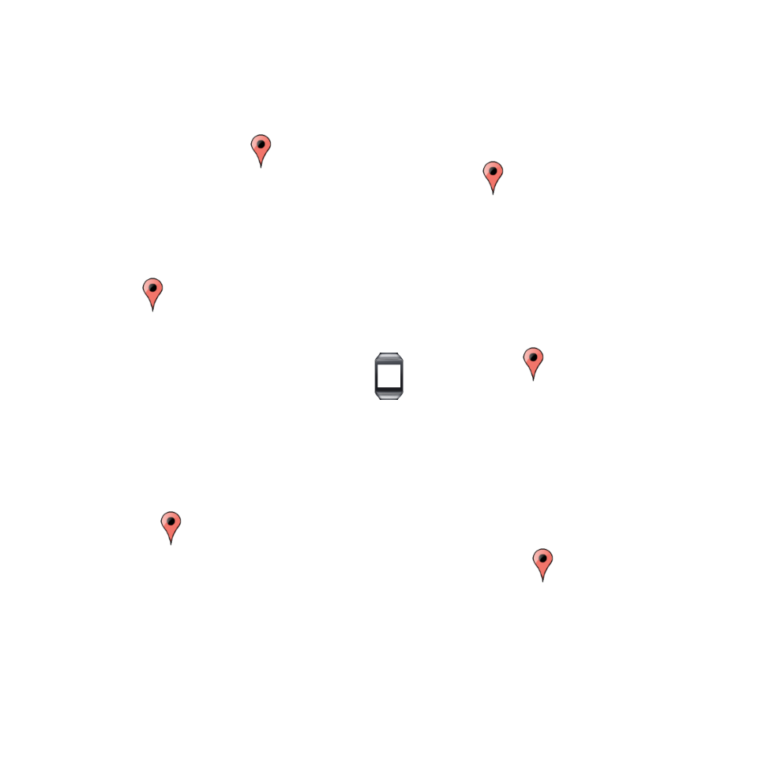
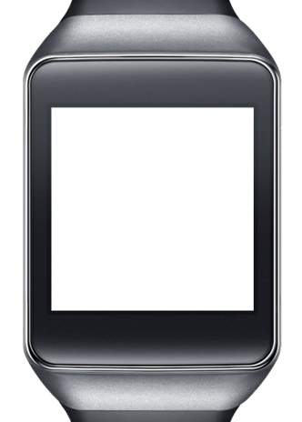
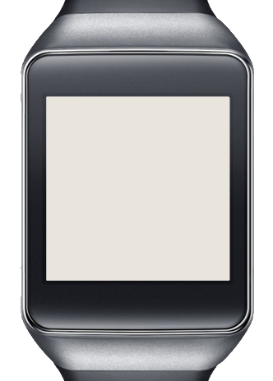
Overview

Slide 18
EdgeRadar

Slide 19
d
θ
EdgeRadar

Slide 20
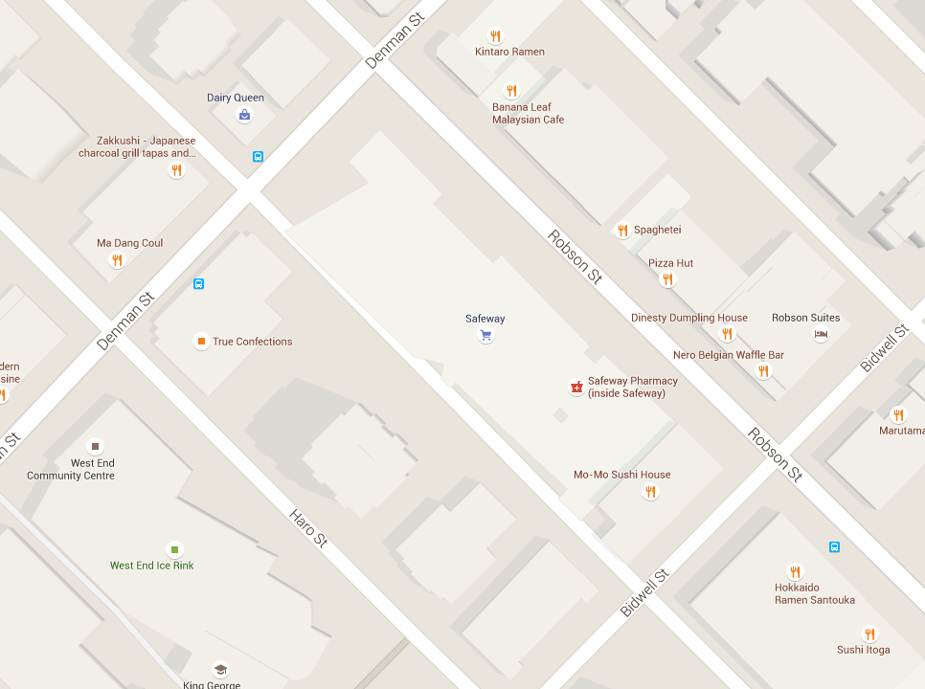
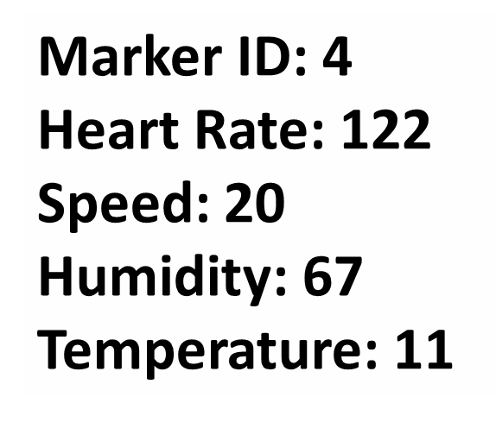
Marker ID: 4
Heart Rate: 122
Speed: 20
Humidity: 67
Temperature: 11
50cm
38cm

Slide 21
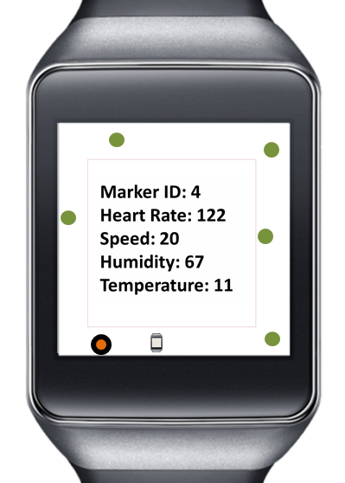
Marker ID: 4
Heart Rate: 122
Speed: 20
Humidity: 67
Temperature: 11

Slide 22
3 × 2 within-subject design
3 usage mode
Wrist
Hold
Index
2 visualization
Overview
EdgeRadar

Slide 23
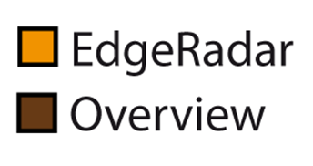
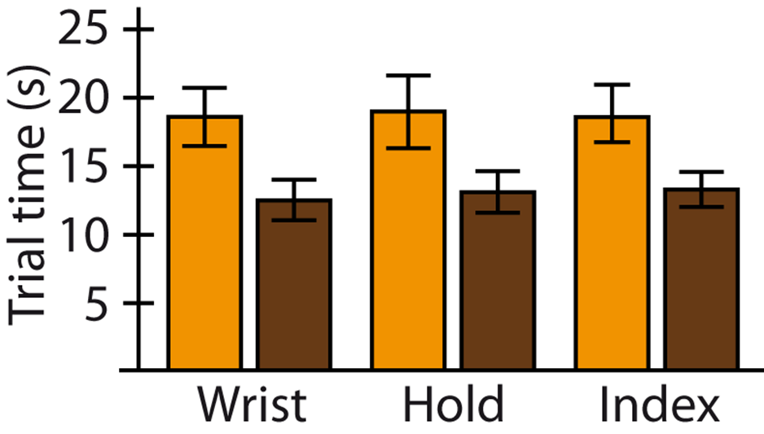
RESULTS

Slide 24
Design space exploration
Session A
Usage mode
Feedback type
Session B
Selection technique
Anchor placement

Slide 25
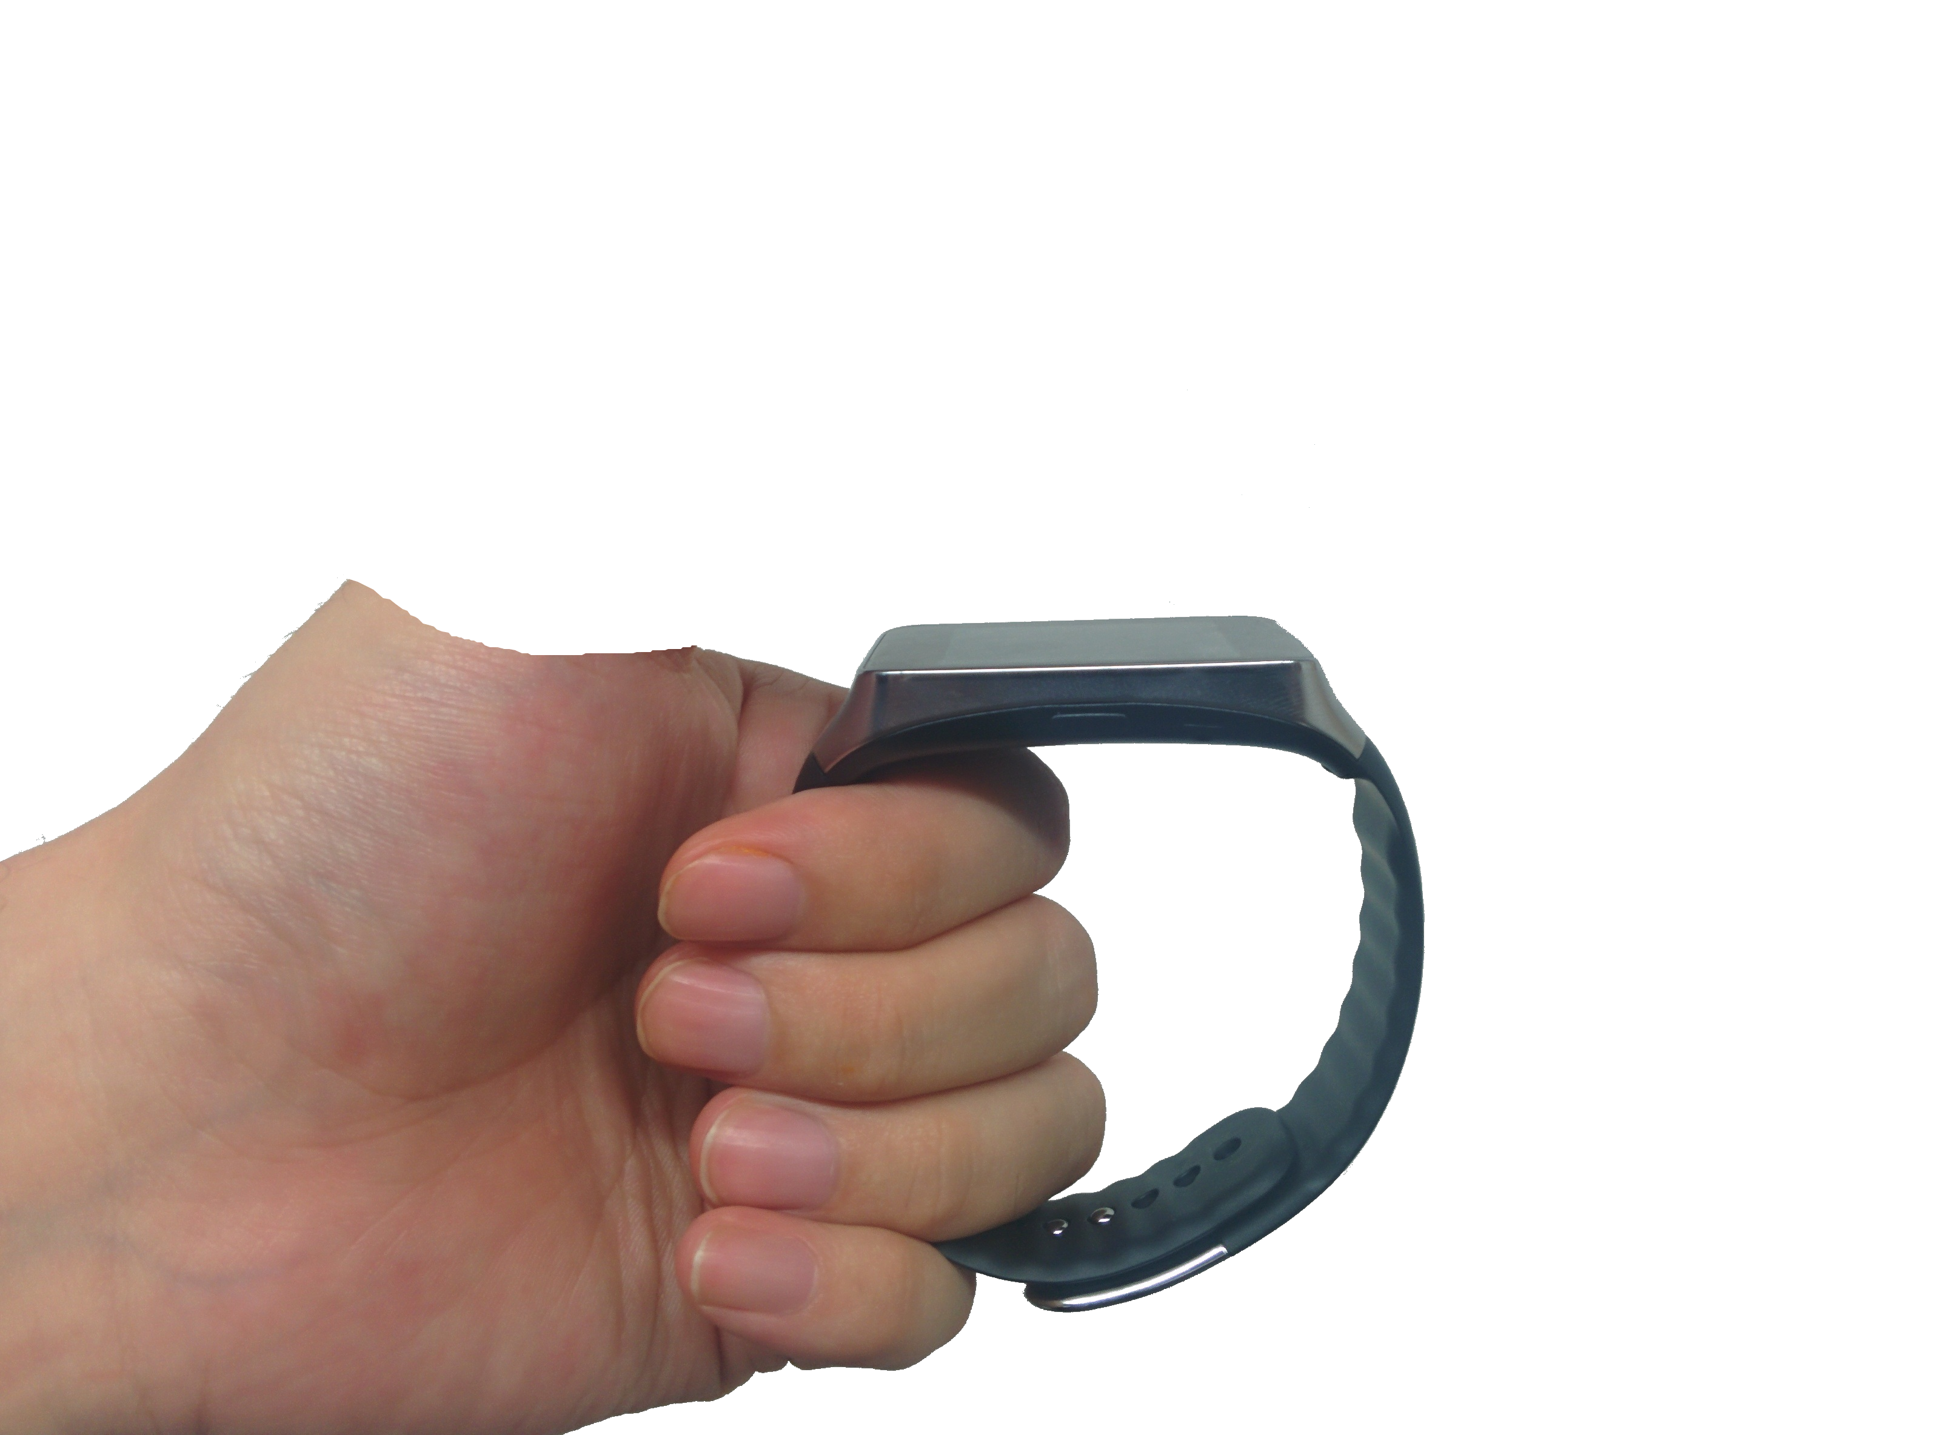
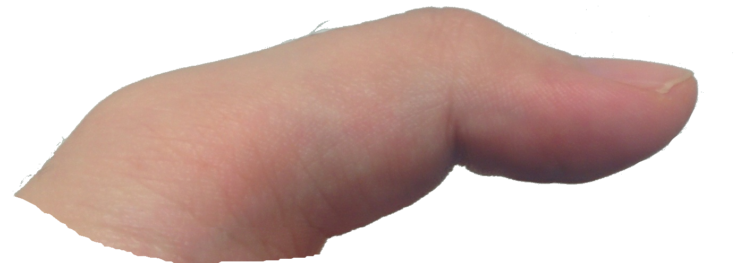
Hold+Tap

Slide 26
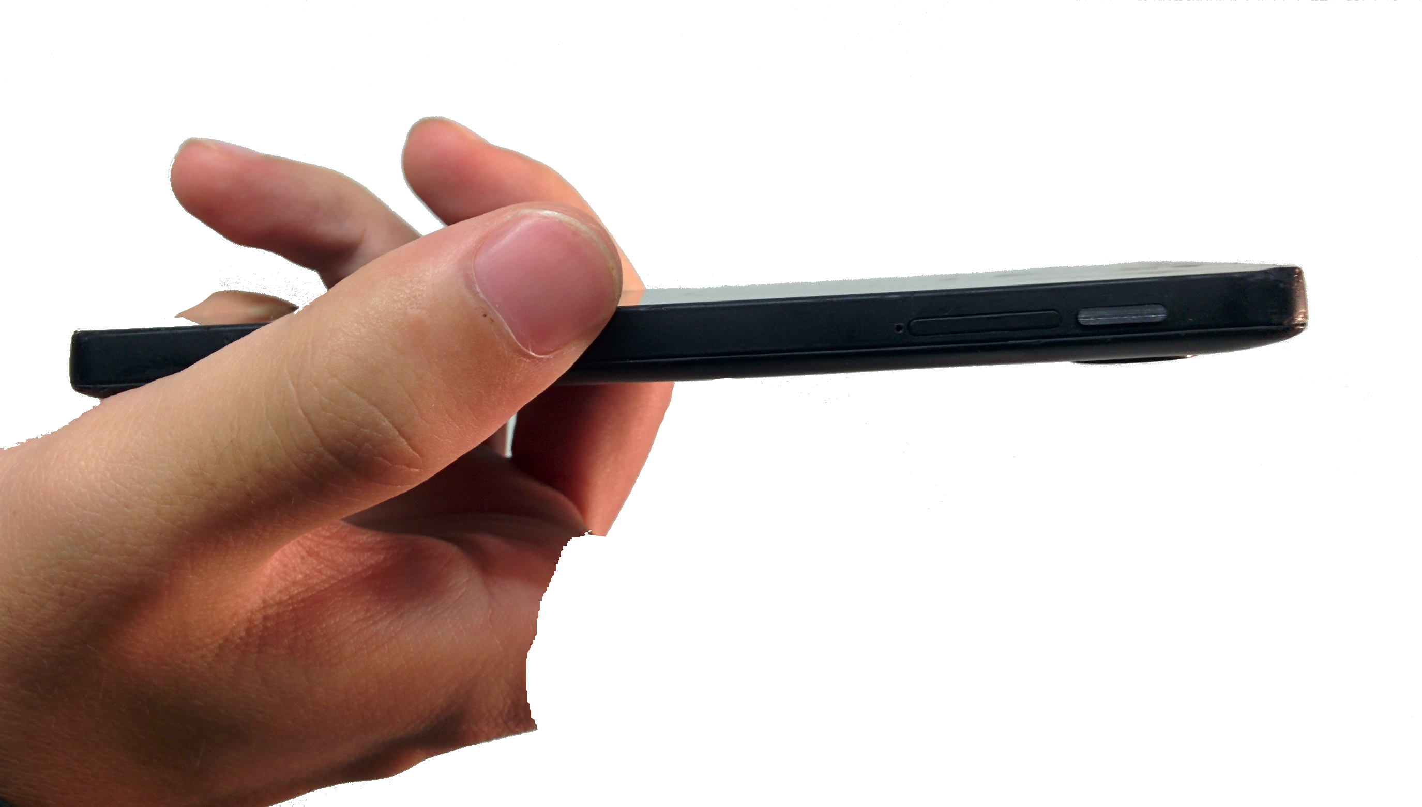
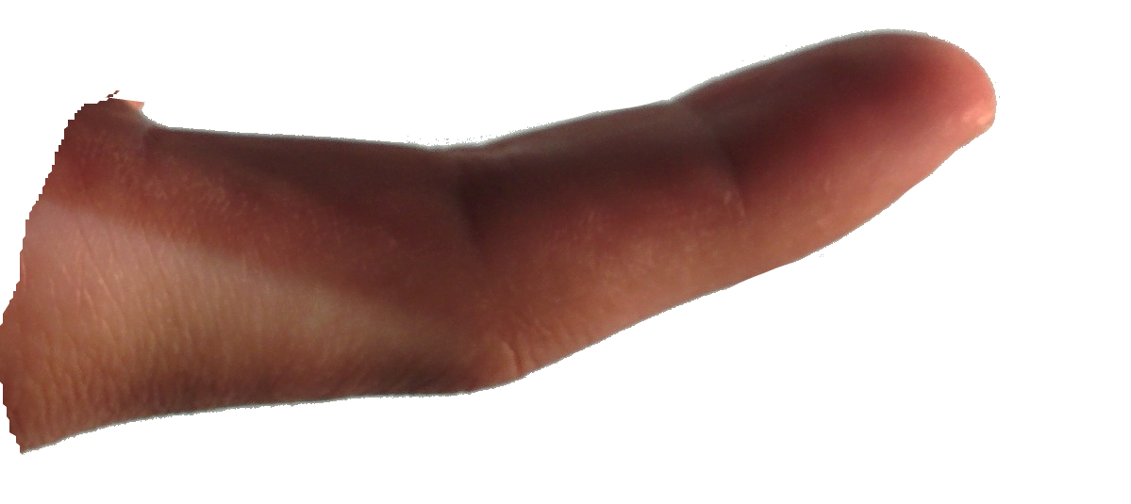
Index+BackTap

Slide 27
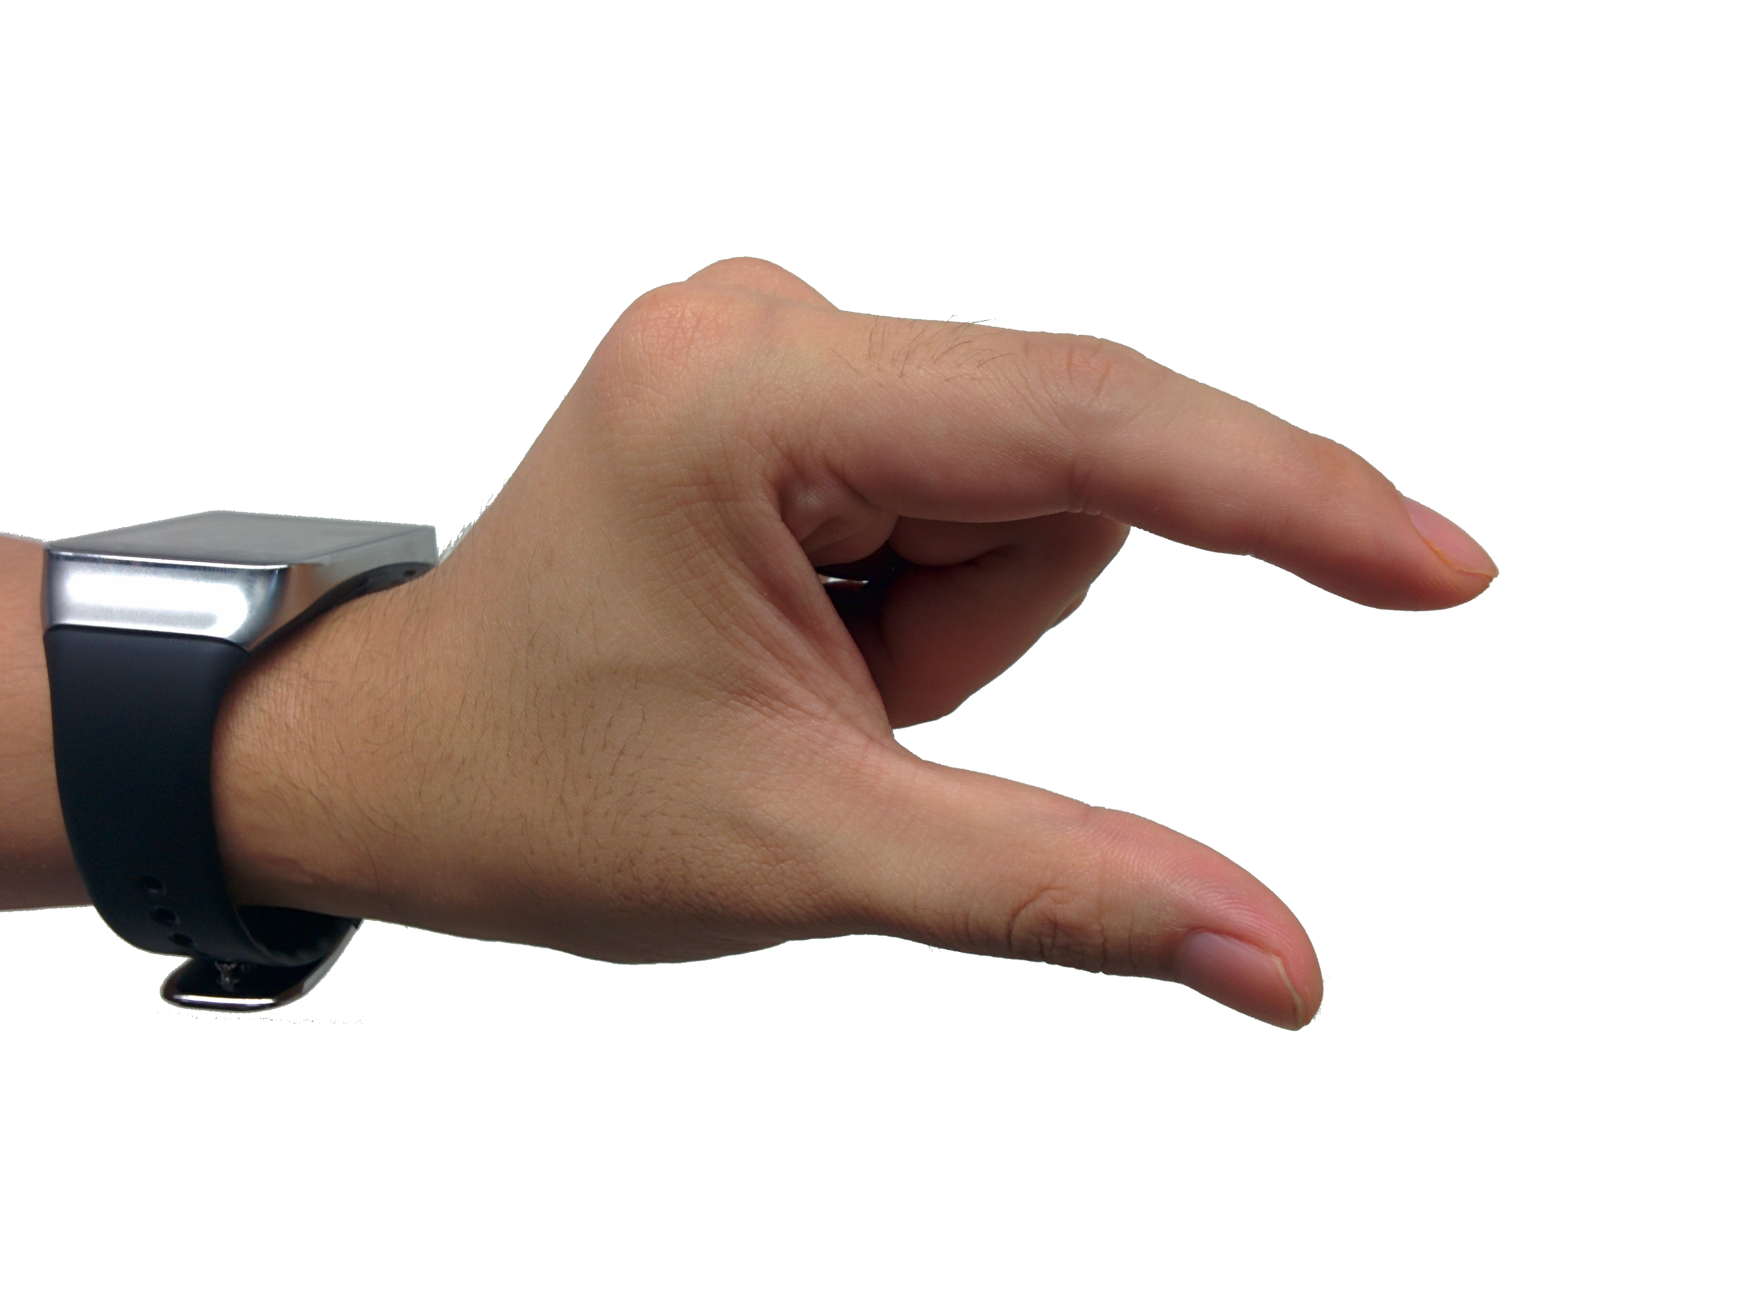
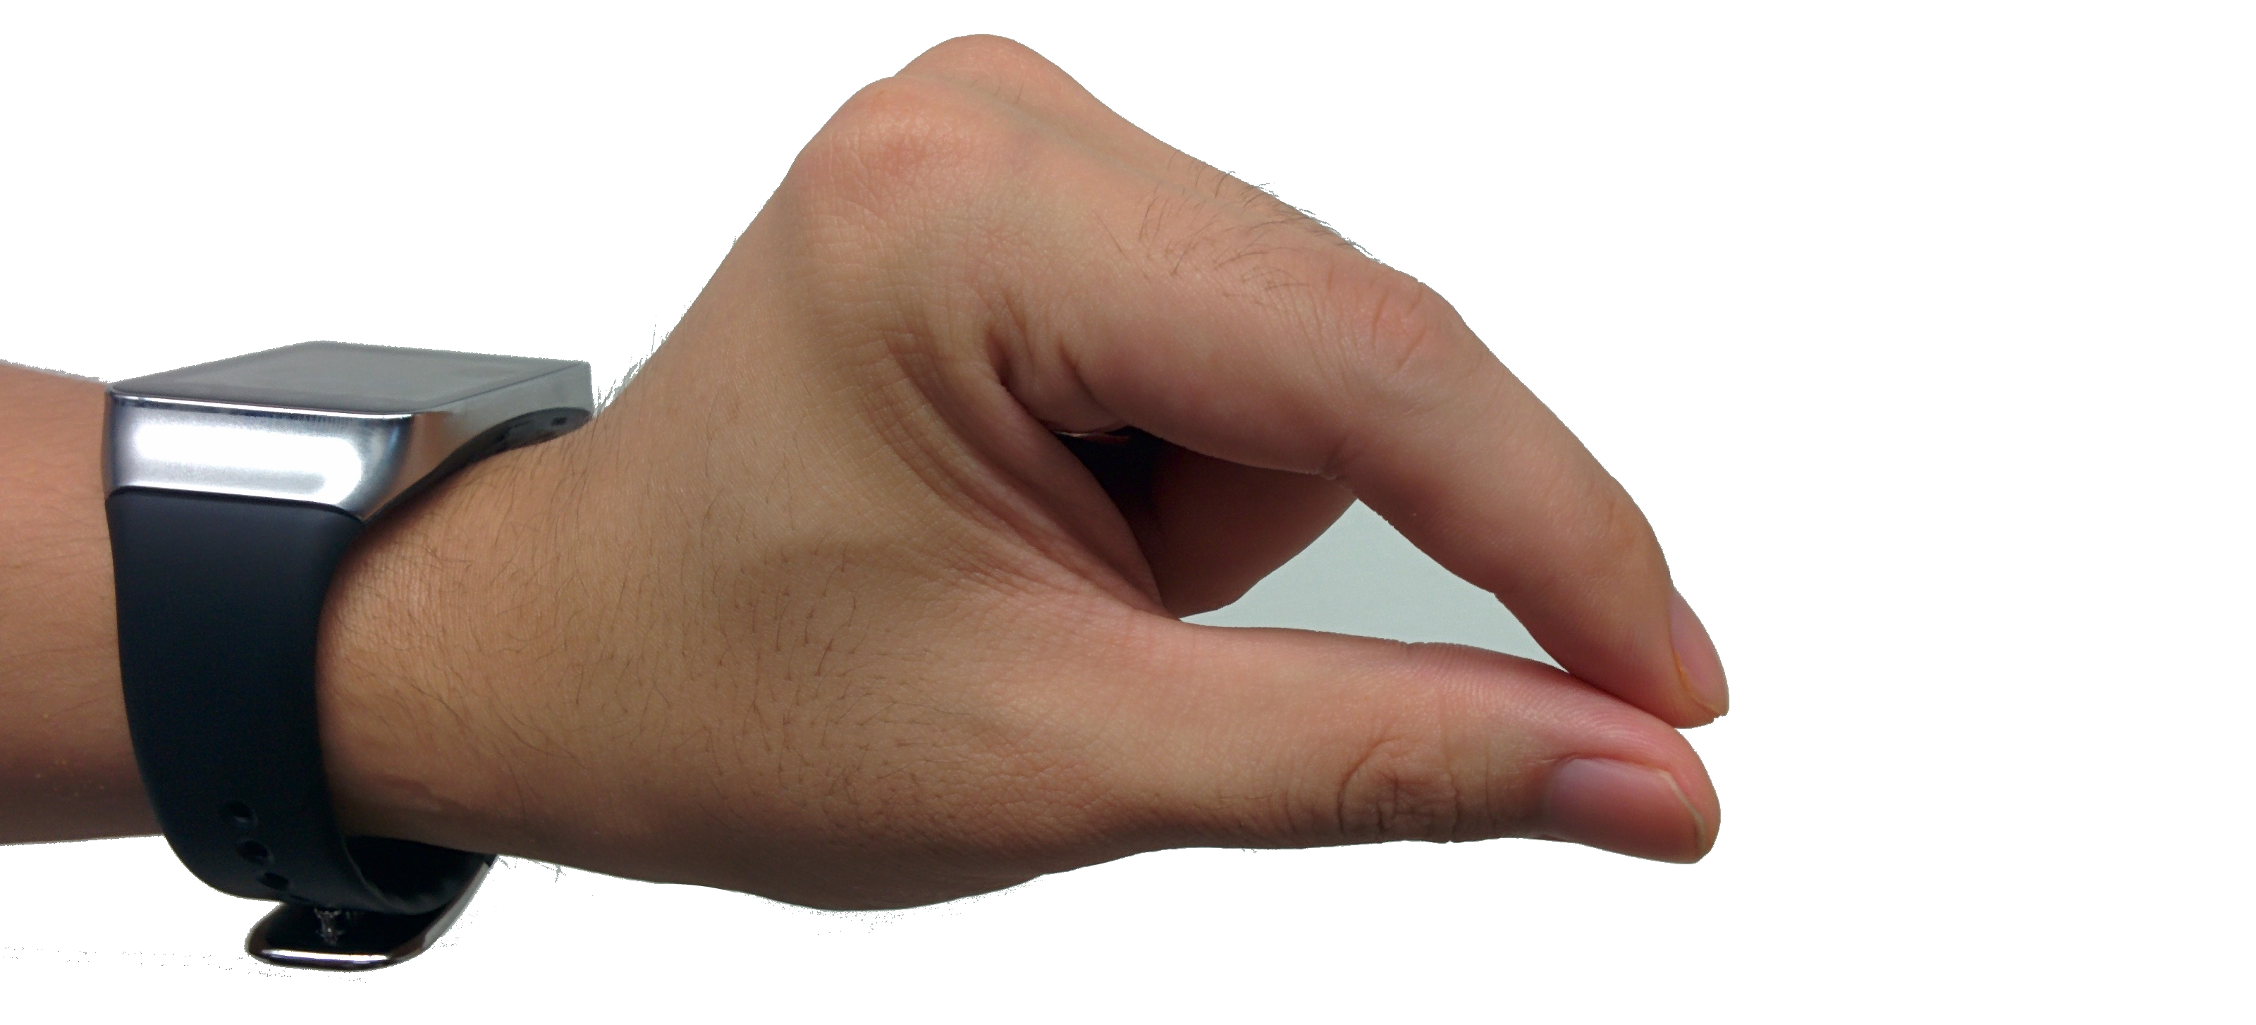
Index+Pinch

Slide 28
Design space exploration
Session A
Usage mode
Feedback type
Session B
Selection technique
Anchor placement

Slide 29
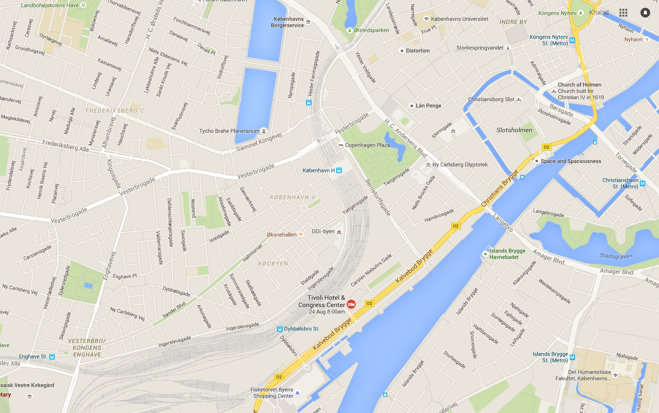
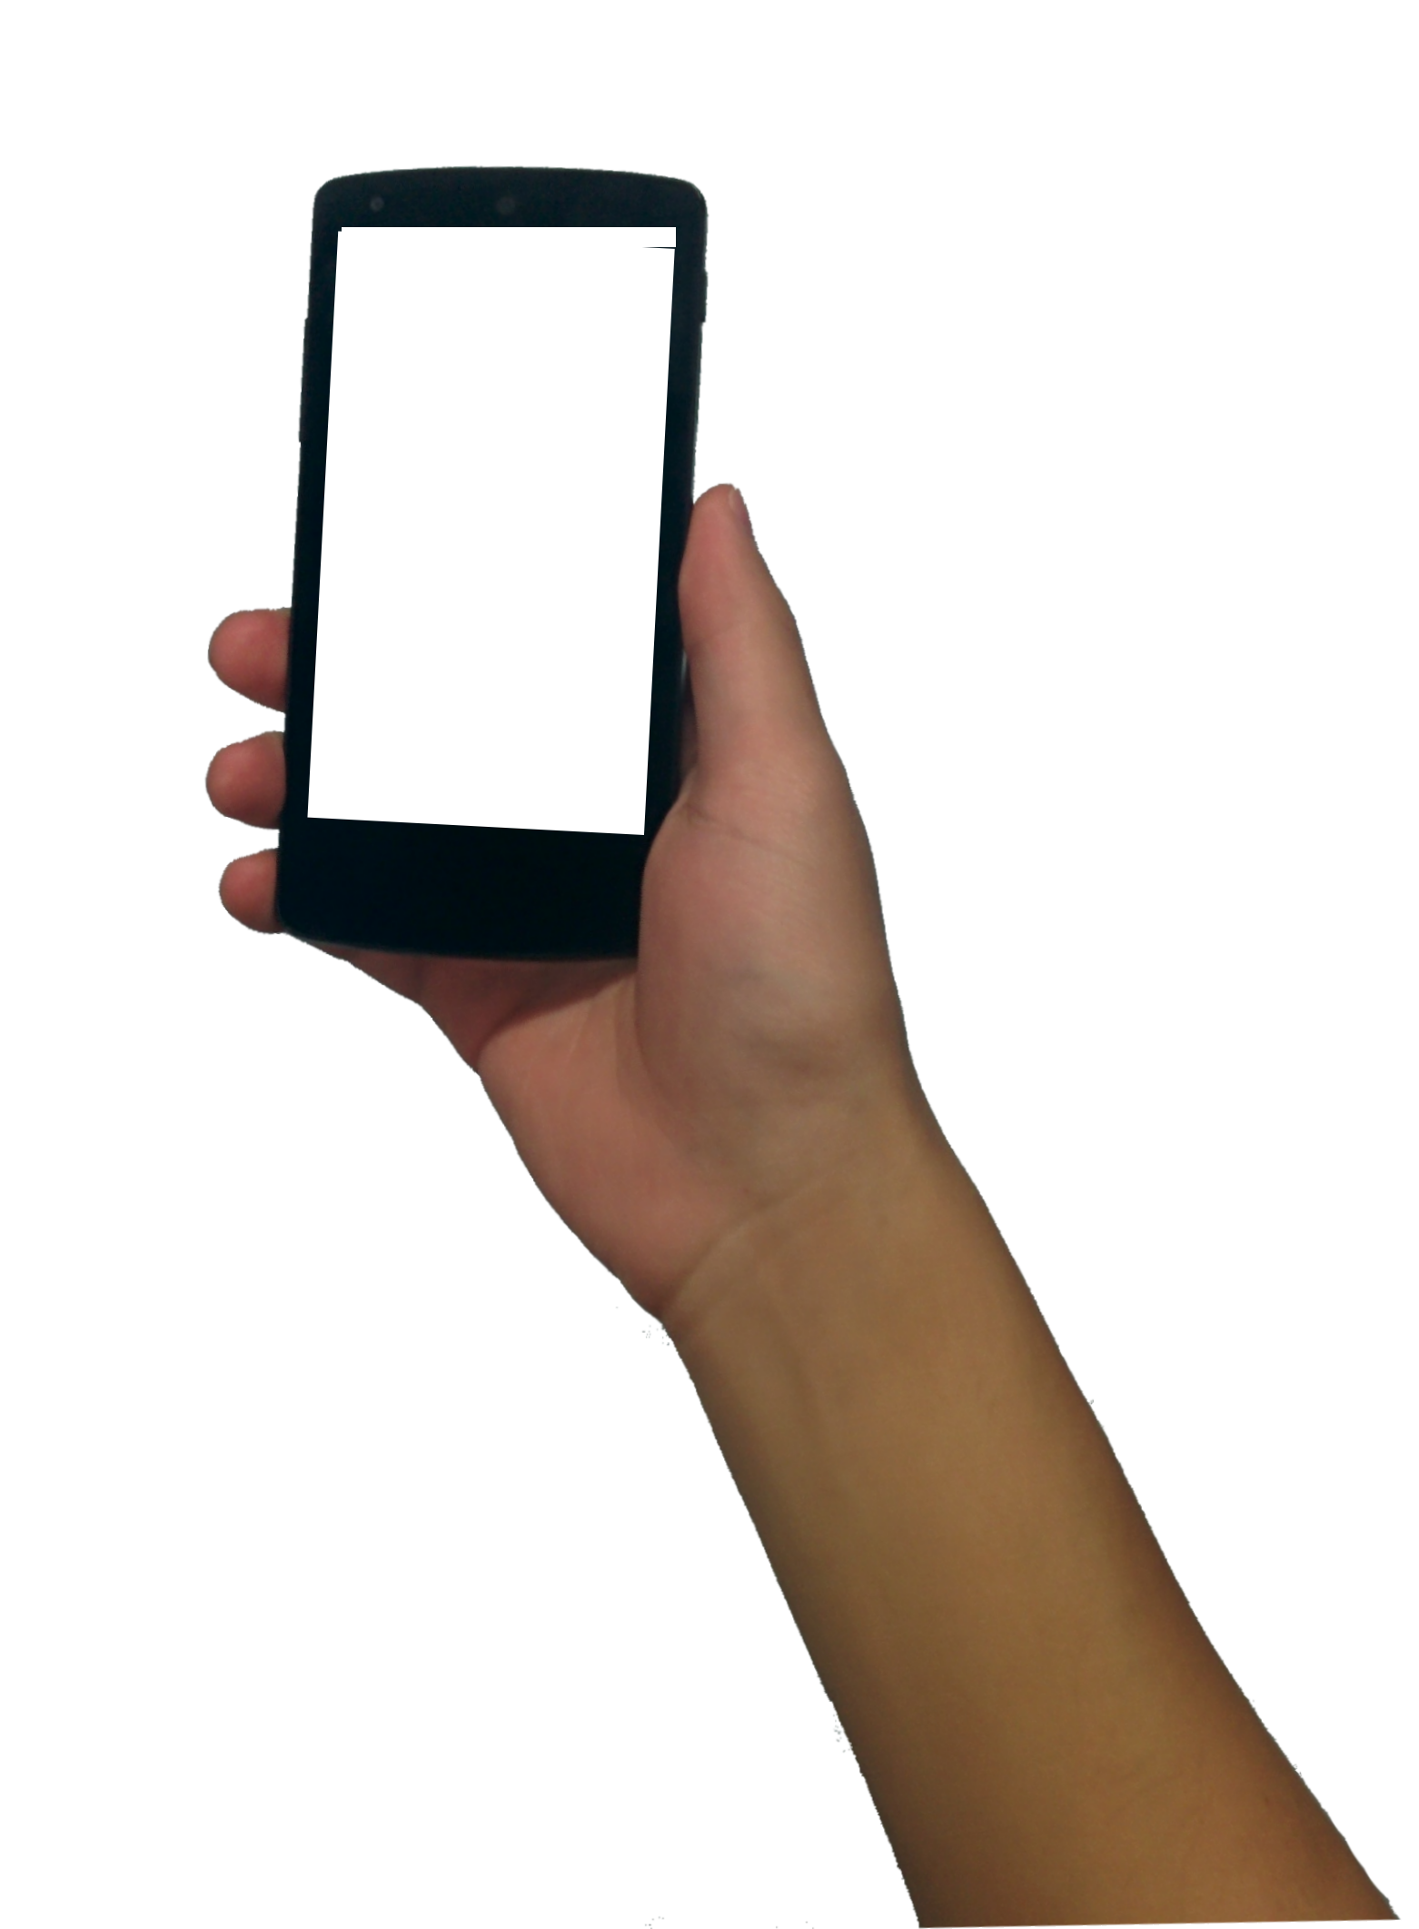
Device

Slide 30
External

Slide 31
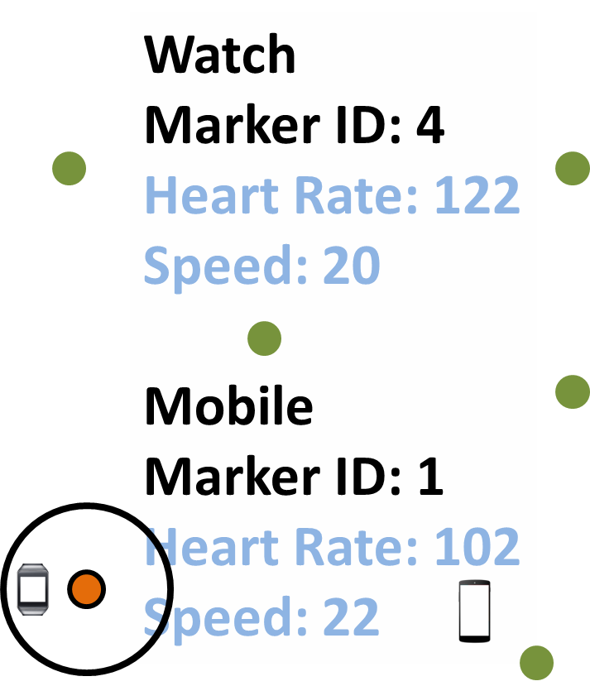
Watch
Marker ID: 4
Heart Rate: 122
Speed: 20
Mobile
Marker ID: 1
Heart Rate: 102
Speed: 22
Marker ID: 4
Heart Rate: 122
Speed: 20
Humidity: 67
Temperature: 11
50cm
38cm

Slide 32
3 × 2 within-subject design
3 selection techniques
Hold+Tap
Index+BackTap
Index+Pinch
2 anchor placements
Device
External

Slide 33
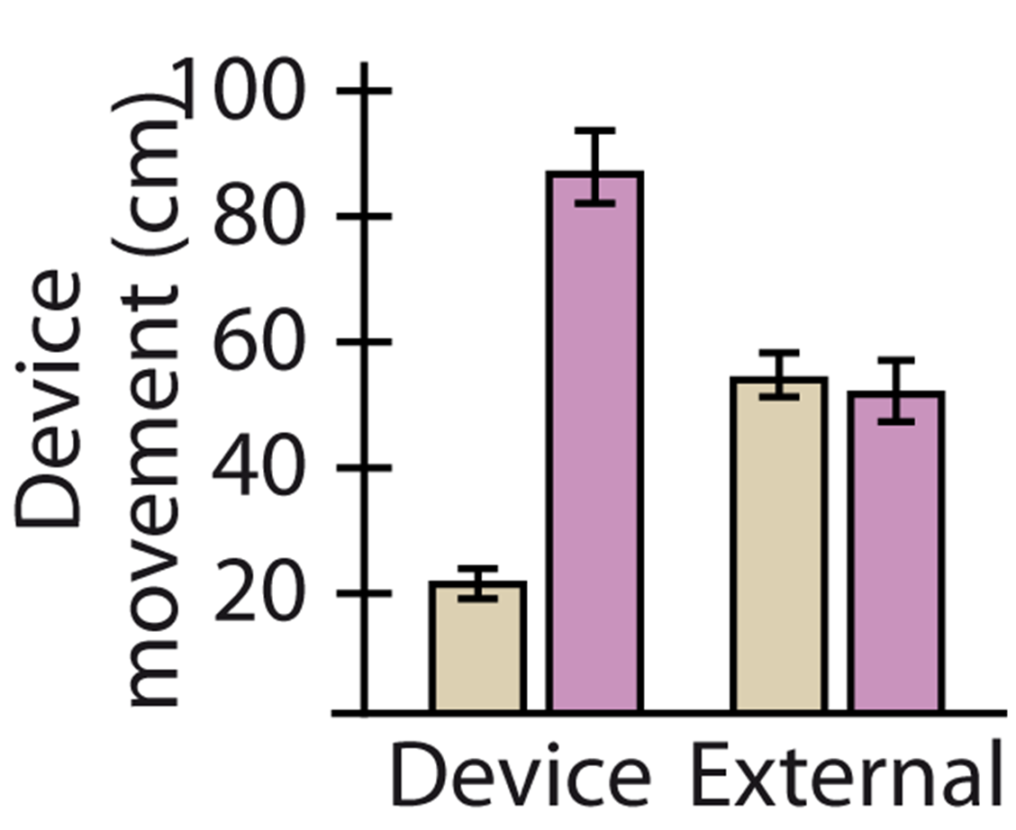
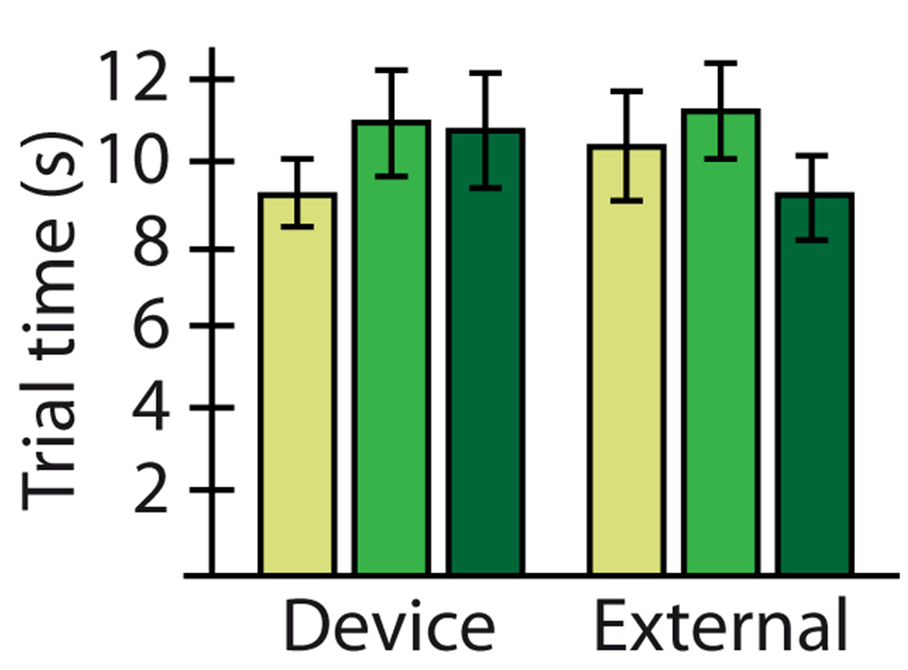
RESULTS

Slide 34
Analytic map navigation task
SAMMI vs. Touch

Slide 35
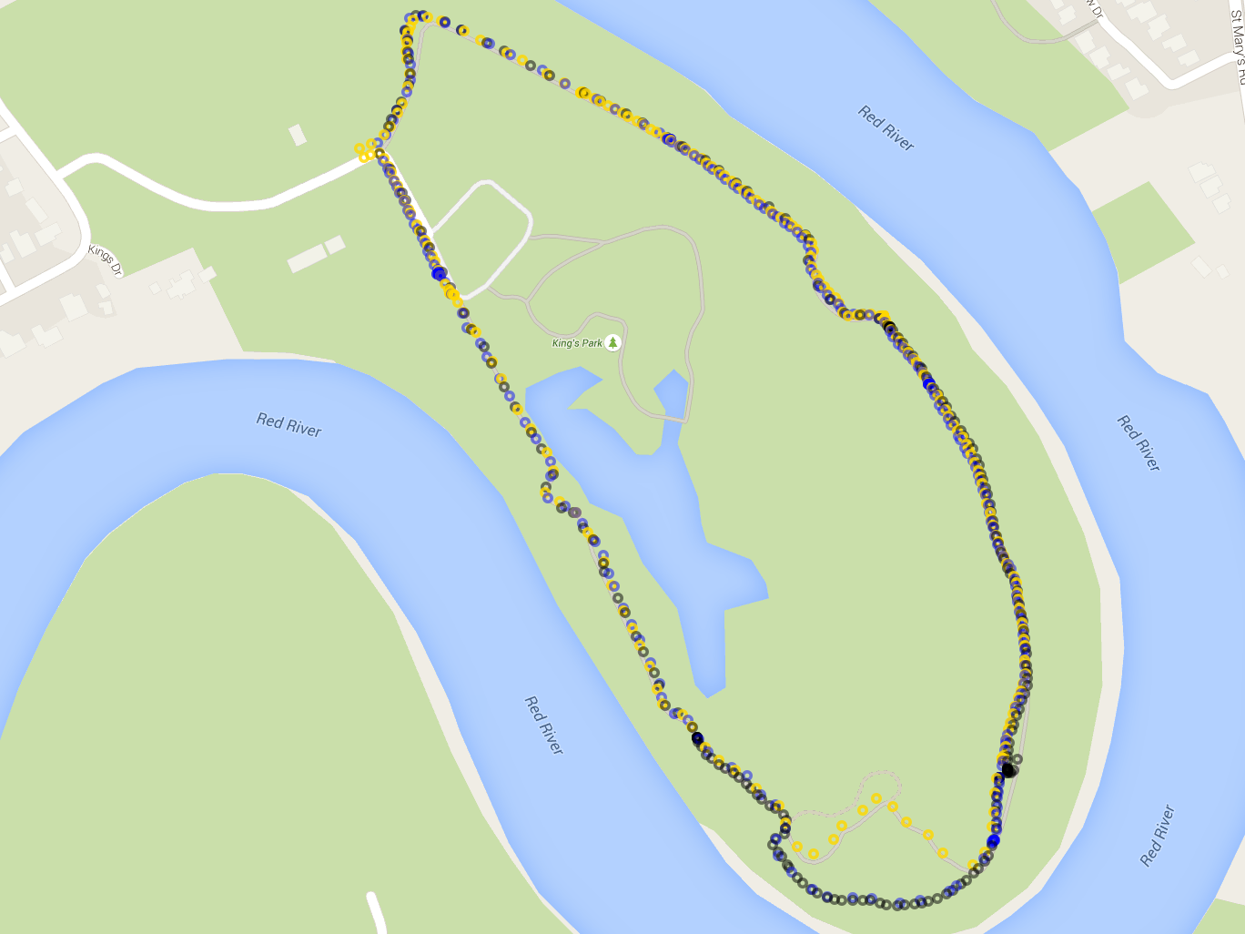
GPS coord.
Altitude
Heart rate
Music played
Pictures taken

Slide 36
‘What songs were played when walking speed was low?’
‘What altitudes were measured when the heart rate was high?’

Slide 37
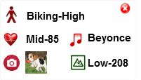
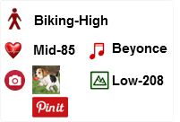
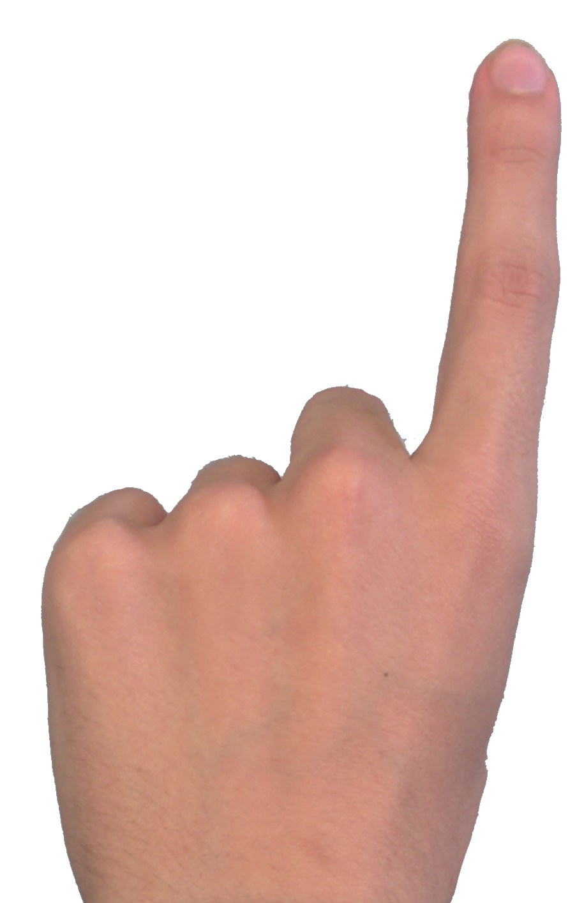
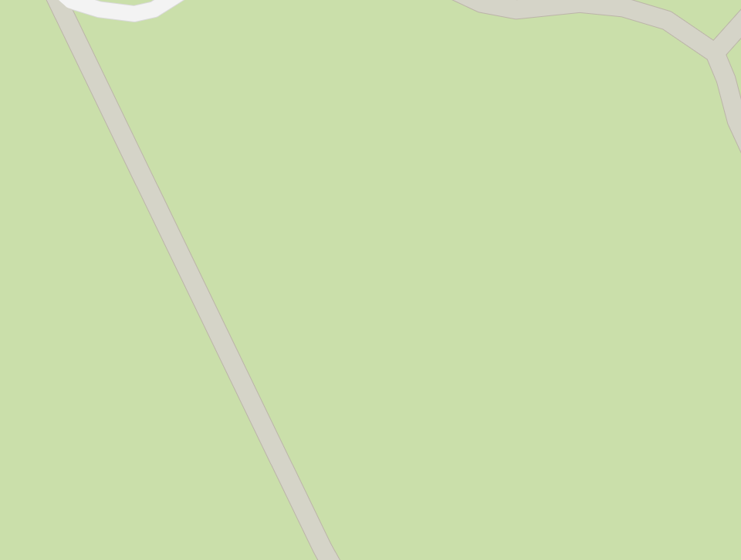
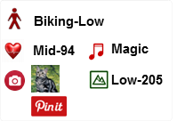
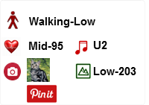
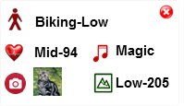
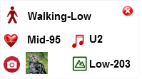
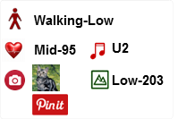
Biking-High
High-100
Beyonce
Low-208

Slide 38
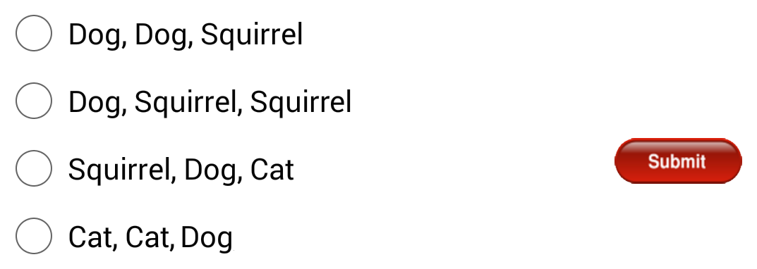

Slide 39
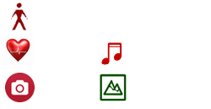
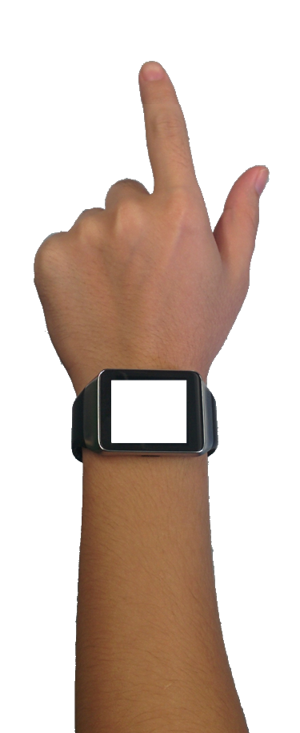
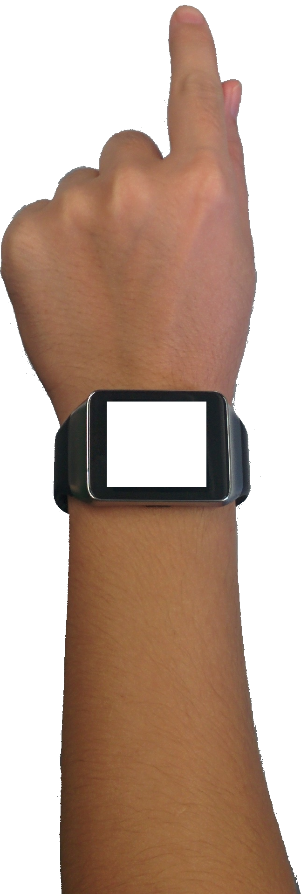
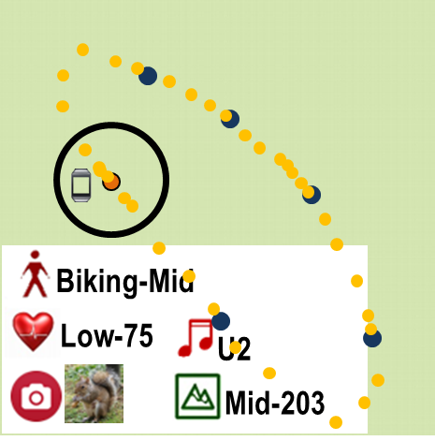
Biking-Mid
Low-75
U2
Mid-203
Biking-High
High-100
Beyonce
Low-208

Slide 40
2 × 2 within-subject design
2 techniques
Touch
SAMMI
2 number of markers
6 markers
12 markers

Slide 41
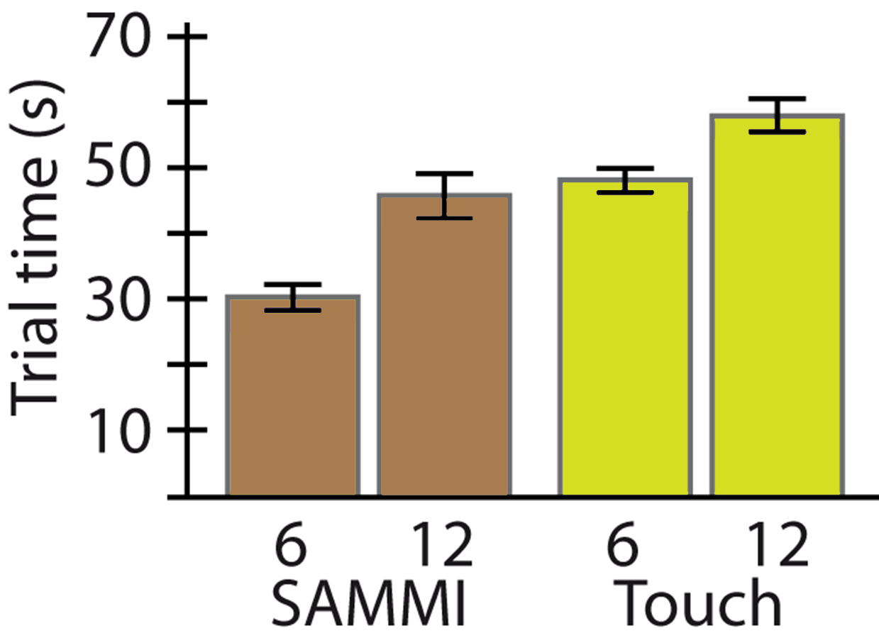
RESULTS
~28% faster

Slide 42
SAMMI
applications

Slide 43
Video browsing

Slide 44
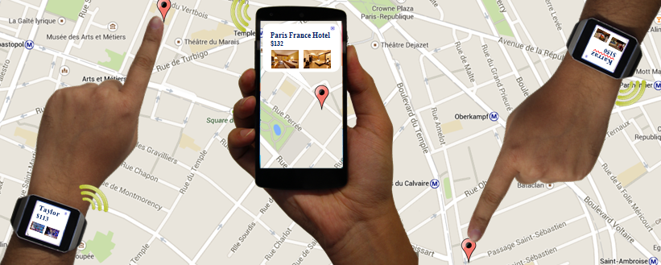
Coordinated mobile devices for collaboration

Slide 45
SAMMI: A Spatially-Aware Multi-Mobile Interface
SAMMI’s design space
SAMMI as an efficient spatial navigation interface

Slide 46
SAMMI:
A Spatially-Aware Multi-Mobile Interface for Analytic Map Navigation Tasks
Khalad Hasan, David Ahlström, Pourang Irani
Thank you

