Slide 1
Camera Calibration

Slide 2
What is it?
Build a relationship between an image and the 3D world

Slide 3
What is it?
Build a relationship between an image and the 3D world
why bother?
Scale
Orientation
Lens distortion
etc

Slide 4
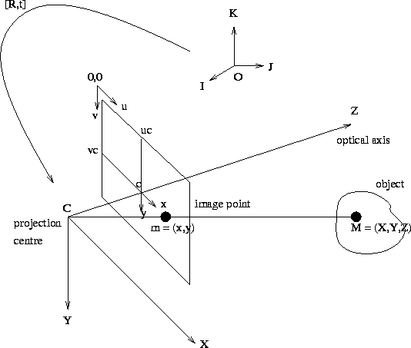
What is it?
Build a relationship between an image and the 3D world
http://homepages.inf.ed.ac.uk/rbf/CVonline/LOCAL_COPIES/OWENS/LECT9/node2.html

Slide 5
What is it?
Build a relationship between an image and the 3D world
http://homepages.inf.ed.ac.uk/rbf/CVonline/LOCAL_COPIES/OWENS/LECT9/node2.html

Slide 6
What is it?
Build a relationship between an image and the 3D world
Convert from 3D in camera space to image point
http://homepages.inf.ed.ac.uk/rbf/CVonline/LOCAL_COPIES/OWENS/LECT9/node2.html

Slide 7
Calibration– more
convert from x,y to u,v

Slide 8
Calibration– more
convert from x,y to u,v

Slide 9
Calibration– more
convert from x,y to u,v
These (f,u,v,uc,uv) are intrinsic
parameters – they do not rely on
the 3D scene

Slide 10
Calibration– more
convert from x,y to u,v
These (f,u,v,uc,uv) are intrinsic
parameters – they do not rely on
the 3D scene
Extrinsic?(rely on 3D scene)
Rotation and translation from I,J,K to
X,Y,Z

Slide 11
Calibration– more
convert from x,y to u,v
These (f,u,v,uc,uv) are intrinsic
parameters – they do not rely on
the 3D scene
Extrinsic?(rely on 3D scene)
Rotation and translation from I,J,K to
X,Y,Z
R is 3x3 rotation, 3DOF
t is a 3x1 translation, 3DOF

Slide 12
Calibration– more
Camera calibration

Slide 13
Calibration– more
Camera calibration
internal
external

Slide 14
Multiply out…

