Slide 1
Optical Flow

Slide 2
What is it?
The perceived movements (flow) of objects in a scene.

Slide 3
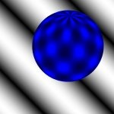
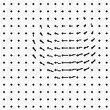
What is it?
The perceived movements (flow) of objects in a scene.
http://of-eval.sourceforge.net/

Slide 4
What is it?
The perceived movements (flow) of objects in a scene.
Length of vectors?
speed
http://of-eval.sourceforge.net/

Slide 5
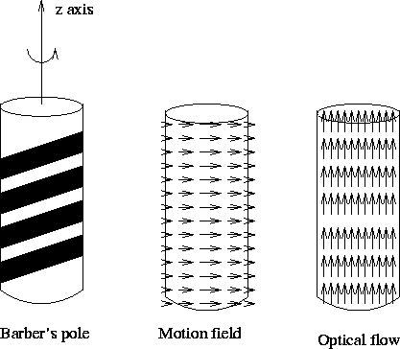
What is it?
The perceived movements (flow) of objects in a scene.
Length of vectors?
speed
Vs Motion field?
Lighting changes..
http://of-eval.sourceforge.net/

Slide 6
Lets think about optical flow
As always, many ways..

Slide 7
Lets think about optical flow
As always, many ways..
Velocity vectors , direction, magnitude is speed.

Slide 8
Lets think about optical flow
As always, many ways..
Velocity vectors , direction, magnitude is speed.
E(x,y,t) is image brightness at x,y, time t.

Slide 9
Lets think about optical flow
As always, many ways..
Velocity vectors , direction, magnitude is speed.
E(x,y,t) is image brightness at x,y, time t.
E(x+Δx, y+Δy, t+Δt) = brightness at some offset (Δx, Δy) at some time Δt later.

Slide 10
Lets think about optical flow
As always, many ways..
Velocity vectors , direction, magnitude is speed.
E(x,y,t) is image brightness at x,y, time t.
E(x+Δx, y+Δy, t+Δt) = brightness at some offset (Δx, Δy) at some time Δt later.
If an object moved from E(x,y) at time t to E(x+Δx, y+Δy) over time Δt, then we expect E(x,y,t) = E(x+Δx, y+Δy, t+Δt)

Slide 11
Lets think about optical flow
As always, many ways..
Velocity vectors , direction, magnitude is speed.
E(x,y,t) is image brightness at x,y, time t.
E(x+Δx, y+Δy, t+Δt) = brightness at some offset (Δx, Δy) at some time Δt later.
If an object moved from E(x,y) at time t to E(x+Δx, y+Δy) over time Δt, then we expect E(x,y,t) = E(x+Δx, y+Δy, t+Δt)
x,y
ｘ+Δｘ,y+Δy
Time t
Time t＋Δｔ

Slide 12
Taylor expansion
Remember this? No? doesn’t matter…

Slide 13
Taylor expansion
Remember this? No? doesn’t matter…

Slide 14
Taylor expansion
Remember this? No? doesn’t matter…
If we know where an object moved, and how fast, then

Slide 15
Taylor expansion
Remember this? No? doesn’t matter…
If we know where an object moved, and how fast, then
(as just discussed)

Slide 16
Taylor expansion
Remember this? No? doesn’t matter…
If we know where an object moved, and how fast, then
(as just discussed)
Rewrite and ignore seccond,etc, derivatives

Slide 17
Taylor expansion
Remember this? No? doesn’t matter…
If we know where an object moved, and how fast, then
(as just discussed)
Rewrite and ignore seccond,etc, derivatives
Now.. We know how much the image changed over time, so solve for that:

Slide 18
Taylor expansion
Remember this? No? doesn’t matter…
If we know where an object moved, and how fast, then
(as just discussed)
Rewrite and ignore seccond,etc, derivatives
Now.. We know how much the image changed over time, so solve for that:

Slide 19
Optical Flow Constraint Equation

Slide 20
Optical Flow Constraint Equation
Ugly!

Slide 21
Optical Flow Constraint Equation
Ugly!
- how fast intensity changing over time.

Slide 22
Optical Flow Constraint Equation
Ugly!
- how fast intensity changing over time.
- spatial rates of intensity change… i.e, how rapidly
intensity is changing in any given direction.

Slide 23
Optical Flow Constraint Equation
Ugly!
- how fast intensity changing over time.
- spatial rates of intensity change… i.e, how rapidly
intensity is changing in any given direction.
how much the intensity changed in each direction in
the given time. i.e, speed of object.

Slide 24
Optical Flow Constraint Equation
Ugly!
- how fast intensity changing over time.
- spatial rates of intensity change… i.e, how rapidly
intensity is changing in any given direction.
how much the intensity changed in each direction in
the given time. i.e, speed of object.
These quantities exist at all x,y,t.

Slide 25
Optical Flow Constraint Equation
Ugly!
- how fast intensity changing over time.
- spatial rates of intensity change… i.e, how rapidly
intensity is changing in any given direction.
how much the intensity changed in each direction in
the given time. i.e, speed of object.
These quantities exist at all x,y,t.
Remember velocity vectors ?

Slide 26
Optical Flow Constraint Equation
Ugly!
- how fast intensity changing over time.
- spatial rates of intensity change… i.e, how rapidly
intensity is changing in any given direction.
how much the intensity changed in each direction in
the given time. i.e, speed of object.
These quantities exist at all x,y,t.
Remember velocity vectors ? Well,

Slide 27
Constraint equation…
Solve for u,v across the image.
can be directly solved given
subsequent frames
One equation per pixel, but two unknowns…….

