Slide 1
Optical Flow
Lucas and kanade

Slide 2
Constraint equation…

Slide 3
Constraint equation…
One equation per pixel, two unknowns…

Slide 4
Constraint equation…
One equation per pixel, two unknowns…
Look at neighborhood!

Slide 5
Constraint over n pixels

Slide 6
Constraint over n pixels

Slide 7
Constraint over n pixels
region to be used
]]

Slide 8
Constraint over n pixels
region to be used
]]
Given n pixels, then we have

Slide 9
Constraint over n pixels
region to be used
]]
Given n pixels, then we have
How to solve??

Slide 10
Constraint over n pixels
region to be used, generally 2x2
]]
Given n pixels, then we have
How to solve?? Least squares!

Slide 11
Least squares..

Slide 12
Least squares..
Inversion at each pixel is SLOW

Slide 13
Eigen values
Eigen values of A^{t}A here give insight into the nature of the least squares results.
Two eigen values, λ_{1,} λ_{2,} where 1 is largest.

Slide 14
Eigen values
Eigen values here give insights into the nature of the least squares results.
Two eigen values, λ_{1,} λ_{2,} where 1 is largest.

Slide 15
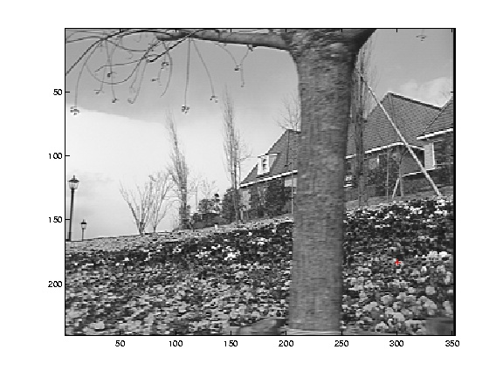
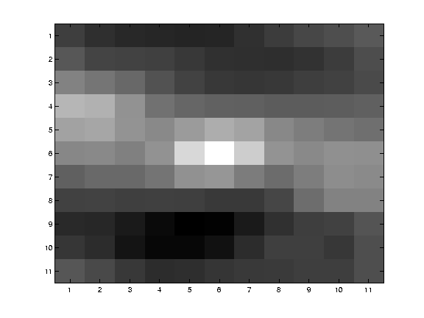
Eigen values
If… λ_{1,} λ₂> τ (threshold) – unique solution, do inverse.

Slide 16
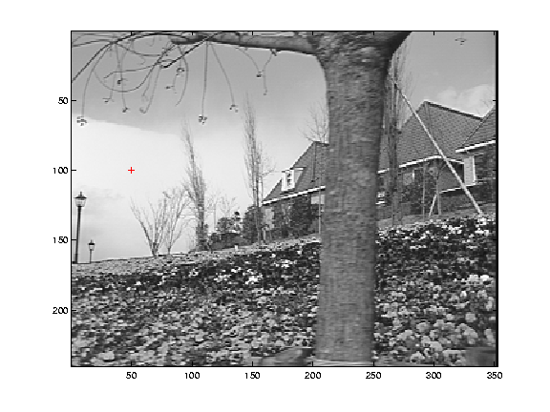
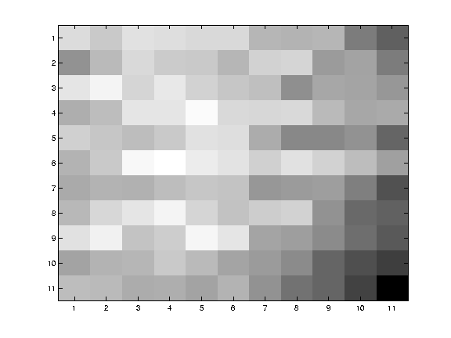
Eigen values
If… λ_{1,} λ₂<= τ – no strong gradient info (flat)

Slide 17
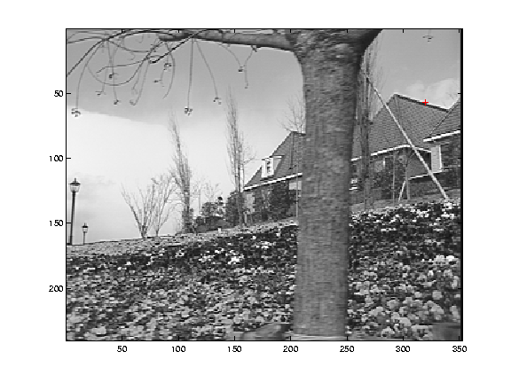
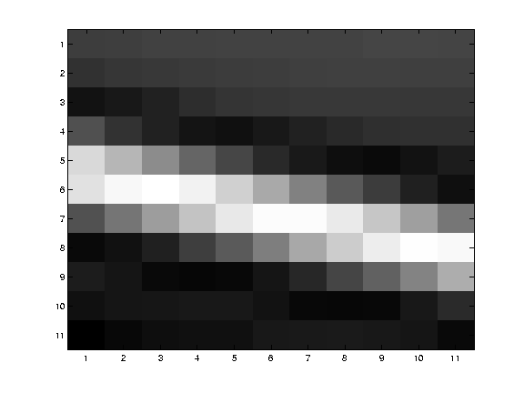
Eigen values
If… λ₁> τ, λ₂<= τ – constant gradient. Use gradient flow
http://graphics.cs.cmu.edu/courses/15-463/2005_fall/www/Lectures/direct-alignment.ppt

Slide 18
Lets solve it!

Slide 19
Lets solve it!
Image region

Slide 20
Lets solve it!
Image region

Slide 21
Lets solve it!
Image region

Slide 22
Lets solve it!

Slide 23
Lets solve it!

Slide 24
Lets solve it!

Slide 25
Lets solve it!

Slide 26
Lets solve it!
Algorithm!

Slide 27
Lets solve it!
Algorithm!
Compute Ex, Ey, Et

Slide 28
Lets solve it!
Algorithm!
Compute Ex, Ey, Et
Compute Ex², Ey², ExEy, ExEt, EyEt

Slide 29
Lets solve it!
Algorithm!
Compute Ex, Ey, Et
Compute Ex², Ey², ExEy, ExEt, EyEt
Check if AtA is invertible (look at eigen
values)

Slide 30
Lets solve it!
Algorithm!
Compute Ex, Ey, Et
Compute Ex², Ey², ExEy, ExEt, EyEt
Check if AtA is invertible (look at eigen
values)
4. Invert / ignore /gradient flow

Slide 31
Get eigen values
What is an eigen value?

Slide 32
Get eigen values
What is an eigen value?
x is eigen vector. Lambda is eigen value.

Slide 33
Get eigen values
What is an eigen value?
x is eigen vector. Lambda is eigen value.
Rewrite:

Slide 34
Get eigen values
What is an eigen value?
x is eigen vector. Lambda is eigen value.
Rewrite:

Slide 35
Get eigen values
What is an eigen value?
x is eigen vector. Lambda is eigen value.
Rewrite:

Slide 36
Get eigen values
This MUST be invertible, to solve for x.

Slide 37
Get eigen values
This MUST be invertible, to solve for x.
has two solutions, two eigen values

Slide 38
Get eigen values
This MUST be invertible, to solve for x.
has two solutions, two eigen values
In our case, 2x2 window…

Slide 39
Get eigen values
This MUST be invertible, to solve for x.
has two solutions, two eigen values
In our case, 2x2 window…

Slide 40
What about weights?
Equations in your notes have weights. This is easy.

Slide 41
What about weights?
Equations in your notes have weights. This is easy.

Slide 42
What about weights?
Equations in your notes have weights. This is easy.

Slide 43
What about weights?

Slide 44
What about weights?
Equations in your notes have weights. This is easy.
Algorithm!
Compute Ex, Ey, Et
Compute Ex², Ey², ExEy, ExEt, EyEt
Convolve step 2 with gaussian weights
Check if AtA is invertible (look at eigen
values)
4. Invert / ignore /gradient flow

