Slide 1
Partials of Images

Slide 2
Partial Derivative
Derivative of a multi-dimension variable, but in terms of one of the variables while the rest are fixed constant.
.
Eg.

Slide 3
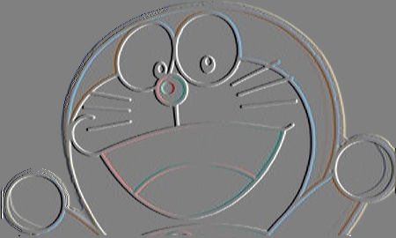
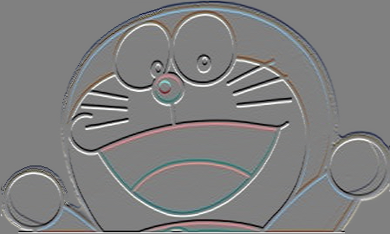
Partials of images?
Derivative of each dimension individually
f(x,y) = ,

