Slide 1
Plane/Rotation Induced Homographies

Slide 2
Homography
Maps from one coordinate space to another

Slide 3
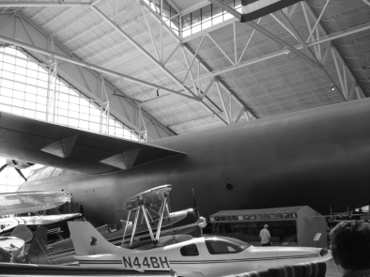
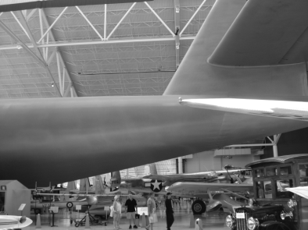
Homography
Maps from one coordinate space to another
i.e., from one image plane to another
+
+…+

Slide 4
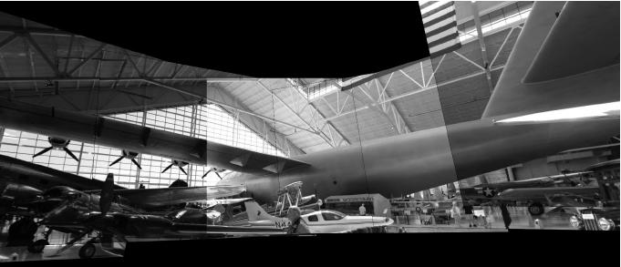
Homography
Maps from one coordinate space to another
i.e., from one image plane to another
+
+…+

Slide 5
Homography
Camera images.. How do you solve?
Setup homography equation
Use sample correspondences with equation
Solve for homography
Two systems that give solutions
Rotation induced
Plane induced

Slide 6
Rotation Induced
3D Scene –
Camera rotates but no translation

Slide 7
Rotation Induced
3D Scene –
Camera rotates but no translation

Slide 8
Rotation Induced
3D Scene –
Camera rotates but no translation

Slide 9
Rotation Induced
3D Scene –
Camera rotates but no translation
On ANY axis. All rotations OK
If camera moves, homography
unsolvable
Rotation about focal point

Slide 10
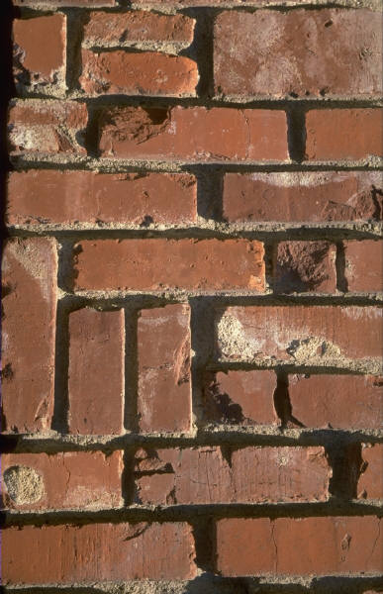
Plane Induced
3d scene is planar

Slide 11
Plane Induced
3d scene is planar
Camera can have arbitrary
movement, rotation

Slide 12
Plane Induced
3d scene is planar
Camera can have arbitrary
movement, rotation

Slide 13
Plane Induced
3d scene is planar
Camera can have arbitrary
movement, rotation
If scene is 3D, falls apart

Slide 14
Homography
Which one is this?
+
+…+

