Slide 1
#1
Introduction
Who belongs in the course, what is programming, and what is a computer language

Slide 2
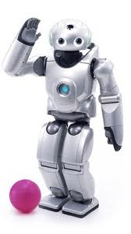
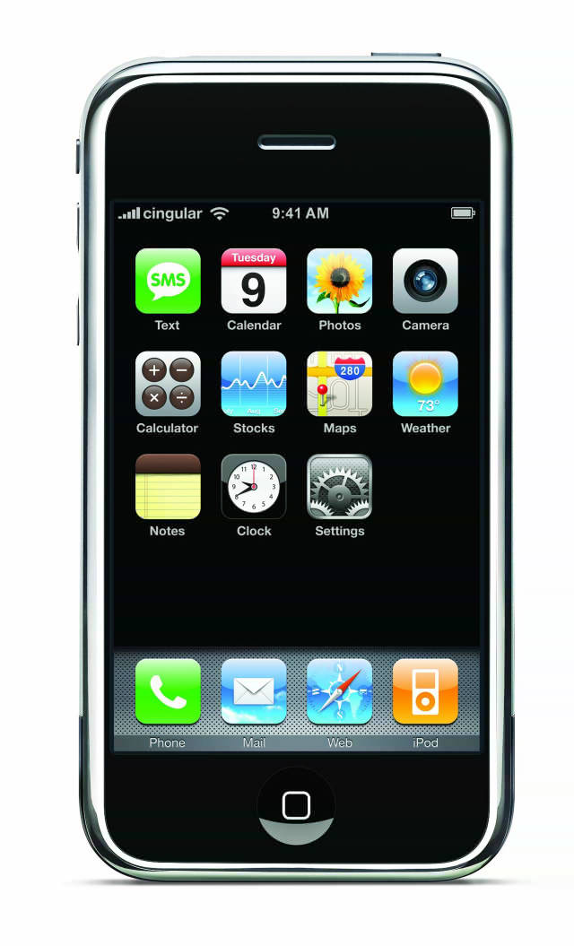
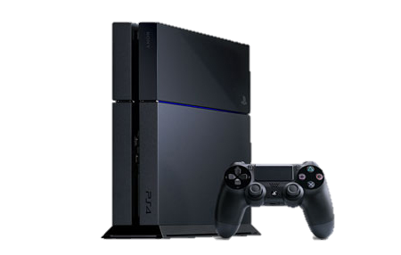
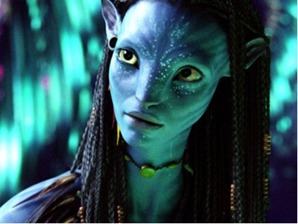
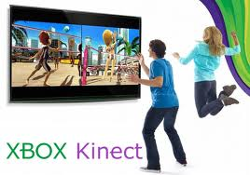
computer science….
toys and fun!

Slide 3
who can take this course?
no computer programming background required!
basic computer usage skills: typing, using new software, using the web..
if you have extensive programming background:
a) you may be surprised at what you still learn
b) there are ways of challenging the course

Slide 4
what is this course about?
problem solving
  how do you reach a goal given a set of tools?
  learn the tools
  practice using them to solve problems
computer programming
  a specific set of tools that match computers
  make computers solve problems for you

Slide 5
what is this course not about?
learning how to use software
microsoft word
microsoft excel
learning how to make web pages
learning how to make a blog
how to use the internet

Slide 6
USE BACKUP SOFTWARE
Dropbox, one drive, Wuala, Spideroak
automatically backs up as you work
you can access online if your laptop dies
synchronize between machines

Slide 7
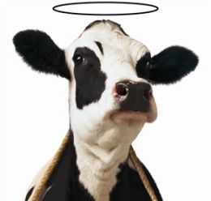
computers are fast!!
Cheap website:
$500
2.9GHz
six cores
2.9GHz = 2.9 billion cycles =
2,900,000,000 calculations per second!
six cores – do six in parallel! =
17,400,000,000 calculations per second
holy cow

Slide 8
computers are stupid!
http://www.youtube.com/watch?v=2H7NZ0GNIIE
no common sense
no cultural sense!
doesn’t speak english!
no ability of reason
can’t “fill in the blanks” or “figure things out”
e.g., pick up the phone
pass the salt
copy my vacation photos

Slide 9
computers are stupid!
computers only understand concrete, simple, unambiguous, logical instructions
has a specific, VERY limited, logical language
but, it can do billions of them per second!
“computers do exactly what you tell them to do. Not what you want them to do.”

Slide 10
computer programming:
Computer programming is the task translating something that you want to do into the computer’s limited language.
Given a task or a job, you provide a “recipe” or exact set of instructions for the computer to complete that job.

Slide 11
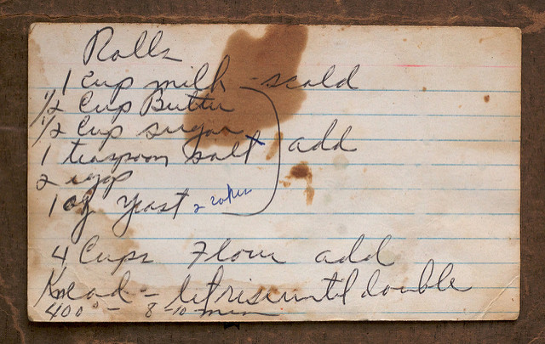
example – cooking recipe
© Susy Morris
a cooking recipe is a standard way to represent how to cook something so that (ideally, hah!) anyone can make a given dish. This is a program for cooking.

Slide 12
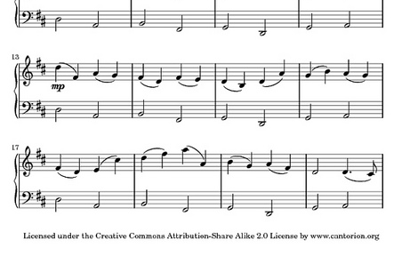
example – music!
this music score is a program for reproducing a piece of music. Gives /most/ of the details, the notes, the rhythm

Slide 13

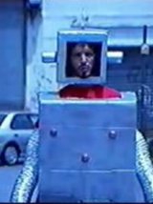
programmer-computer game
make pairs!!!
decide who is the programmer and who is the computer
task: write a set of instructions to reproduce a diagram:
no pictures! words only!
no metaphors or simile, no references, just basic objects and shapes!
programmer
computer

Slide 14
computers! put your heads down!!
computer

Slide 15

programmers, write your programs!
programmer

Slide 16
computers, execute the program!
computer

Slide 17
programming – not easy
and in this case, you had a smart HUMAN reading your program….

Slide 18
Some quick history

Slide 19
computers work on just a bunch of switches!
each switch can be either On or Off (no in the middle!)
shorthand, we say on is “1” and off is “0”
put 10 switches in a row: 0011011100
this language of 1s and 0s is called binary, and in the old days (<1950s), you would program a computer with a bunch of switches!

Slide 20
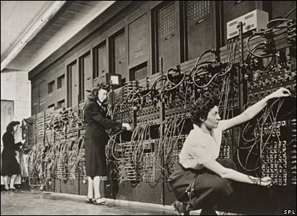
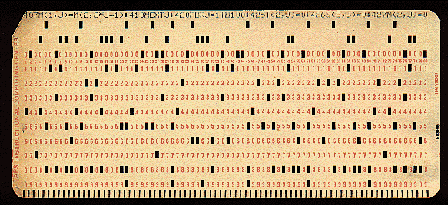
early programming..
eniac computer, 1946
5 million hand-soldered joints, 27tonnes, 150kWatts of power
5khz (5000 cycles / second),
385 multiplications / second
punch cards: still binary
used even up to mid 70s

Slide 21
away from binary
assembly language: replace common binary sequences with commands for keyboard entry
e.g., (made up)
00111101 perhaps means to add the following numbers, so replace with the word “add”
this introduced a level of abstraction that made programming easier. This is “higher level” than pure binary programming

Slide 22
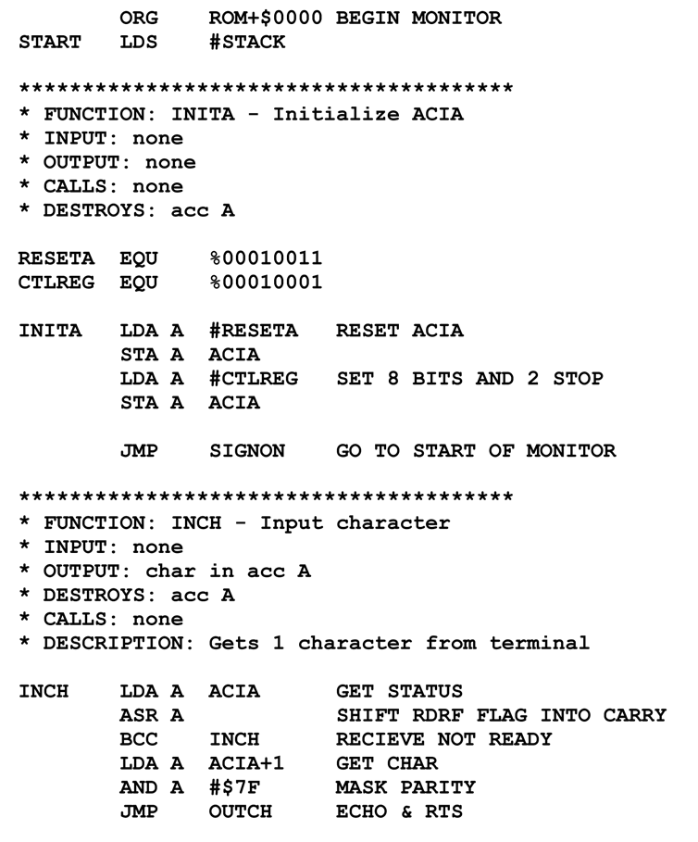

Slide 23
High level languages
most programming languages aim to be human-readable (hah) so you don’t have to work in binary or assembly
java and processing are such “high-level” languages

Slide 24

introduction to Java
Java is a programming language
a standard way to give
instructions to a computer
Other languages:
Perl
Python
C, C++
C#

Slide 25
A basic Java program:
public class D1HelloWorld
{
public static void main (String [] args)
{
System.out.println ("Hi out there!");
}
}
Puts the text “Hi out there!” to the screen

Slide 26
A basic Processing program
line(0,0,10,10);
draws a line to the screen

Slide 27
#2. Processing and Programming Basics
Installing Processing, introduction to the environment, the Processing Canvas. First computer programs, setting the paint color, and order of drawing. Using comments to organize.

Slide 28
introduction to processing
download it!
https://processing.org/download/
run it during class!!

Slide 29
Processing Development Environment
Project name
Version
JAVA processor
Run and stop buttons. Shortcuts.
Tabs (not used for us)
Text editor.
Message bar
console

Slide 30
processing sketch
Programs are called Sketches!
Sketchbook
Change sketchbook location
  (BACKUP!!)

Slide 31

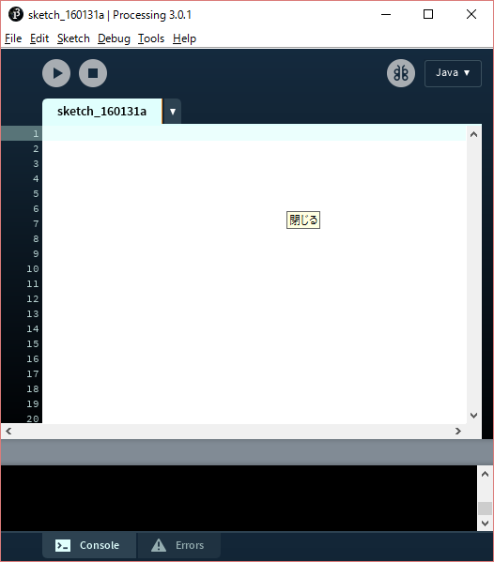
The canvas!!!
play button
stop button
grey inside and outside

Slide 32
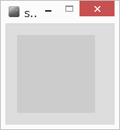
The Canvas co-ordinate system
Euclidean coordinates
0,0 at top left
Default window is 100 by 100 dots (pixels)
0,0
x
y

Slide 33
OK! Your first Processing Command draw a line!!!
Processing has some basic rules that we have to follow to give it commands. These rules are called syntax.
Remember how stupid computers are. We need to follow syntax or the computer won’t understand.

Slide 34
syntax of a command statement:
We need to specify the command (e.g, draw a line)
We need to pass information to the command (e.g., where to draw the line)
command(parameter1, parameter2, …);
line(0,0,100,100);
toY
fromX
toX
fromY

Slide 35
line(0,0,100,100);
How do you know what the required parameters are and what they mean???
Processing Help -> Reference

Slide 36
syntax issues…
command(parameter);
Everyone seems to remember the parenthesis ()
But don’t forget the semi colon!
The semi-colon means: end of command
Also – you can have spaces around the brackets and commas – doesn’t matter.
What happens if you forget semi colon?

Slide 37
Processing is case sensitive!
anything you type in processing is case sensitive
this means that upper case is different than lower case
Line (OK)
Line (BAD)
LiNe (BAD)
(computers are stupid)

Slide 38
compile time errors
When Syntax Errors happen, Processing cannot convert your program into computer code. It happens when Processing tries to “compile” the program into binary. This means your program is never run.

Slide 39
some more processing commands
Check these out in the reference
size()
ellipse()
… at home
point()
rect()
triangle()

Slide 40
The Canvas co-ordinate system
Euclidean coordinates
0,0 at top left
0,0
x
y

Slide 41
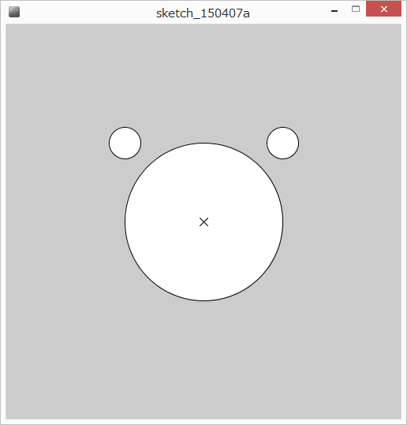
Let’s draw an image!
(500x500 canvas)

Slide 42
solution
size(500,500);
ellipse(250,250,200,200);
ellipse(150,150,40,40);
ellipse(350,150,40,40);
line(245,245,255,255);
line(255,245,245,255);

Slide 43
What is the coordinate of the bottom right corner?
size(500,500);
line(0,0,499,499);

Slide 44
statements are run sequentially top to bottom
The order of commands to processing changes the result
size(500,500);
line(225,225,275,275);
ellipse(250,250,200,200);
Where is the line???

Slide 45
comments

Slide 46
Quick! What does this program do?
size(500,500);
ellipse(250,250,300,300);
triangle(375,80,300,150,400,200);
triangle(125,80,200,150,100,200);
ellipse(175,225,60,30);
ellipse(325,225,60,30);
ellipse(175,225,15,30);
ellipse(325,225,15,30);
line(250,300,200,275);
line(250,300,300,275);
line(250,300,190,300);
line(250,300,310,300);
line(250,300,200,325);
line(250,300,300,325);
ellipse(250,300,30,30);

Slide 47
comments
English language additions to a program to help a programmer understand what is going on.
The computer ignores comments – for humans only.

Slide 48
comments for readability
computer code is not always obvious and you may want to document your reasons:
what does a statement do?
if it looks odd, why are you doing it that way?
what big function does some block of statements do?
who wrote this code – who should I fire ask for help from?
all reasons for comments

Slide 49
overall making your program easy to read and understandable!
helps you understand! (fewer bugs!)
helps others understand (real-world!)
you lose marks if you don’t!

Slide 50
block comments
start with the characters /*
end with the characters */
EVERYTHING in between is ignored by processing
/* eric the fish */
/* eric the fruit bat, and,
eric the cat, and,
eric the kangaroo */
/********************
=^.^= O_O -_- o_O
*********************/

Slide 51
Header block – common (and required) block comment
Put a block comment at the beginning of your program explaining what it does…

Slide 52
/*******************
* Cat Face! Draw a cat face on the screen
* author: Teo the dog
* version: try #awesome
* purpose: to show how a cat can be drawn
********************/
size(500,500);
ellipse(250,250,300,300);
triangle(375,80,300,150,400,200);
triangle(125,80,200,150,100,200);
ellipse(175,225,60,30);
ellipse(325,225,60,30);
…

Slide 53
in-line comments
For shorter bits
use the characters: //
not ＼＼
everything after // is a comment until the end of the line
line(0,0,500,500); // a diagonal line

Slide 54
Add comments to the program
/*******************
* Cat Face! Draw a cat face on the screen
* author: Teo the dog
* version: try #awesome
* purpose: to show how a cat can be drawn
********************/
size(500,500); // make a 500x500 canvas
//draw the head
ellipse(250,250,300,300);
//draw the ears
triangle(375,80,300,150,400,200);
triangle(125,80,200,150,100,200);
//draw the eyes
ellipse(175,225,60,30); // left eye
ellipse(175,225,15,30);
ellipse(325,225,60,30); // right eye
ellipse(325,225,15,30);
//whiskers!
line(250,300,200,275);
line(250,300,300,275);
line(250,300,190,300);
line(250,300,310,300);
line(250,300,200,325);
line(250,300,300,325);
// draw the nose. draw after whiskers for nice overlap effect
ellipse(250,300,30,30);

Slide 55
Choosing your paint!

Slide 56
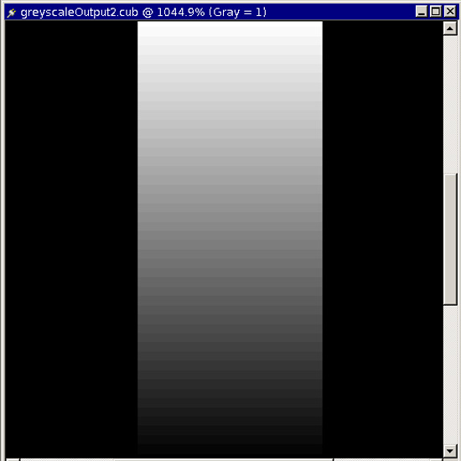
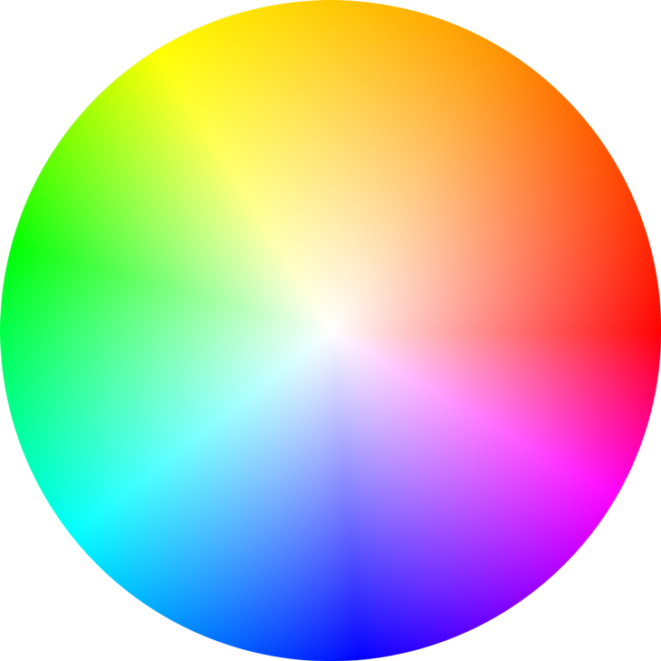
Color!

Slide 57
Grey: 0..255
0……………………………….128………………………...….255

Slide 58
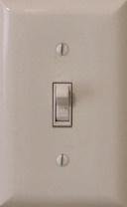
Advanced!
Why 0..255?
Computer uses 8 bits (switches) to store this color
1 switch – two possible combinations
2 switches – four possible combinations
n switches – 2^{n} possible combinations
8 switches – 2⁸ = 256 possible combinations

Slide 59
stroke – brush color
stroke(gray level) // sets the brush color
stroke(0) vs stroke(255)
Try with line

Slide 60
stroke – try with ellipse
stroke(0)
ellipse(250,250,50,50)
Why is the ellipse still filled with white?

Slide 61
fill color
Processing has two paint colors: stroke and fill
fill(gray) // 0..255 gray fill level
stroke(255);
fill(0);
ellipse(250,250,50,50);

Slide 62
how to change the color of the background?
Draw a rectangle over the whole screen!
  Annoying…
Use the built in background command
background(grey)
Paints the entire canvas with the color (erases everything else)

Slide 63
#3, Variables and Integers
Variables, integers, creating variables, using variables. Integer operations: addition, subtraction, multiplication, division, modulo, order of operations

Slide 64
Remember the cat?
/*******************
* Cat Face! Draw a cat face on the screen
* author: Teo the dog
* version: try #awesome
* purpose: to show how a cat can be drawn
********************/
size(500,500); // make a 500x500 canvas
//draw the head
ellipse(250,250,300,300);
//draw the ears
triangle(375,80,300,150,400,200);
triangle(125,80,200,150,100,200);
//draw the eyes
ellipse(175,225,60,30); // left eye
ellipse(175,225,15,30);
ellipse(325,225,60,30); // right eye
ellipse(325,225,15,30);
//whiskers!
line(250,300,200,275);
line(250,300,300,275);
line(250,300,190,300);
line(250,300,310,300);
line(250,300,200,325);
line(250,300,300,325);
// draw the nose. draw after whiskers for nice overlap effect
ellipse(250,300,30,30);
What if we want to make the nose and whiskers little higher? Say, 100 pixels higher?
Let’s do it

Slide 65
That was a pain!!
There must be a better way..

Slide 66
variables

Slide 67
variables
sometimes we need to store data to use it in various places in the program:
e.g., log into a website: it should remember who you are!
in this case, it would store your name in a variable!
e.g.,: Hi [name], welcome to our site! We see that you come from [city]. People in [city] have previously bought the following items from us
note: this company writes the above line ONCE. [name] and [city] are variables. When you login, your name and city are stored in those variables.

Slide 68
math example:
x = 1
y = 15
z = (x+1)*y
what does z =?
x, y, and z are variables because they can store a range of numbers depending on the circumstances
store the #1 in the variable x
store the #15 in the variable y
read the values from variables
x and y, do a calculation, and
store the result in z

Slide 69
box analogy
variables can be seen as boxes that you put data into
42
variable
variable
42
variable

Slide 70
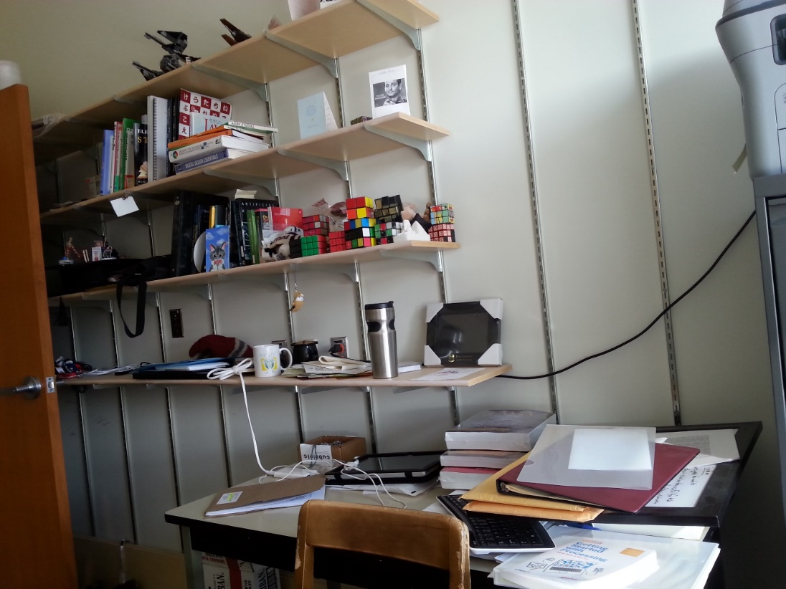
sorting a mess into designated boxes….
books
papers
toys

Slide 71

processing is just as strict
When you create a variable (a box), you need to tell processing what kind of information you are going to store in it
A number
Some text
Some music!!
So how do you specify this in
processing?
books
papers
toys

Slide 72
Your first data type: the integer (int)
What is an integer? (highschool math?)
a whole number with no fractional part
42, -5002, 0, 24
what is the biggest integer?
theoretically there is none
Processing limits the amount of computer memory used by your integer so there is a maximum and a minimum
maximum: 2,147,483,647!
(((huh!? 2³²/2-1)))
minimum: -2,147,483,648!
there are data types available with more memory but we will talk about them later

Slide 73
back up a second.. No fractions??? why such a ridiculous limitation?
its easier and faster for computers to store and work with whole numbers, so we usually stick to them if its all that we need
Decimals (real numbers) in computers have really strange limitations, as we’ll see
we‘ll learn a new data type for decimals later

Slide 74

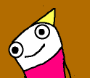
three operations on variables (boxes)
a) make a new box to store some data in
b) put data into a box
c) look at the data in a box
256
256
variable
integer

Slide 75
variables in processing
a) make a new variable to store some data in
b) put data into a variable
c) look at the data in a variable
variableType variableName;
int noseCenterX;
int noseCenterY;

Slide 76
variables in processing
a) make a new variable to store some data in
b) put data into a variable
c) look at the data in a variable
variableName = data;
noseCenterX = 250;
noseCenterY = 200;
literals

Slide 77
literals
Any data that is typed in, hard-coded into a program, and is not calculated, retrieved from the internet, the user, etc.

Slide 78
variables in processing
a) make a new variable to store some data in
b) put data into a variable
c) look at the data in a variable
use the variableName anywhere you would use raw data
ellipse(noseCenterX,noseCenterY,30,30);
noseCenterX = noseCenterY;

Slide 79
Data is always copied, not linked read top to bottom
int a;
int b;
a = 20;
b = a;
a = 10;
What does b equal?

Slide 80
Let’s update our program with nose center variables

Slide 81
Defining variables
You can define multiple variables at a time
type var1, var2, var3…;
Eg.,
int pointX, pointY;
Is the same as
int pointX;
int pointY;

Slide 82
combined declaration and assignment
You can create a variable and assign it a value in one statement!
Instead of….
int noseCenterX;
noseCenterX = 250;
variableType variableName = data;
int noseCenterX = 250;

Slide 83
variables are.. well.. variable..
int circleSize = 50;
ellipse(100,100,circleSize,circleSize);
circleSize = 10;
ellipse(100,100,circleSize,circleSize);
Same command but different result!

Slide 84
Re-defining variables
int circleSize = 50;
ellipse(100,100,circleSize,circleSize);
int circleSize = 10;
ellipse(100,100,circleSize,circleSize);
Variables can only be defined once, otherwise it’s like you’re trying to create two different ones with the same name. Like building a new house on top of an existing one!!

Slide 85
empty variables
int circleSize;
ellipse(100,100,circleSize,circleSize);
Well – what would you expect to reasonably happen?
Variables must be initialized – given a value – before they are used.

Slide 86
rules for variable names
no spaces!
no special characters !”#%&’()-=^[]{}
exception: underscore _
cannot start with a number but can contain one
no reserved words

Slide 87
reserved words…
are special words that already have a special meaning, so you cannot use them as your program or variable names.
e.g.,
int int

Slide 88
Reserved Words:
Strategy: be aware of the problem, but don’t memorize

Slide 89
Integer Operations

Slide 90
integer operations!
you can do a bunch of standard math operations on integers:
addition
subtraction
multiplication
division
…?

Slide 91
integer “operators” (operations?)
addition!
the “+” symbol:
<integer> + <integer>
5+4, 6+10, 657+552, 5554543+2223232
Let’s look at one of the cat whiskers.

Slide 92
integer “operators” - subtraction
the “-” symbol:
<integer> - <integer>
10-2, 5-10, 40-30, 34243401-1312322

Slide 93
Remember the cat?
/*******************
* Cat Face! Draw a cat face on the screen
* author: Teo the dog
* version: try #awesome
* purpose: to show how a cat can be drawn
********************/
size(500,500); // make a 500x500 canvas
//draw the head
ellipse(250,250,300,300);
//draw the ears
triangle(375,80,300,150,400,200);
triangle(125,80,200,150,100,200);
//draw the eyes
ellipse(175,225,60,30); // left eye
ellipse(175,225,15,30);
ellipse(325,225,60,30); // right eye
ellipse(325,225,15,30);
//whiskers!
line(250,300,200,275);
line(250,300,300,275);
line(250,300,190,300);
line(250,300,310,300);
line(250,300,200,325);
line(250,300,300,325);
// draw the nose. draw after whiskers for nice overlap effect
ellipse(250,300,30,30);

Slide 94
Cat whisker:
line(250,300,300,325);
→line(noseCenterX,noseCenterY,300,325);
Notice: the line end point is..
50 pixels to the right (250→300)
25 pixels below (300→325)
line(noseCenterX, noseCenterY,
noseCenterX+50, noseCenterY+25);

Slide 95
Cat whisker:
line(250,300,200,275);
→line(noseCenterX,noseCenterY,200,275);
Notice: the line end point is..
50 pixels to the left(250→200)
25 pixels above (300→275)
line(noseCenterX, noseCenterY,
noseCenterX-50, noseCenterY-25);

Slide 96
/*******************
* Cat Face! Draw a cat face on the screen
* author: Teo the dog
* version: try #awesome
* purpose: to show how a cat can be drawn
********************/
size(500,500); // make a 500x500 canvas
int noseCenterX = 275;
int noseCenterY = 400;
//draw the head
ellipse(250,250,300,300);
//draw the ears
triangle(375,80,300,150,400,200);
triangle(125,80,200,150,100,200);
//draw the eyes
ellipse(175,225,60,30); // left eye
ellipse(175,225,15,30);
ellipse(325,225,60,30); // right eye
ellipse(325,225,15,30);
//whiskers!
line(noseCenterX,noseCenterY,noseCenterX-50,noseCenterY-25);
line(noseCenterX,noseCenterY,noseCenterX+50,noseCenterY-25);
line(noseCenterX,noseCenterY,noseCenterX-60,noseCenterY);
line(noseCenterX,noseCenterY,noseCenterX+60,noseCenterY);
line(noseCenterX,noseCenterY,noseCenterX-50,noseCenterY+25);
line(noseCenterX,noseCenterY,noseCenterX+50,noseCenterY+25);
// draw the nose. draw after whiskers for nice overlap effect
ellipse(noseCenterX,noseCenterY,30,30);

Slide 97
Let’s look back at the cat code: the eyes
//draw the eyes
ellipse(175,225,60,30); // left eye
ellipse(175,225,15,30);
ellipse(325,225,60,30); // right eye
ellipse(325,225,15,30);
Pupil is 15 wide
Pupil is twice high as it is wide (30 high)
eye height = pupil height (they just touch!)
eye width is twice the eye height

Slide 98
integer “operators” - multiplication
the “*” symbol:
<integer> * <integer>
5*5, 10*2, 2*2, 231421341*12341234
Setup the code for the pupil size

Slide 99
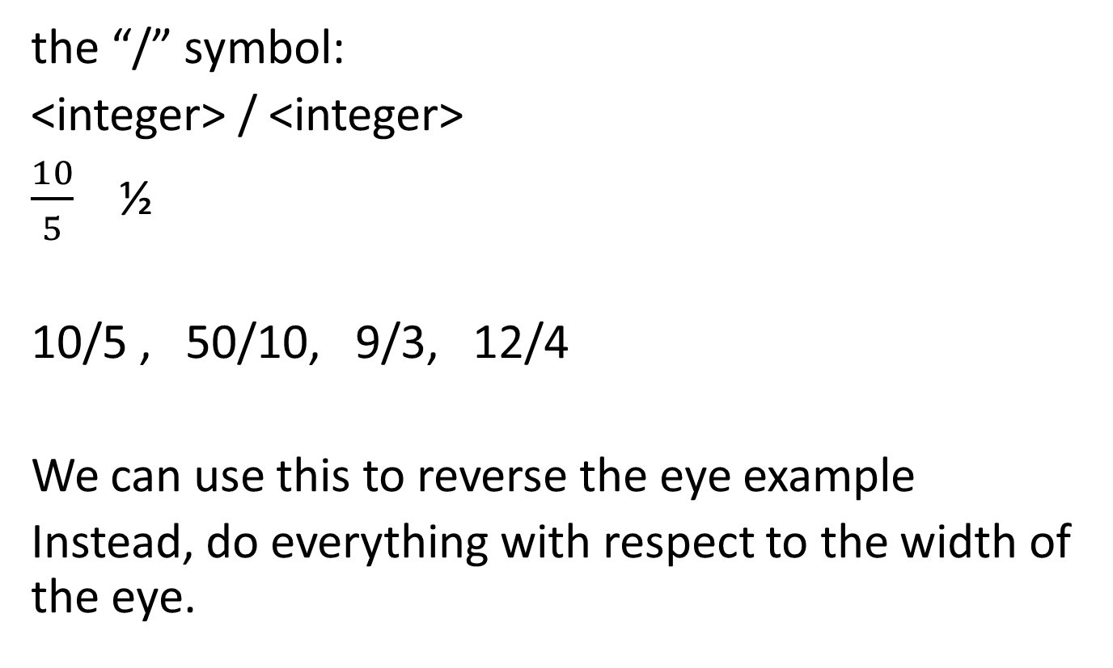
integer “operators” - division
the “/” symbol:
<integer> / <integer>
$\frac{10}{5}$ ½
10/5 , 50/10, 9/3, 12/4
We can use this to reverse the eye example
Instead, do everything with respect to the width of the eye.

Slide 100
Eye ratios:
Eye width is 60
Eye height is half width
Pupil height is half eye width
Pupil width is quarter eye height

Slide 101
Cat example – practice update with variables (at home)
We already have nose/whiskers and eye sizes done
Head center
  Update head ellipse
  Update Eye locations
  Update ear locations
  Update nose center

Slide 102
Back to division….
Let’s make a line that goes X percent across the screen
int percent = 33;
int targetX = percent/100*500;
line(0,250,targetX,250);
what happened?

Slide 103
Reality check – calculate by hand
33/100*500 = ?
165 – try it
Why did we get a different answer?

Slide 104
IMPORTANT HELPER TOOL
Remember the console in processing?
You can toss data out there for a reality check
New processing command:
println(data);
Use this to debug our problem

Slide 105
before highschool:
How did you do 10/3 in elementary school?
The answer is 3 remainder 1
In processing with integers: 3 is the result
The remainder is discarded

Slide 106
division – integers never give a fraction amount. (seriously)
1/2 = ?
11/3 = ?
100/26 = ?
integer division always discards the fraction amount and gives you the whole amount.
does it always round down?
-9/10 = ?

Slide 107
remainder: (also called modulo, mod)
difficult but useful - highly recommend you practice this
use the “%” symbol
10%2
remainder when you do 10/2
10/2 = 5 R 0
10%2 = 0
5%2?
5/2 = 2 R 1
5%2 = 1
11%3?
11/3 = 3 R 2
11%3 = 2

Slide 108
Order of operations!

Slide 109
order of operations!
complex statements:
3+2*6/3%4
what is the answer?
order of operations!! BEDMAS
Brackets!
Exponents (and roots)!
Division and Multiplication (and remainder)
Addition and Subtraction

Slide 110
order of operations!
not 100% sure? just use brackets to enforce what you mean:
3+2*6/3%4 → 3 + (2*6/3)%4 = 3

Slide 111
#4, Coding Style and Standards
Coding style, meaningful variable names, named constants

Slide 112
Coding style is VERY important!
commenting!
indentation!
Use meaningful variable names
  int a; // bad. Too short. Not meaningful.
  int a2; // even worse!
  3. Use named constants! (in a second)
  4. More…

Slide 113
Variable names..
Descriptive
Self-commenting
e.g.,
float t; // tax rate
float taxRate;
int p1S; // player 1 score
int p2S; // player 2 score
int player1Score;
int player2Score;
Standards – be aware of them
int _data;
boolean isHit;

Slide 114
Camel case!
<make slide on this>

Slide 115
“readable” code
what does this mean?
int resultA = 100*5*26;
int resultB = 52*5*26;
int resultC = 88*5*26;
in this case, a summer cottage industry calculating season costs:
the first number is the cost of a service per day, the second is the number of days a week open, and the third number (26) is how many weeks the business is open a year
what are two problems with my above example?
1) hard to read
2) what if the season or week length changes? I need to make a bunch of changes

Slide 116
<first do self-commenting variable names>

Slide 117
named constants!!
constant – a value or piece of information which we guarantee will not change while the program is running. e.g., length of a business season, or sales tax, etc.
int resultA = 100*5*26
int resultB = 52*5*26;
int resultC = 88*5*26;
int resultA = 100*DAYS_PER_WEEK*WEEKS_PER_YEAR;
int resultB = 52*DAYS_PER_WEEK*WEEKS_PER_YEAR;
int resultC = 88*DAYS_PER_WEEK*WEEKS_PER_YEAR;
int hydroCost = hydroDaily *DAYS_PER_WEEK*WEEKS_PER_YEAR;
int resultB = 52*5*26;

Slide 118
naming conventions
note: naming conventions are not processing rules, but accepted standards that help improve readability:
note: named constants are usually ALL_CAPS_WITH_UNDERSCORES_FOR_SPACES
regular changing variables are usually smallFirstWordAndCapitalizeEveryOtherWord.
int hydroCost = hydroDaily *DAYS_PER_WEEK*WEEKS_PER_YEAR;

Slide 119
<benefit of changing only in one location>

Slide 120
named constants in Processing are done with the “final” keyword.
final type variableName;
final variables can only be set ONCE and never change:
final int WEEKS_PER_YEAR = 26;
or
final int WEEKS_PER_YEAR;
WEEKS_PER_YEAR = 26;
WEEKS_PER_YEAR = 0; // ← illegal because already set

Slide 121
for your assignments…
reasonable variable names
consistent and good indentation
reasonable comments (err on the side of too many)
will be stressed more as we go through the course

Slide 122
<no named constants for size command>

Slide 123
#5, Active Processing
Interactive Processing programs, code blocks, variables and blocks, mouse position

Slide 124
Active Processing
So far – static processing
one run through, shows the result at the end
Active processing
the program starts, and keeps running!!
things can animate
respond to keyboard, mouse!

Slide 125
Magic line to draw a line<Random>

Slide 126
Boring static program:
Line from center to random spot
line(250,250,random(500),random(500));
Left to right, two times it calls random:
line(250,250,random(500),random(500));
line(250,250,124,random(500));
line(250,250,124,492);

Slide 127
Moving to active..
Active programs have two regions, or blocks.
- setup – run once
- draw – run over and over!!
60 times a second!
Processing has special syntax to specify blocks

Slide 128
Processing block syntax
{
// this is a code block
}

Slide 129
How to setup your active blocks
You can give blocks names – these are called functions (later). Kind of like making your own commands
Some commands take parameters and some give you data. Some do both.
line(1,2,3,4);
random(500)
We setup our regions in a similar way

Slide 130
How to setup your active blocks
resultType blockName(parameters)
{
}
for now, don’t worry too much about the result or parameters…
No result? Put “void”

Slide 131
Active blocks – setup and draw
void setup()
{
// run once
}
void draw()
{
// run 60 times every second
}

Slide 132
NO COMMANDS OUTSIDE THESE BLOCKS
(only create variables.. Later)

Slide 133
First active program:
void setup()
{
size(500,500);
line(250,250,random(500),random(500));
}
void draw()
{
}

Slide 134
Make it active – move to the draw
void setup()
{
size(500,500);
}
void draw()
{
line(250,250,random(500),random(500));
}

Slide 135
<new slide to step through this>

Slide 136
Variables and blocks RULE #1
If you define a variable inside a block, it only exists until the block is finished. You can do it, but once the block is over, the variable gets destroyed.
The next time into the block, the variable gets re-created and re-initialized
Called a local variable

Slide 137
What do you expect to happen in this program
void setup()
{
size(500,500);
}
void draw()
{
int linePosition = 0;
line(250,0,linePosition,linePosition);
linePosition = linePosition + 1;
}

Slide 138
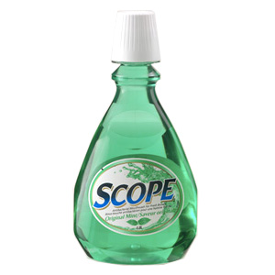
Variables and blocks RULE #2
A variable created inside one block is only visible within that block. Other blocks cannot see them.
This is called a scope rule – it defines the area where a variable is visible

Slide 139
Maybe move the declaration to the startup?
void setup()
{
size(500,500);
int linePosition = 0;
}
void draw()
{
line(250,0,linePosition,linePosition);
linePosition = linePosition + 1;
}

Slide 140
Solution: global variables
Put variables at the top of the program, outside the blocks
- visible in all blocks
- only created once and not destroyed on every redraw!

Slide 142
result
int linePosition = 0;
void setup()
{
size(500,500);
}
void draw()
{
line(250,0,linePosition,linePosition);
linePosition = linePosition + 1;
}

Slide 143
MOUSE!!! YAY!!
Processing globals
// current mouse position at beginning of DRAW
mouseX
mouseY
// previous mouse position, at last draw
pmouseX
pmouseY

Slide 144
Example 1: line to mouse position

Slide 145
Example 1: line from last position to current

Slide 146
Example 3: don’t erase background

Slide 147
Hold the roof up!
Make a line that is falling down, like a roof, and hold it up with the mouse.
First, make a falling line
Variable for current line position
Draw across the screen at that y
Increase y each time it draws

Slide 148
New commands:
New commands!
max(a,b) – gives the bigger of the two
min(a,b) – gives the smaller of the two
e.g.,
int bigger = max(100,200);
→ int bigger = 200;
int smaller = min( max(3, 5), 4);
int smaller = min( 5, 4);
int smaller = 4;

Slide 149
Hold the roof up!
Make a line that is falling down, like a roof, and hold it up with the mouse.
Each time you draw, move the line, so it draws in a new place next time
Use min or max to be sure that the line never goes below the mouse.

Slide 150
Hold up the roof!
int lineTop = 0;
void setup()
{
size(500,500);
}
void draw()
{
background(255);
lineTop = lineTop + 1;
lineTop = min(mouseY, lineTop);
line(0,lineTop,499,lineTop);
}

Slide 151
<go through the cases to illustrate min>

Slide 152
Trucking along…
Understanding programs:
computers have tunnel vision
explicit, one by one instructions
simplest approach to getting it:
you need to know what happens, in what order
re-visit the “hold up the roof” example

Slide 153
Let’s update the cat face program
/*******************
* Cat Face! Draw a cat face on the screen
* author: Teo the dog
* version: try #awesome
* purpose: to show how a cat can be drawn
********************/
// variables
int headCenterX = 250;
int headCenterY = 250;
int noseSize = 30;
int pupilWidth = 15;
int noseCenterX = headCenterX;
int noseCenterY = headCenterY+50;
size(500,500); // make a 500x500 canvas
//draw the head
ellipse(headCenterX,headCenterY,300,300);
//draw the ears
triangle(headCenterX+125,headCenterY-170,
headCenterX+50,headCenterY-100,
headCenterX+150,headCenterY-50);
triangle(headCenterX-125,headCenterY-170,
headCenterX-50,headCenterY-100,
headCenterX-150,headCenterY-50);
//draw the eyes
ellipse(headCenterX-75,headCenterY-25,
pupilWidth*4,pupilWidth*2); // left eye
ellipse(headCenterX-75,headCenterY-25,
pupilWidth,pupilWidth*2);
ellipse(headCenterX+75,headCenterY-25,
pupilWidth*4,pupilWidth*2); // right eye
ellipse(headCenterX+75,headCenterY-25,
pupilWidth,pupilWidth*2);
//whiskers!
line(noseCenterX,noseCenterY,noseCenterX-50,noseCenterY-25);
line(noseCenterX,noseCenterY,noseCenterX+50,noseCenterY-25);
line(noseCenterX,noseCenterY,noseCenterX-60,noseCenterY);
line(noseCenterX,noseCenterY,noseCenterX+60,noseCenterY);
line(noseCenterX,noseCenterY,noseCenterX-50,noseCenterY+25);
line(noseCenterX,noseCenterY,noseCenterX+50,noseCenterY+25);
// draw the nose. draw after whiskers for nice overlap effect
ellipse(noseCenterX,noseCenterY,noseSize,noseSize);

Slide 154
Let’s update the cat face program
Keep the variables global: break code into setup and draw
And clear background command
Link nose to mouse
Eyes?

Slide 155
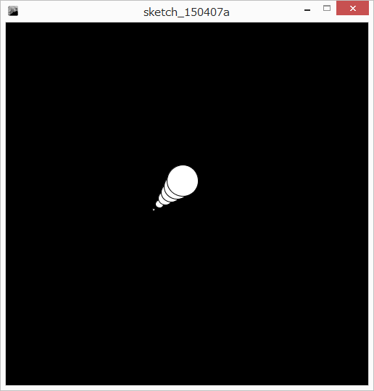

Mouse cursor bubbles!
Bubble starts size 0
Goes right (+x)
Goes up (-y)
Bursts at size 50

Slide 156
How to attack this???
When you’re stuck, start by doing what you know
Draw a circle size 0 at the mouse!
Next step – size 1, 1 above and 1 right
Next.. Size 2
Last? Size 50
See a pattern?

Slide 157
At each step the command is the same except for that step number
Make a variable
Make the variable get bigger by one each time
What next??? How do we stop it from getting bigger?
We already learned the tool…

Slide 158
Non obvious – use modulo (remainder)
If you take any number n and divide it by 5, what is the possible range of remainders?
n
n/5
n%5
0
0
0
1
0
1
2
0
2
3
0
3
4
0
4
5
1
0
6
1
1
7
1
2
8
1
3
9
1
4
10
2
0
11
2
1
12
2
2
/5 -> remainders 0..4
If you do n/m, you get numbers in the range 0..m-1

Slide 159
How can we use modulo to help us with our step variable?
Modulo 50

Slide 160
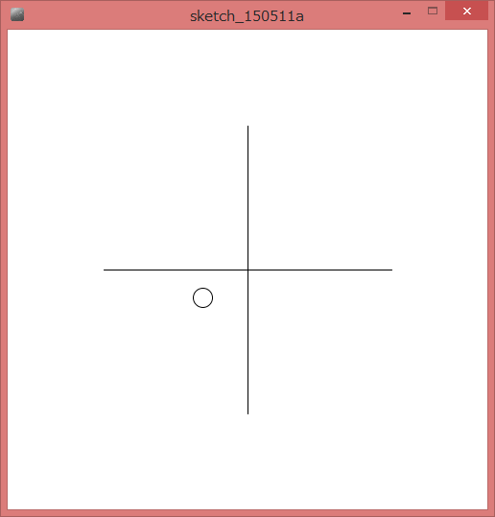
Joystick for a ball!
Ball moves based on mouse position
mouse in center – don’t move
mouse to right/left – move to right/left
mouse to top/bottom – move up or down
First, draw the crosshairs
Make globals to remember the position of the ball

Slide 161
How to calculate how much the ball moves?
X
mouseX-250
if mouse is at 250, we get 0
if mouse is left of 250, we get neg.
if mouse is right of 250, we get pos.
Make new variables: moveX and moveY

Slide 162
Woah! Flies off the screen!
How to make sure it doesn’t go off the edge?
min and max!!!!
What is the smaller of 499, and mouseX going to be?
if mouseX is right of the screen, then 499
if mouseX is in the screen, then the mouse
ballX = min(mouseX,499);
What is the larger of 0 and mouseX going to be?
if mouseX is left of the screen (negative), then 0
if mouseX is on the screen, then mouseX
ballX = max(0,mouseX);

Slide 163
Too fast…
Scale down the movement

Slide 164
#6, User-Defined Functions Part 1
User-Defined Function Syntax, functions calling other functions, functions and scope, reusing code, top-down programming.

Slide 165
User-defined functions- make your own commands
<<<NEED TO REVISE AND UPDATE BASED ON LAST SHUFFLE AND NOTES>

Slide 166
user-defined functions
user-defined functions: code which the user can write once and then use over and over. E.g., random was written once and you can use it over and over by calling random(number)
create once and use many times!

Slide 167
Example: draw random squares
If the mouse is pressed, clear to white first
If a key is pressed, clear to black first
Random place, random size, random color
Global: max size
Tedius – repetitive
What if I want to make a change, e.g., location range?
Let’s make a new command called drawRandomSquare();

Slide 168
user-defined functions
require:
function name: the keyword used to invoke (use) the function. e.g., ellipse is a function name
some code: the processing code to run every time the function is invoked (called).

Slide 169
user-defined functions: syntax
void functionName ()
{
…//java code;
}
void sayHello()
{
text(“Hello”,100,100);
}

Slide 170
user-defined functions: syntax
this is a the name of a new command we just created!
void sayHello()
{
text(“Hello”,random(width),random(height));
}
… in your other code
sayHello();

Slide 171
create outside the draw and start blocks!
note: user-defined functions created outside the other blocks
you can place them before or after them, it is a matter of style

Slide 172
jump around…
when a function is called, Processing remembers where it left off, and jumps to the function. When the function is done, it jumps back.

Slide 173
program flow
void sayHello()
{
text(“Hello”, random(width),random(height));
}
void draw()
{
sayHello();
sayHello();
}
run each command in the function (compartment) in order
to run this command, jump up here! To the compartment!
program starts here
as usual
run this command first,
as usual
when the function is done, come back here
and continue where we left off
and run the function again!

Slide 174
Example: draw random squares
Let’s make a new command called drawRandomSquare();

Slide 175
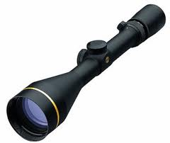
functions and scope
note: scope is the range within which a variable exists. Outside of that scope, you cannot access or work with that variable.
blocks define scope!
Functions each have their own scope – data in one method is not visible to other methods – try it

Slide 176
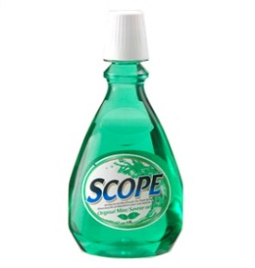
variable scope is limited to its function
void sayHello()
{
text(message,100,100);
}
void draw()
{
String message = “Hey there!”;
sayHello();
}
note: a variable declared in one function is not accessible from another function!
you cannot read it, or change it.
No nesting of scopes here

Slide 177
the same variable name?
void sayHello()
{
String message = “say hi”;
println(message);
}
void draw()
{
String message = “Hey there!”;
sayHello();
println(message);
}
variables in different scopes can have the same name, but they do not share data – they are completely separate.

Slide 178
divide and conquer
Divide and Conquer: a great way to break up a complex programming problem into smaller steps
as your programs get longer and longer, this provides a method to enable you to focus on one piece at a time.

Slide 179
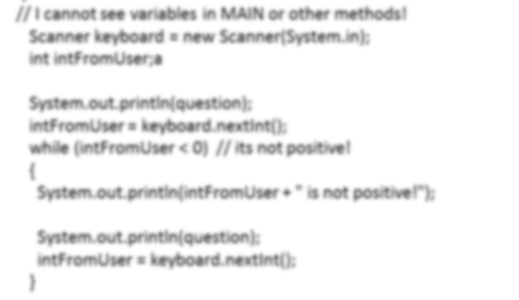
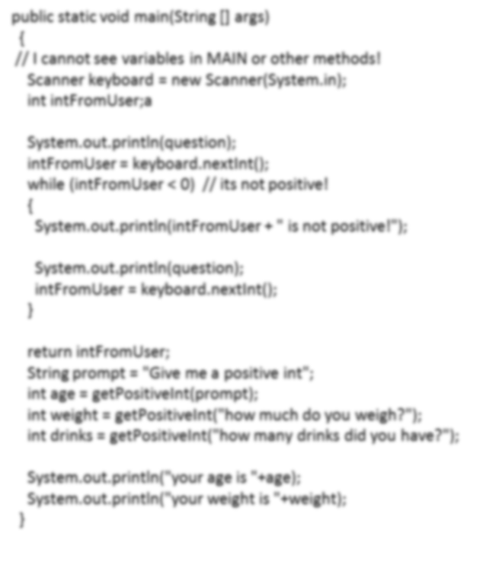
Assuming these commands work, everything makes sense
Think of the program as a high-level flow
Overview of the program, in
Your draw loop..
Details on the right

Slide 180
#7, Real Numbers
Floating point numbers, trigonometry, random numbers, basic math shortcuts, width and height globals

Slide 181
integer is fine.. but I want fractions!
I WANT 5/2 to give me 2.5
I don’t want to be restricted to integers…
what do I do???
you need a new data type that allows decimal portions…
Floating point!

Slide 182
why is it called floating point? (advanced)
its scientific notation:
first, we give a bunch of numbers:
e.g., 1234567
then, we tell it where to put the point:
e.g., after 4th digit: 1234.567
1.234567 x 10³
5 before first digit: 0.000001234567
1.234567 x 10⁻⁶
5 after last digit: 123456700000.0
1.234567 x 10¹¹
we can store VERY small and VERY large numbers

Slide 183
How to make a floating point variable
Instead of:
int variableName;
float variableName;
Use floats to draw 30% way across the screen
float percent = 0.3;

Slide 184
floating point variables
size(500,500);
float percent = 0.3;
float targetX = percent*500;
line(0,250,targetX,250);

Slide 185
Change the example
float percent = 30/100;
What happens?
Use println to investigate

Slide 186
Doesn’t work!!
Processing still does integer division!!! why??
note: the right side of the assignment does not change based on the variable on the left!!
so.. why is 30/100 giving an integer result?
note: if the numbers in an operation are integers, the computer does integer arithmetic:
in programming speak: if the operands are integers, processing uses an integer operator

Slide 187
how to do floating point math?
note: if the numbers in an operation are integers, processing does integer arithmetic:
note: if either number in an operation is floating point, Java does floating point arithmetic
how do we force 30/100 to be floating point?
make either the 30 or the 100 a floating point:
30.0/100 or
30/100.0 or
30.0/100.0

Slide 188
Processing works one step at a time…
(confusing but important)
what about 1.0+1/2*3.0?
lets try it
why? – processing does it one step at a time.
Order of operations!
1.0+1/2*3.0
1/2 -> int / int -> integer division -> 0
1+0*3.0
(this is floating point, since int * double)
1+0.0

Slide 189
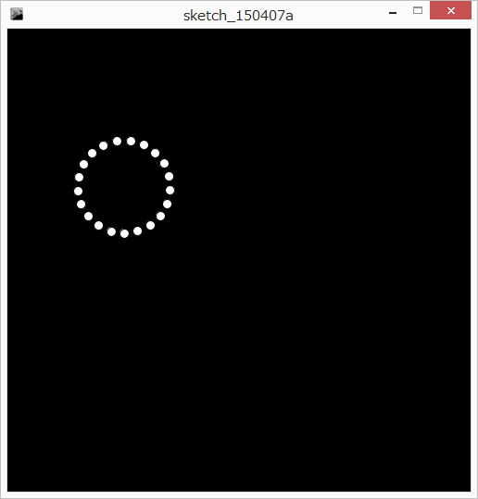

new example:
Make a ball circle around
the mouse
We need trigonometry

Slide 190
Trigonometry and processing
Processing uses radians not degrees
Circle goes from 0..2PI
PI?
-> 180 degrees
PI/4?
-> 45 degrees

Slide 191
Trigonometry and processing
New constant: PI (all caps)
New way to show you commands
type commandName(type parameter);
float sin(float radians)
float cos(float radians)
float tan(float radians)

Slide 192
More trigonometry
We have inverse functions-> sin⁻¹, cos⁻¹, tan⁻¹
Also called arccos, arcsin, arctan.
float asin(float ratio)
float acos(float ratio)
float atan(float ratio)
ADVANCED: atan2 (see notes)

Slide 193

Back to our mouse orbiter!
Start with simple static case
Let’s pick an angle, theta, and start at some point
We also need a radius – how far the ball will circle

Slide 194
Given a radius and an angle, what is the x, and y?
sin(θ) = y/radius
y = sin(θ)* radius
cos(θ) = x/radius
x = cos(θ)* radius
It worked!! We can now place a ball at some distance and angle from the mouse
y
radius
θ
x

Slide 195
How to make it animate?
What did we do for mouse bubbles?
Every time we draw, adjust angle by a little delta
What about the angle getting too big?
mod and floating point is messy…
angles wrap around we’re safe!

Slide 196
At home exercise:
Here is an extension you can try at home: expand this to having multiple planets orbiting the mouse at different speeds. Here are some helping steps:
rename the variables to start with p1 for planet 1
copy all your variables for each planet. Try three planets
make each planet move at a different speed. What if one moves at a negative speed??

Slide 197
aside: more globals
width
height
Carful! Only use those AFTER you set the canvas size.

Slide 198
New command: random
Generate a number [0..high)
from 0 to high but excluding high.
random(high);
e.g.,
random(5); // generate a random number 0..4.99

Slide 199
random returns a number that you can use anywhere you can use a literal
println(random(10));
random 10 gives you a number
That number is placed in the println
println(random(10));
→println(3);

Slide 200
A closer look at random…
Let’s lookup random in the reference
Random returns a float. Means the data gives you is floating point
Can only be stored in a floating point variable

Slide 201
block moving randomly around a screen
A block that jumps around
Globals
block position
block size
how fast it can move

Slide 202
Block moving randomly…
What is random? How much the block moves. Not the block position
float moveX = random(MAX_MOVE);
Then we add the movement to the position
blockX = blockX + moveX;

Slide 203
The block can only move right!
How can we also make it move negative?
random(blockSpeed*2)-blockSpeed;
if blockspeed is 5..
random(5*2)-5;
Generate double the range .
Subtract the range from it.
If random gives us 0
  0-5 is -5
If random gives us 5
  5-5 is 0
If random gives us 9
  9-5 is 4

Slide 204
It moves off the edge of the screen…
Use min and max to cap it!

Slide 205
Make it ALSO move toward the mouse!!
X first…
How to get how much toward the mouse?
mouseX – blockX
if mouse is to the right, we get how many
if mouse is to the left, we get neg. how many
How to move toward the mouse?
add the difference to the block
Oh no! We just move TO the mouse

Slide 206
Move toward the mouse
Divide the difference by some number….

Slide 207
common basic arithmetic
Processing has a bunch of arithmetic shortcuts that makes your life easier… as long as you understand them

Slide 208
common basic arithmetic
it is very common in programming to increase, decrease, or multiply a variable by a certain amount:
variable = variable + 5;
variable = variable * 10;
variable = variable / 4;

Slide 209
combined operations
variable = variable + 5;
variable += 5;
variable = variable * 10;
variable *= 10;
variable = variable / 4;
variable /= 4;
variable = variable – 5;
variable -= 5;
variable = variable % 2;
variable %= 2;

Slide 210
examples..
price = price * SALES_TAX;
price *= SALES_TAX;
posX = posX – moveX;
posX -= moveX;
payment = payment / NUMBER_OF_PEOPLE;
payment /= NUMBER_OF_PEOPLE;

Slide 211
another shorthand: incrementors and decrementors
straight forward: what does increment and decrement mean?
variable = variable + 1; // increment variable
variable = variable – 1; // decrement variable
one short hand: variable += 1; variable -= 1;
incrementor: variable++
decrementor: variable--

Slide 212
incrementor / decrementor example
int i = 5;
i++;
i++;
i--; // what does I equal?
int i = 5;
i++; // i now equals 6
i++; // i now equals 7
i--; //i now equals 6

Slide 213
trivia: why is c++ called c++?
a very popular programming language was called C, but it did not have object oriented programming.
some people updated C to include object oriented programming, and called it c++. it means c + 1 ☺

Slide 214
#8, Text
String variables, combining strings, convert between strings and numbers, get the length of a string, characters, getting a character from a string

Slide 215
Text in processing: strings

Slide 216
Strings
(strings of characters…..?)
“hello”
“this is a pen!”
“Hello, my name is Jim!!”
Put some text inside quote marks
println(“hello world”);

Slide 217
look a little closer…
println(“hello world”);
our parameter is in double quotes “”
warning: this is not two ‘ or ` (single quotes)
hold SHIFT and press single quote ‘ by the enter key
“” is used to denote that we are providing text
what happens if we remove the “ “?
compile-time error!!

Slide 218
Strings are strange: a new kind of data
So far, all data are “primitives”
simple nuggets of data
Strings are more complicated, larger chunks of data, different sizes, etc.
Strings are Objects. They act differently in many ways from your other data ☹

Slide 219
the String data type
String variableName;
Notice the capital S! → object
String s = “Hello World!!”;
println(s);

Slide 220
The EMPTY String! (a little zen?)
Question: what would be the shortest String that you could think of?
1 character long?
how about 0 characters long?
in Processing, the empty string is a string that is 0 characters long
you do it by: "" putting two quotes together
String nickName = "";

Slide 221
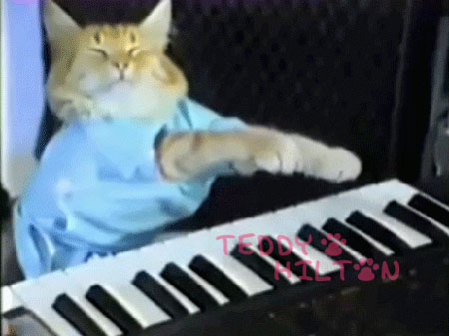
Combining two strings?
String firstName = “Jim”;
String lastName = “Young”;
String fullName = “Jim Young”;
Wouldn’t it be nice if we could simply build fullName from the other two?
In Processing, we use + sign to concatenate strings:
fullName = “Jim” + “Young”;
fullName = firstName + lastName;
fullName = firstName+ “ “+ lastName;

Slide 222
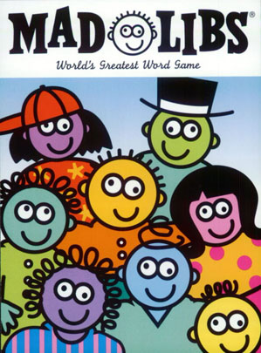
madlibs
“<exclamation>! He said <adverb> as he jumped into his convertible <noun> and drove off with his <adjective> partner.”
Do this in Processing?
Create variables for each of the unknowns
Store answers for each
Calculate the output String
Display the output String

Slide 223
Graphical text in processing
Two new commands:
text(string, x, y); // draw string at x,y
textSize(size in pixels);
Some string
Coordinates point at bottom left corner

Slide 224
What number is this?
五
いつつ
오
다섯
|||||
V
5
The number 5 can be represented in thousands of ways… that is text versus the abstract number

Slide 225
String type versus number types
is String “5” different than integer 5?
note: String is text, language-dependent representation, and numbers are abstract numbers independent of representation:
e.g., “1234.56” and “1,234.56” and “12,34.56” are string representations, and all are equivalent to the abstract number 1234.56.

Slide 226
Try conversions
String s = "5";
int i = s;
int i = 5;
String s = i;

Slide 227
So how to convert between a string and a number?
int int(String)
float float(String)
String str(numerical)
int takes a String parameter, and returns an Integer that you can use.
float takes a String parameter, and returns a float that you can use.
str takes a numerical parameter, and returns a String that you can use.

Slide 228
Fail cases?
String s = "1,234";
int i = int(s);
float f = float(s);
println(i);
println(f);

Slide 229
special case: string concat +=
String s = “output: “;
s += “other string”; // s = s + “other string”
s += 20;
s = s + 20; // converts 20 to “20”

Slide 230
Shortcut for number -> String
If you try to concatenate a String with a number, processing inserts the str() conversion for you
String s = "my age: “;
s = s + 19;

Slide 231
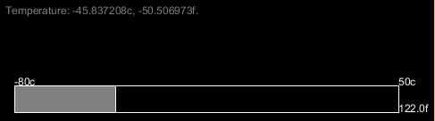
Example: interactive temperature scale
Globals!
S_TOP
S_LEFT
S_WIDTH
S_HEIGHT
HOT
COLD
TEMP_RANGE
Draw outside rectangle

Slide 232
Labels <update>
Calculate and output celcius label at each tick
Calculate Fahrenheit:
f = 9/5c+32
Output at each tick at bottom of scale

Slide 233
Mouse interactive..
Calculate how far along the scale the mouse is. Take the mouse position and subtract the left end of the scale
Make sure we’re not off either end of the scale!!
Draw the filling using that width

Slide 234
Mouse reading
Convert the mouse position to percentage,
Then convert to temperature
Put a string out with the reading

Slide 235
char type
holds a single character
char variablename = 'x';
you specify a single character by using single quotes: 'x'
note: a String is " " and a char is ' '
traditionally, 1 byte
in Processing, its 2 bytes (don’t memorize)
1B
char
2B

Slide 236
what is a single character??
a letter, e.g., ‘f’
a number, e.g., ‘8’
a symbol, e.g., ‘+’
a space, ‘ ‘
etc…
Is there an empty character?
no

Slide 237
How Computers stores characters
in the old days, computers only had a small number of characters they could display:
ASCII standard:
this is a table of characters, and each character has a number.

Slide 238
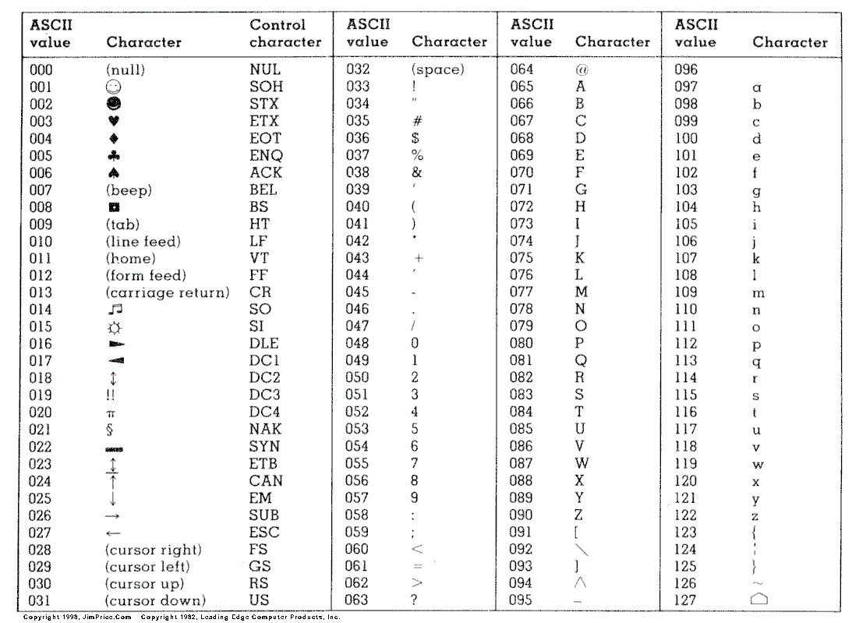
standard ASCII table:

Slide 239
why do we number the characters?
everything in a computer is stored as numbers.
even your music and photos!!!
some clever people decided on a standard numbering, so that, e.g., the number 65 is A, 78 is N, etc.

Slide 240
How to check the ascii number of a character?
Force the data into an integer
(advanced, gimmicky, don’t study)

Slide 241
ASCII is limited!!!
only one language at a time:
language-specific, accented letters, etc.
does not handle complex writing systems!
こんにちは！ 中国語 안녕 하세요 שָׁלוֹם
remember those garbled websites?

Slide 242
Unicode:
ONE standard for all languages
is the reason I can put many languages at once:
こんにちは！ 中国語 안녕 하세요 שָׁלוֹם
double the memory of ASCII –
note: each character takes 2 bytes of memory.
ascii unicode
1B
char
2B

Slide 243
String structure
each character has a specified “index” (box)
“sprocket”
S P R O C K E T
char
2B
char
2B
char
2B
char
2B
char
2B
char
2B
char
2B
char
2B

Slide 244
String indices
each box has a designated number
the 1st box is box 0
2nd is box 1….. and so forth
Note: OFF BY ONE ERROR!
S P R O C K E T
char
2B
char
2B
char
2B
char
2B
char
2B
char
2B
char
2B
char
2B
0
1
2
3
4 5 6 7

Slide 245
String methods!! (Object)
Your string variable type has several built-in methods (commands) that you can use.
variableName.method(parameters);
String dogName;
dogName = “sprocket”;
// dogName.method(parameters);
dogName.length(); // takes no parameters
…

Slide 246
String Length: int variableName.length()
What is the length of this string?
note: the index of the last character is string.length() - 1
off by one error
S P R O C K E T
char
2B
char
2B
char
2B
char
2B
char
2B
char
2B
char
2B
char
2B
0
1
2
3
4 5 6 7

Slide 247
Get character: char variableName.charAt(int index)
returns the specific single character at the given index (box #).
e.g.,:
String dogName = “sprocket”;
char secondLetter = dogName.charAt(1);
S P R O C K E T
char
2B
char
2B
char
2B
char
2B
char
2B
char
2B
char
2B
char
2B
0
1
2
3
4 5 6 7

Slide 248
Off-by-one string length error
String s = “SPROCKET”;
char lastCharacter = s.charAt(s.length());
char lastCharacter = s.charAt(s.length()-1);
ERROR
S P R O C K E T
char
2B
char
2B
char
2B
char
2B
char
2B
char
2B
char
2B
char
2B
0
1
2
3
4 5 6 7

Slide 249
#9, Data and Memory, Casting and Conversion
Basic data types, memory usage, casting

Slide 250
Data types and memory

Slide 251
bits and bytes and nibbles… (don’t memorize)
A computer stores everything as switches (bits)
represent 0 (off) and 1 (on).
A group of 8 bits (switches) makes a byte
00110110 ← one byte of data
A group of 4 bits (half a bite) make a nibble
(I kid you not!) 1101 is a nibble of data
1024 bytes (2¹⁰) make a kilobyte
1024 kilobytes (2²⁰ bytes) make a megabyte
1024 megabytes (2³⁰ bytes) make a gigabyte
1024 gigabytes (2⁴⁰ bytes) make a terabyte
A terabyte has 1,099,511,627,776 bytes or
8,796,093,022,208 switches
using a 7cm standard light switch… 615 million KM
4 times the distance to the sun!!!!!!!!!!!!!
(aside: new standard units are moving to even powers of ten where 1 terabte = 1,000,000,000,000 bytes)

Slide 252
Counting with bits!!!!! (not covered in class, not testable)
0 -> 0
1 -> 1
How to represent “2”?
we need another bit. Put it in front
Start over..
00 // right column is 2⁰ place
01
10 -> 2 // left column is 2¹ place
11 -> 3
100 -> 4 // left column is 2² place
What is 6?
110

Slide 253
data types so far
int (4B)
float (4B)
boolean (1B?)

Slide 254
integer overflows
“int” type in Processing stores 4 bytes of info
smallest number is -2,147,483,648
largest is 2,147,483,647 (try it!)
what happens when you go past these numbers accidentally?
3,147,
483,649
302
int (4B)

Slide 255
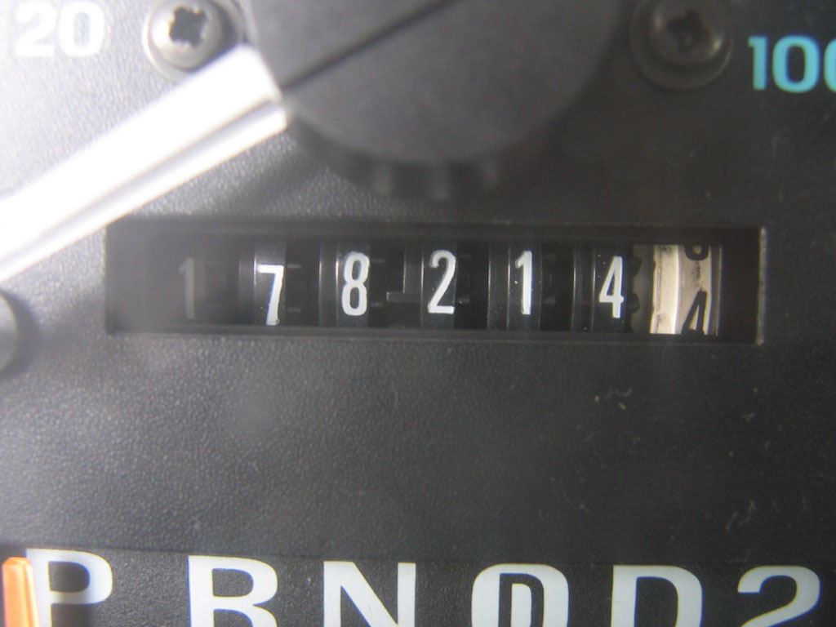
variable overflow
note: when you go over the specified maximum value of an integer variable, the value wraps around to the smallest value.
when you go below the specified minimum, it wraps in the other direction.

Slide 256
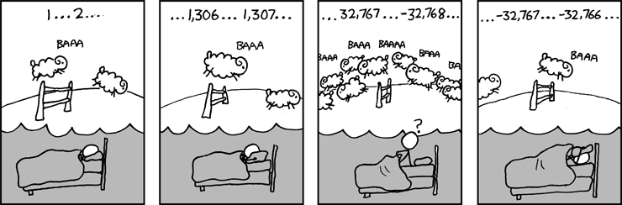
quick comic
a data type that we do not use in this course, called a short (a short integer), is 2 bytes (int is 4) and can hold the range -32,768…32,767
XKCD.com

Slide 257
two ways to avoid overflow:
use a different data type
be clever with your calculations to avoid large numbers

Slide 258
Primitive data types: integers
type | size | minimum | maximum
byte | 1 byte | -128 | 127
short | 2 byte | -32,768 | 32,767
int | 4 byte | -2³¹ | 2³¹-1
long | 8 byte | -2⁶³ | 2⁶³-1
All used like int
Integer math

Slide 259
Primitive data types: floating point
float – 4 bytes
double – 8 bytes
More memory is more precision, not more range
e.g.,
float - 0.6666667
double - 0.6666666666666666

Slide 260
primitives
boolean – true, false
char – store one character (later!)

Slide 261
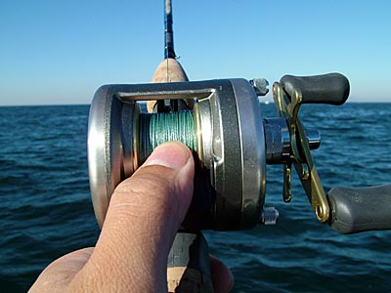
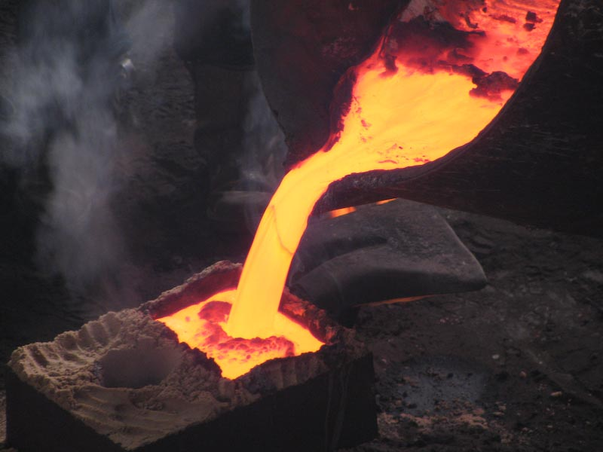
Casting

Slide 262
conversion between types (casting)
we have int, long, float, double, etc., how do they relate? how do we go between them?

Slide 263
Try …
int i = 1234;
byte b = i;
What will happen?
1234 cannot fit into byte?
What about..
long l = 1234;
int i = l;

Slide 264
It just doesn’t fit!!
Processing knows that the int only has half the memory. It doesn’t even try
It’s dangerous!
Narrowing conversion
(8B)
long
int (4B)

Slide 265
Other direction
int small;
long large;
small = 15;
large = small; // Convert an int to a long!!
Widening conversion
int (4B)
long (8B)

Slide 266
casts
widening conversions automatically convert (cast) the data types – this is called an implicit cast
narrowing can result in the loss of data, so Processing requires that you explicitly cast the data to the new type

Slide 267
Example:
long large = 200;
int small = large;
Error: cannot convert
Processing is saying that you may lose data, so it doesn’t want to do it.
(8B)
long
int (4B)

Slide 268
Explicit cast:
put (type) in front of a variable or value
long large = 200;
int small = (int)large;
This tells Processing to convert
Just do it! I know what I’m doing!
(8B)
long
int (4B)

Slide 269
floating point..
float (4B)
float is 4 bytes
double is 8 bytes
widening conversion is an implicit cast
narrowing conversion requires an explicit cast:
float f = 1.234;
double d = f;
float floatVariable = (float)doubleVariable;
double (8B)

Slide 270
converting between integer and floating point types
floating point -> integer, data is lost so an explicit cast is needed to make Java happy.
integer -> floating point, implicit cast because floating point is more capable and can accommodate the integer.
int (4B)
float (4B)
long (8B)
double (8B)

Slide 271
Float -> integer
When explicitly cast to an integer, a floating point number gets truncated. The decimal portion is lost.
float f = 123.456;
int i = (int)f;
println(i);

Slide 272
order of operations with the explicit cast!
int integerVariable = (int)0.5*3.0;
Casts happen first!
the cast converts the 0.5 to an int first, = 0
second, the multiplication takes place: 0 * 3.0
the result is a floating point.
To fix this?
int integerVariable = (int)(0.5*3.0);

Slide 273
What we learnt…
Data types have a fixed amount of memory, which dictates how much information they can store
Different datatypes store information differently, e.g., floating point versus integer
you can convert between data types (floating point or integer) and between memory sizes (e.g., long<->int, float<->double) using casts.

Slide 274
Char and casting
Since the character is simply an integer number underneath, you can convert back and forth to an integer.
char -> int is a widening cast because the int has more memory (impicit cast)
int->char is a narrowing cast because the char is less capable: requires an explicit cast
char
2B
int (4B)

Slide 275
Strings and casting
<to do>

Slide 276
#10, booleans – true and false
The boolean type, basic conditionals, if-then-else statements, nested if statements, logical operators, if statements and scope

Slide 277
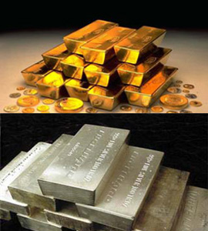



Boolean!!
(not bullion)

Slide 278
the boolean data type
note: the boolean data type stores only two different values: true and false.
boolean isStudentSleeping;
isStudentSleeping = true;
boolean jimIsRich = false; // :(
true,false are not numbers.. they’re booleans.
true, false
boolean

Slide 279
but what use is this?? just storing true and false??
we need to learn two things to make booleans useful:
conditionals: code that only runs if a boolean is true or false, e.g.,
if (jimIsRich) { stealHisMoney(); }
boolean operations : calculations that use and result in booleans!

Slide 280
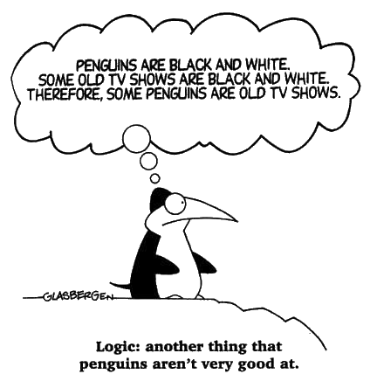
the boolean data type is used in computer logic – it gets confusing fast

Slide 281
conditionals!!
using booleans to have code run ONLY if certain conditions are met

Slide 282
so far, our programs run in a straight path:
start at the top
work down.
what if we only want to grow or shrink the ball, but not both? Depending on circumstances?
what if we only want to draw the ball if it is not too small?
int ballSize = 5;
ballSize += １０;
ballSize -= 10;
ellipse(posX,posY,ballSize,ballSize)

Slide 283
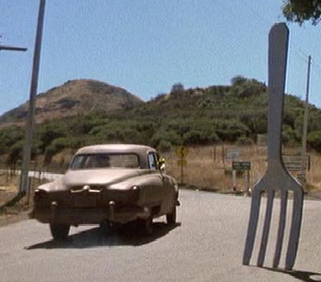
a fork in the road!
we need a way to choose which lines of code are run and which are not run,
and under what conditions they are run
this is conditional programming, and achieved using if statements
is the mouse pressed?
if yes
if no
ballSize += 10;
ballSize -= 10;

Slide 284
the if statement!
Processing uses the if keyword, and a boolean test, and executes a block of code IF AND ONLY IF the boolean test is true.
// .. your program…
if (booleanValue)
{
// then do this code
}
// more program…
this code is ONLY run if the booleanValue
is true. otherwise, it is skipped completely!!

Slide 285
Processing has some great pre-defined booleans
boolean mousePressed;
boolean keyPressed;
e.g.,
if (mousePressed)
{
// do stuff
}

Slide 286
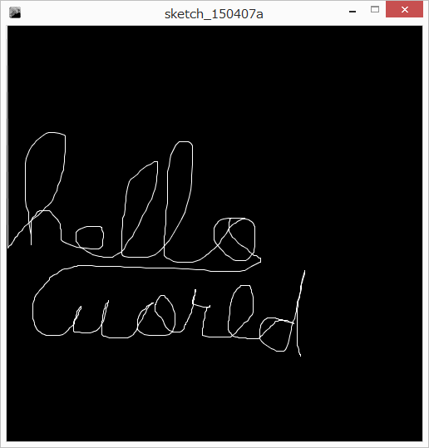
Update our drawing program
Only draw when the mouse is pressed
Erase the screen when the keyboard is pressed

Slide 287
Draw a dashed line!!
Have two drawing colors – A and B.
  One is black one is white
  Each time we draw, we swap A and B
  int colorA =255;
  int colorB = 0;
  How do we swap the values in two variables???

Slide 288
Swap version1
  int colorA =255;
  int colorB = 0;
  // swap
colorA = colorB;
colorB = colorA;
What happens?
  colorA set to 0
  color b set to 0

Slide 289
To swap a variable, you need a temporary holding variable
  int colorA =255;
  int colorB = 0;
  int swapTmp;
  // swap
  swapTmp = colorA;
colorA = colorB;
colorB = swapTmp;
  save colorA copy (255)
  colorA is now 0
  colorB set to colorA copy(255)

Slide 290
Note: the ^ sign does not do power
int a = 2^2;
This does a bitwise exclusive or (advanced topic beyond this course)

Slide 291
Opposite test
We can do code IF something is TRUE
What about if something is not true?
Goal – if the mouse button is NOT pressed, then draw a black circle underneath it to simulate an eraser

Slide 292
boolean operations!: negation
negation!! how can we get the opposite?
true ->false, false -> true
!boolean, the exclamation part negates
boolean isJimRich = false;
boolean isJimPoor = !isJimRich;
also known as “not”.

Slide 293
Somewhat confusing…
if (!mousePressed)…
if the opposite of MousePressed is true
if mousePressed is false
Then draw a black circle!

Slide 294
Growing / shrinking ball
First make a program where a ball grows or shrinks
use the if statement to detect if the mouse is pressed, and act on that
is the mouse pressed?
if yes
if no
ballSize += growth;
ballSize -= shrink;

Slide 295
we often do two opposite tests:
if (mousePressed)
{
// do stuff
}
if (!mousePressed)
{
// do stuff
}

Slide 296
Two opposite tests!
it would be useful if we could say: otherwise
e.g., if the mouse is pressed, do something, otherwise, do something else
Processing has the else keyword to do this!
if (mousePressed)
{ //… }
else
{ //… }
this code is ONLY run if the boolean test
above is FALSE.

Slide 297
if-then-else
if (boolean test) {
// then do all this stuff..
…
} else {
// otherwise do all this stuff.
}
Update the program

Slide 298
Make a ball move left if the mouse is pressed, right otherwise
Up if keypressed, down otherwise
Don’t clear the BG, and set a stroke color to leave a trail

Slide 299
nesting ifs…
in computer programming, nesting is when you put one thing inside of another
Let’s update our drawing program.
Previously: press a key clears the canvas to black
Let’s make it so that if you press a key while the mouse is down, clear to white

Slide 300
Previous code
if (mousePressed)
{
stroke(255);
line(pmouseX, pmouseY, mouseX, mouseY);
} else {
stroke(0);
fill(0);
ellipse(mouseX, mouseY, 25, 25);
}
if (keyPressed)
{
background(0);
}

Slide 301
How:
Once we check if a key is pressed, make the clear color depend on whether or not the mouse is down.
Use another if statement INSIDE the first one

Slide 302
if (keyPressed)
{
if (mousePressed)
{
background(255);
} else {
background(0);
}
}
Inside the if keypressed block, so this code is ONLY RUN if the keyPressed test is true.
Narrow tunnel vision! Step by step!

Slide 303
Boolean operations
How to do complex boolean tests..
If both x AND y are true then..
If either x OR y are true then..

Slide 304
boolean operations!: and
note: the AND operation uses the symbols && to determine if both of two booleans are true:
boolValueA && boolValueB // true ONLY if both are true
boolean jimIsRich = false;
boolean iNeedMoney = true;
boolean shouldMugJim = jimIsRich && iNeedMoney;
AND (&&) Truth Table
A | B | Operation | Result
false | false | A && B | false
false | true | A && B | false
true | false | A && B | false
true | true | A && B | true!

Slide 305
Make a program to draw a circle at the mouse only if it is in the top left quadrant
If mouseX < width/2
AND
If mouseY < height/2

Slide 306
boolean operations!: or
note: the OR operation uses the symbols || to determine of either of two booleans are true:
boolValueA || boolValueB; // true if A OR B is true
boolean jimIsRich = false;
boolean iNeedMoney = true;
boolean shouldMugJim = jimIsRich || iNeedMoney;
OR (||) Truth Table
A | B | Operation | Result
false | false | A || B | false
false | true | A || B | true
true | false | A || B | true
true | true | A || B | true

Slide 307
blocks impose SCOPE rules
scope is the range within which a variable exists. Outside of that scope, you cannot access or work with that variable.

Slide 308
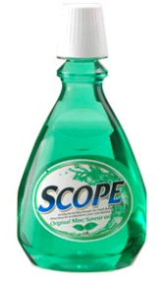
SCOPE
variables created within one block can ONLY be accessed within that block. Each code block has its own local scope.
boolean hasUsedScopeMouthWash = true;
if (hasUsedScopeMouthWash)
{
int freshness = 10;
}
println(freshness);
this code will not compile! The freshness variable was created within the scope of the code block, and once that scope ends, the variable cannot be accessed…
how to fix this?

Slide 309
what about nested blocks?
if (booleanA)
{
int d = 12345;
if (booleanB)
{
println(d);
}
}
the purple scope is inside the blue scope, so it can see the int variable d

Slide 310
what about nested blocks?
if (booleanA)
{
int d = 12345;
if (booleanB)
{
int d2 = d*2;
}
println(d2);
}
ERROR
d2 is created INSIDE the purple scope, so it cannot be accessed outside of that scope

Slide 311
what about nested blocks??
if (goodWeather) {
int goodTemp = 25;
if (inWinnipeg) {
boolean coldAdjust = true;
goodTemp -= 5;
} else if (inAtlanta) {
goodTemp += 5;
boolean warmAdjust = true;
if (coldAdjust)
goodTemp += 5;
}
}
println(goodTemp);
OK!
OK!
ERROR
ERROR

Slide 312
How to avoid scope issues..
Follow good coding practices:
declare all your variables at the top of your draw block
use globals when needed
why not make them all globals?
as your programs grow, very messy!

Slide 313
#11, advanced conditionals
Relational operators, comparing strings, relational pitfalls, if-else-if chains, short circuiting

Slide 314
relational operators: comparing data
== equals, true if the left and right operands are equal
a == b // gives a boolean result
int a = 3;
int b= 3;
boolean areEqual = (a == b); // brackets not necessary!!

Slide 315
Test if the mouse is on the diagonal and do something – draw a circle
Make Boolean variable that checks
Do if statement based on that

Slide 316
If Booleans are true…?
if (mousePressed)
{
….
}
if (mousePressed==true)
{
…
}

Slide 317
relational operator summary
operator example true if…
!= a != b they are /not/ equals!
< a < b true if a is less than b
<= a <= b true if a is less than or equal to b
> a > b true if a is greater than b
>= a >= b .. a is greater than or equal to b
these all return the boolean type
boolean result = a < b;

Slide 318
relational operator examples
2 < 5
2 <= 5
2 > 5
2 == 2
2 <= 2
2 >= 2
2 != 2
2 == (1+1)
3 == min(9, 3);
// true, 2 is less than 5
// true, 2 is less than or equal to 5
// false, 2 is not greater than 5
// true, 2 is equal to 2
// true, 2 is less than or equal to 2
// true, 2 is greater than or equal to 2
// false, 2 is equal to 2
// true, 2 equals 1+1
// true!

Slide 319
relational operator examples
2*10 <= max(-10,-2)
3 == 3*1
3 != min(3, 1)
// false, 20 is not <= -2
// true, 3 == 3!!
// true, 3 != 1!

Slide 320
Variable not needed for if statement..
boolean onDiagonal = (mouseX==mouseY);
if (onDiagonal)
{
// ...
}
if (mouseX == mouseY)
{
// …
}

Slide 321
Don’t use == for floats!!
Floating point numbers are approximations. How they are stored inside the computer means that base 10 numbers cannot be perfectly stored
There is an accumulated error as you do operations
If you have a pocket of change, and you..
count nickles, then dimes, then quarters, then loonies, an you get $15.25
same change: count loonies, then quarters, then dimes, then nickles, you may get $15.22!
The order matters! -> don’t use ==

Slide 322
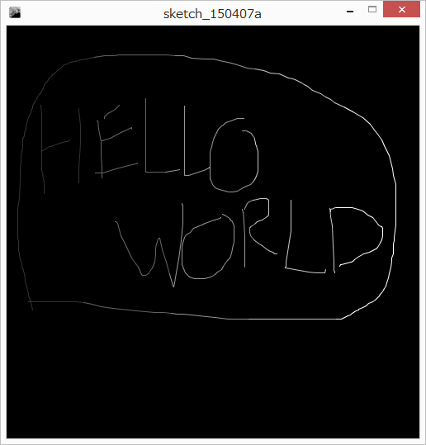
Example with relational operators and ifs
Set color based on x value
0..99 color 50
100..199 color 100
200..299 color 150
300..399 color 200
400..500 color 255

Slide 323
Start with simple example: draw if mouse pressed, clear on key press
First test – add mouseX < 100
how to add the next one? 100..199?
re-think – not < 100, but < 200
use the else block
Next one? 200..299?
same approach
THIS IS GETTING MESSY!

Slide 324
If – else – if is a very common pattern
New syntax!
if (condition)
{
}
else if (condition) // only if above condition was false
{
}
else if (condition) // only if all above are false
{
}
else // only run if ALL the above conditions are false
{
}
Update program
have as many as you want

Slide 325
Careful points..
Hard to match brackets up – always make set of { and } when making a block to avoid problems
What about.
if(…)
{
} else {
// ..
} else {
//
}

Slide 326
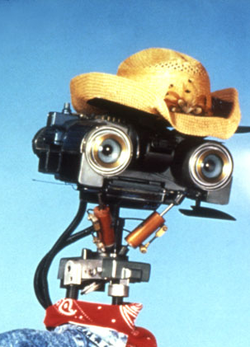
short-circuiting!
note: if a condition is met, does not test any other conditions in the if-else-if chain
if (mouseX < 500) {
stroke(255);
} else if (mouseX < 400) {
stroke(200);
} else if (mouseX < 300) {
stroke(150);
} else if (mouseX < 200) {
stroke(100);
} else {
stroke(50);
}
this code has a bad bug!

Slide 327
Make a program that draws only in the top 25% and the bottom 25%
If mouseY < height/2 OR
If mouseY > 3*height/4

Slide 328
Example: click a button
Create a small rectangle to be your button
Name all the parameters as variables
Test one case first – mouse to the right of the button left wall – change button color if true
Test all four walls – use &&
Only change when mouse clicked

Slide 329
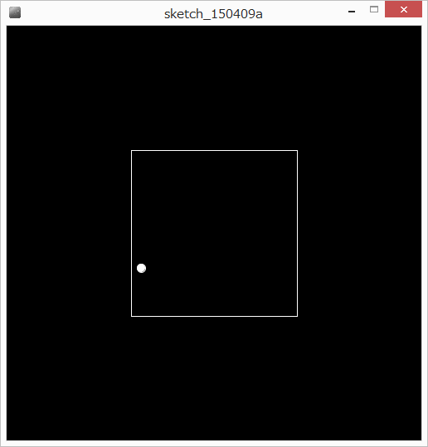
Example – rebounding ball
Make variables for a ball
position, movement, size
Draw the ball
Move the ball (neg. movement?)
Make variables for a box and draw it
How to bounce the ball?

Slide 330
Bounce the ball!
If hit left or right wall – reverse X direction
If hit top or bottom wall, reverse Y direction
How?
Multiply by -1

Slide 331
Exercises:
The ball bounces when the center of the ball – not an edge – hits. Fix so that it bounces when an edge hits
Add a smaller box in the center (say, 10x10) that the ball also bounces off of and stays outside of

Slide 332
boolean logic nesting
boolean result = ! ( c || !(a<b)); // this is legal
Assuming that this runs, what do you know about the data types of the variables a, b, and c?
a and b must be numerical because we are doing a less-than operator.
c must be boolean because it is an operand to the boolean OR operator.
what is the result if a=3, b=1, and c=true; ?

Slide 333
boolean logic nesting
boolean result = ! (c || !(a<b)); // this is legal
what is the result if a=3, b=1, and c=true; ?
! (c || !(a<b))
! ( T || !(3<1))
! (T || !(F))
! ( T || T)
! ( T)
F
If you know that c is true, does it matter what a and b are?
No! T || anything is TRUE
Your computer may save work here

Slide 334
If statements and code blocks

Slide 335
alternate if syntax
We learned if statements with blocks, but blocks are not necessary
note: the curly braces {} are not necessary for if-then-else, but if you don’t use them, you are limited to ONE line of code each
if (boolean test)
{
…
} else {
…
}
if (boolean test)
oneLineCommand;
else
oneLineCommand;

Slide 336
easy to make problems…
if (shouldMugJim)
putOnBlackMask();
practiceToughVoice();
mugJim();
continueProgram();
Only the first command (putOnBlackMask()) is related to the if statement!! everything else will run anyway. Indenting is aesthetics only
Get into the habit of always using {}, its safer.

Slide 337
using {} avoids the risk
if (shouldMugJim)
{
putOnBlackMask();
practiceToughVoice();
mugJim();
}
continueProgram();

Slide 338
you can mix blocks with no blocks..
if (booleanStatement) {
commandA1;
commandA2;
} else if (booleanStatement)
command B;
else
command C
NOTE: always ensure to match opening { with closing } to end the block properly.. otherwise, doesn’t know where your block ends!!
Advice: just use code blocks everywhere

Slide 339
broken if-else chain example
if (temperature < -50 || temperature > 50) { // invalid temperature
severity = -1;
} else { // temperature is valid
if (temperature < -20)
severity = 4;
} else if (temperature < -10) {
severity = 3;
} else if (temperature < 0) {
severity = 2;
} else
severity = 1;
}
despite indentation, there is a mismatch of { and } such that Processing gets the blocks confused.

Slide 340
How to avoid?
ALWAYS USE CODE BLOCKS!

Slide 341
Let’s re-visit the == operator
Compares two values and returns a boolean type
Cannot be used to compare Strings
it may look like it works sometimes, but not what you think
Tells you if they are the same object

Slide 342
String is a special case
String s1 = “hello.”;
String s2 = “hello.”;
if (s1 == s2) // not what you think!!
{
…
}

Slide 343
boolean stringVariable.equals(String)
String chantPartA = “hi”;
String chantPartB = “ho”;
boolean areEquals = chantPartA.equals(chantPartB);
// or, = chantPartB.equals(chantPartA);

Slide 344
#12, loops
for loops, while loops, do-while loop, loops and scope, common loop problems

Slide 345
<<update to match new loop structure in book>>

Slide 346
LOOPS!!!!
sometimes, in a program you want to repeat an operation a bunch of times.

Slide 347
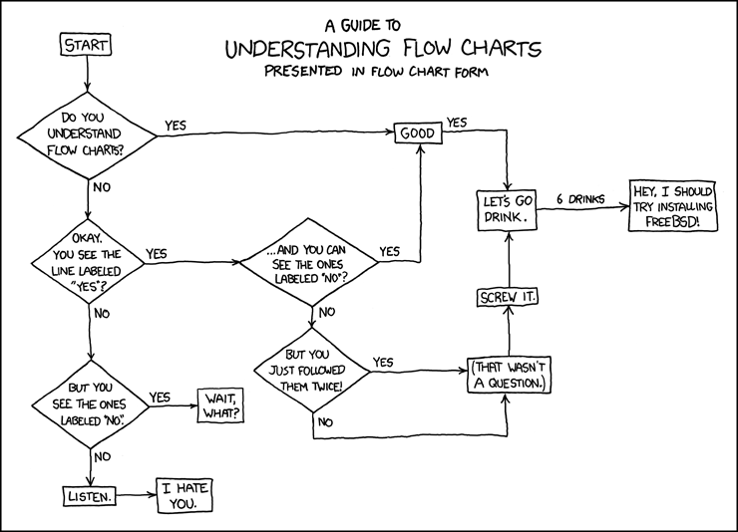
this algorithm (flow chart) has no loops
XKCD

Slide 348
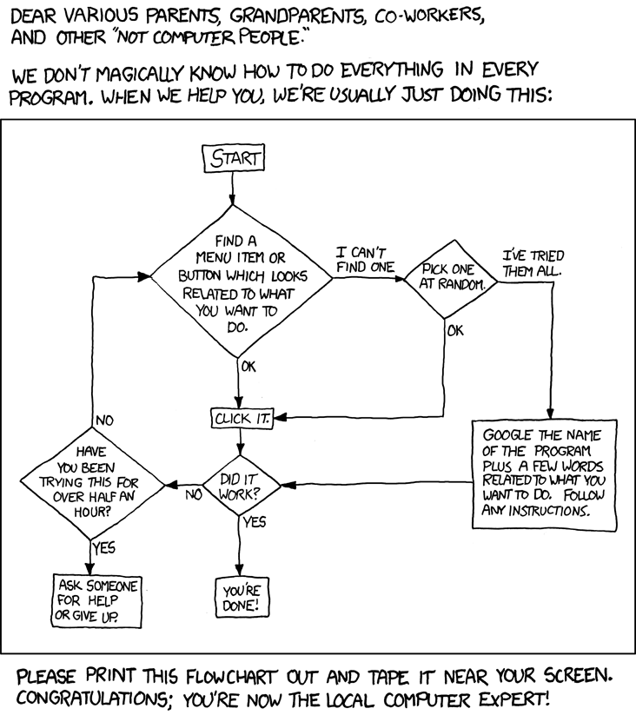
LOOPS!
repeat until some condition is met, like doing for more than 30 minutes or you solved the problem

Slide 349
for loops!
this is tough

Slide 350
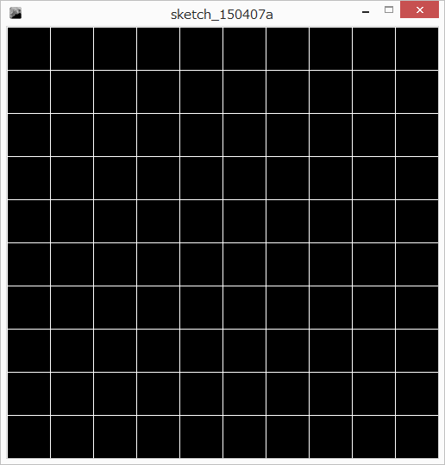
Let’s make a grid on the screen
Setup variables: grid size, cell size
Start making your horizontal lines
A lot of work!!!
What if we wanted a grid of 100?

Slide 351
for loop
wouldn’t it be nice if we could tell processing…
for each value of the variable i in the range from small to large do the following…
e.g., for each value of an integer i from 0 to 10, do our line.
(this is pseudo-code, fake code!)
for 0 <= i < 10:
draw our line at grid position i

Slide 352
for loop – general line formula
line(0, 0, width-1, 0); // top line
line(0, cellSizeY*1, width-1, cellSizeY*1);
line(0, cellSizeY*2, width-1, cellSizeY*2);
(this is pseudo-code, fake code!)
for 0 <= i < 10:
line(0, cellSizeY*i, width-1, cellSizeY*i);

Slide 353
(not correct) kind of do it with an if
for 0 <= i < 10:
line(0, cellSizeY*i, width-1, cellSizeY*i);
int i=0; // declare our counter, start the counter at 0
if (i < 10)
{
line(0, cellSizeY*i, width-1, cellSizeY*i);
i++; // increment i
} < go back to the if and do it again >
With this, the loop runs 10 times, from 0..9

Slide 354
Key pieces
int i=0;
if (i < 10)
{
line(0, cellSizeY*i, width-1, cellSizeY*i);
i++; // increment i
// go back to the if and do it again
}
These pieces, the initialization, condition, body, and upkeep, generally exist in loops that iterate over a series of values.
initialization priming (start)
condition test (end)
(body)
upkeep (step)

Slide 355
the processing for loop syntax!
for (initialization; condition; upkeep)
{
body;
}
read this as:
for the start condition initialization, while condition is true, loop the body and do the upkeep at the end

Slide 356
the Java for loop syntax!
for (initialization; condition; upkeep)
{
body;
}
int i;
for (i = 0; i < 10; i++)
{
line(0, cellSizeY*i, width-1, cellSizeY*i);
}
read this as:
for the start condition i=0, while i<10, loop the body and use the upkeep i++
1,2,3,4,
2,3,4
2,3,4
2
1
4
3

Slide 357
Let’s step through
for (i = 0; i < 10; i++)
{
line(0, cellSizeY*i, width-1, cellSizeY*i);
}

Slide 358
for loop
for (initialization; condition; upkeep) {
body;
}
initialization:
done only ONCE!!!
condition:
checked BEFORE each loop through
upkeep:
done at the END of each time through the loop
body:
executed each time through the loop

Slide 359
super common for loop usage:
declare the iterator variable in the initializer:
for (int i = 0; i < 999; i++) {
do some stuff;
}
println(i);
…. but there’s a problem here. what is it?

Slide 360
for loop and scope
note: just as with any code block, variables created within a for loop code block can only be accessed within that block. Once the block is finished, the variable is destroyed and no longer accessible
for (int counter=0; counter < 200; counter++) {
// some code!
}
println(counter); // error!!
the counter variable only exists within the scope of the for loop.
it is not visible outside the scope of the for loop.

Slide 361
for loop and scope
for (int i=0; i < 200; i++) {
// some code!
}
for (int i=0; i < 300; i++) {
// some code!
}
note: this is valid because the counter variable exists only within the for loop scope. When the second for loop is created, it cannot see the previous counter variable, so there is no problem. It creates a new one.

Slide 362
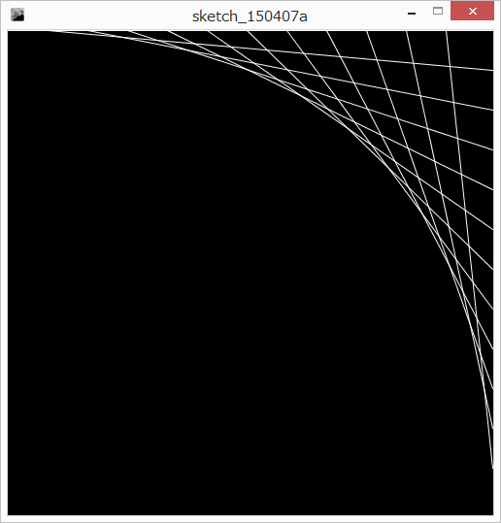
Example: line art
Define how many points and calculate spacing
Hard-code 2-3 lines
Make general case
Put inside for loop

Slide 363
Link to mouse
grid = mouseX/10;
OH NO! RUN TIME ERROR
This is called a run-time error. The program starts up but hits an error that it could not foresee ahead of time. This error makes the program stop running and it gives you some helpful (hah!) information.

Slide 364
Processing is helpful but messy
Description of error
Where the error was
Division by zero! Impossible! And, impossible to foresee before we run it.
How to fix? Many ways, but we can add 1 – we know the possible range for mouseX

Slide 365
the Java for loop syntax!
for (initialization; condition; upkeep)
{
body;
}
for (int i = 0; i < 10; i++)
{
line(0, cellSizeY*i, width-1, cellSizeY*i);
}
1,2,3,4,
2,3,4
2,3,4
2
1
4
3

Slide 366
How many times does the following loop run?
for (int x = 1; x <= 10; x++)
{
println(x);
}
10 times!!

Slide 367
the Java for loop syntax!
for (initialization; condition; upkeep)
{
body;
}
for (int i = 0; i < 10; i++)
{
line(0, cellSizeY*i, width-1, cellSizeY*i);
}
1,2,3,4,
2,3,4
2,3,4
2
1
4
3

Slide 368
comparison
for (int x = 1; x <= 10; x++)
{
println(x);
}
How about…
for (float x = 0.1; x <= 1.0; x += 0.1)
{
println(x);
}

Slide 369
Floating point is not exact!!!!
Due to the way computers store floating point numbers, we get strange rounding and precision errors
Floats cannot be trusted for exact numbers!
- don’t use them in for loops, use ints instead
- don’t use them for serous money
- cannot trust exact comparisons…

Slide 370
Floats: cannot trust equals comparisons
if (0.7 == 0.7)
{
println(1);
}
if (0.7 == 0.6+0.1)
{
println(1);
}

Slide 371
Floats: cannot trust equals comparisons
What to do!?!?!?
Use <, <=, >, >= whenever possible
If you need to test if they’re EQUAL, check if they are CLOSE enough….
Advanced:
float threshold = 0.001;
if ( abs(f1-f2) < threshold)…

Slide 372
Don’t use floats in for loops
Convert the loop to integers, and convert to floats
Instead of..
for (float t = 0; t<=1; t+= 0.1) // ten times..
float steps = 10;
for (int i = 0; i <= steps; i++)
{
float t = i/steps; // careful of int division
}

Slide 373

Example: clock
circle of dots
every fifth dot larger
second hand

Slide 374
circle of dots
60 dots
Calculate angle to a given dot i
Given angle, calculate x and y
(setup globals for clock)
3) Wrap in a for loop to do for all 60
y
radius
θ
x

Slide 375
circle of dots
How to make every 5th a different size?
Use modulo!
reminder: number modulo 5, i%5, gives 0 when?
when i/5 has no remainder.
i=0, i=5, i=10, …. i=55
if (i%5 == 0)…

Slide 376
Second hand
New command!
int second(); // returns the current seconds from the system clock
map seconds to a corresponding tick mark
Draw the second hand

Slide 377
exercise
Add hour and minute hands
Warning: will require some tricky math to make the hand point in the right direction. E.g., 12:00 should be straight up, but 0 degrees is along the positive x axis.

Slide 378
exercise
Smooth the second hand
- use the millis() command, number of milliseconds since program started
WARNING : not number of milliseconds in minute or second, requires tricky math

Slide 379
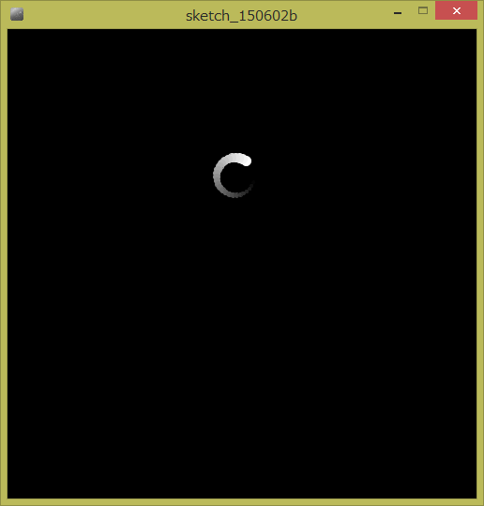
Circle trail around mouse
First draw one circle and make it rotate (old)
Then, draw X circles behind that one!
for loop: on # of circles (int), not on angle
Make the circle fade out
Make the circle shrink

Slide 380
For loop pitfalls
for (int i= 0; i>= 10; i++)
{
// do something
}
Loop is never run, because the test is false

Slide 381
For loop pitfalls
for (int i= 0; i<= 10; i--)
{
// do something
}
Loop keeps running because i doesn’t get > 10

Slide 382
For loop pitfalls
for (i= 0; i<= 10; i++)
{
// do something
}
The variable i is never declared

Slide 383
sum the odd numbers up until 50
→ iterate over all the odd numbers from 1 to 50
for (initializer; condition; update)
initializer?
set a variable to 1, the first odd number
int i = 1;
condition?
loop while the variable is less than or equal to 50
i <= 50;
update?
increment i by 2 to get the next odd number
i+=2
for (int i = 1; i <= 50; i += 2)
sum += i;

Slide 384
count backwards with a for loop!!
what if you want to do…
for i from 20..1?
initializer: set i to the largest number
int i = 20;
condition: loop while i is bigger than or equal to 1.
i >= 1
update: reduce i by 1
i--
for (initializer; condition; update)
for (int i = 20; i >= 1; i--)
pritnln(i);

Slide 385

Exercise: Use a for loop to implement the following:
Space 50 pixels apart
Make x get bigger by 50
each time in the loop

Slide 386
Example: rose art, all at once
X = cos(k*t)*cos(t)*scale+250;
Y = cos(k*t)*sin(t)*scale+250;
k determines number of petals
As t goes from 0 to 2..PI, x and y draw a shape
Previously, t increases each time we draw. We see the rose petal get drawn.
Instead, draw the whole petal using a for loop
k is the number of petals
Draw lines through the x,y points as t goes from 0..２ＰＩ

Slide 387
How to make t go from 0..2PI with a for loop?
0..2PI is a continuous range.
How often should you stop in that range? Computers are not continuous, we need to specify this
Specify number of steps, and use that to setup the for loop.

Slide 388
Example: rose art, all at once
For 0<=i<steps:
t = i/(steps-1)*2PI;
X = cos(k*t)*cos(t)*scale+250;
Y = cos(k*t)*sin(t)*scale+250;
Play with parameters

Slide 389
Example: put string out one character at a time
Select spacing
Off by one errors!
Increase spacing
Link spacing to mouse

Slide 390
While loops

Slide 391
while loop
while (booleanCondition) { // is true
repeatTheseCommands;
repeatTheseCommands;
}
e.g., :
int i = 2;
while (i < 10) {
i++;
}
everything between the brackets gets repeated again and again while the condition is true.
println(i); // is i 10 or 9?

Slide 392
the while loop:
count to 1000
setup like an if statement
change the if to while
int i = 1;
while (i < 1000) {
println(i);
i++;
}
int i = 1;
if (i < 1000) {
println(i);
i++;
}

Slide 393
just like the if, put multiple statements in the while loop
while (booleanCondition)
{
statementA;
statementB;
}
this entire block gets repeated while the booleanCondition is true

Slide 394
once inside the loop, the condition does not get checked again until the end
int i = 1;
while (i < 10) {
println(i);
i++;
println(0);
}
the “and” gets print out even after the last #

Slide 395
The while loop has four general parts
while loop
int i = 1;
while (i <= 10) {
println(i);
i++;
}
priming
test
body
upkeep

Slide 396
for loop and while loop are similar…
for loop
for (i = 1; i <= 10; i++) {
println(i);
}
while loop
int i = 1;
while (i <= 10) {
println(i);
i++;
}

Slide 397
general usage of loops:
for loops : repeating something a certain number of times, e.g.,
going over every student record and calculating letter grades
going over a range of numbers for a calculation on each one
while loops: iteration count unsure, keep looping until a condition is met, e.g.,
you are not sure ahead of time how many times to loop
checking a network connection
choosing the wrong loop is not a big deal, you can easily fix it.

Slide 398
Example: random ball path
If a ball starts at the mouse, and moves randomly, what path will it take to get off the screen?
We can do this already
  Each time we draw, move the ball, and draw a dot.
  Don’t clear -> we get a path.
BUT! What if we want to draw the whole path in a frame?
- how many random movements will it take to get off the screen?
- if we knew how many, we could do a for loop
- but we don’t know how many -> while loop

Slide 399
Random ball path: algorithm
Draw:
if the mouse is pressed:
place a ball at the mouse position
clear the screen
while the ball is still on the screen
do a random movement
draw a point to represent the ball

Slide 400
Implement the skeleton without the while…
Then setup the while loop
- boolean variable for on screen
- test the variable
this doesn’t work!! Why??
We need the loop upkeep!

Slide 401
exercise: infinite loop?
for (int i = 1; i > 0; i++) // infinite loop?
{
; // do nothing
}
background(255);
line(0,0,mouseX,mouseY);
is this an infinite loop?
lets test

Slide 402
!(infinite loop):
for (int i = 1; i > 0; i++) // infinite loop?
{
; // do nothing
}
this is not an infinite loop because i cannot get infinitely large. It is limited by the memory of the int data type. Once it hits the largest limit, adding one will make it “roll over” to the smallest value, making it less than 0.

Slide 403
final float MAX_SPEED = 10;
final float BALL_SIZE = 5;
void setup()
{ size(500, 500); }
void draw()
{
stroke(255); fill(255);
if (mousePressed)
{
background(0);
float ballX = mouseX; float ballY = mouseY;
boolean onScreen = ballX >= 0 && ballX < width && ballY >= 0 && ballY <= height;
while (onScreen)
{
float move = random(2*MAX_SPEED)-MAX_SPEED;
ballX += move;
move = random(2*MAX_SPEED)-MAX_SPEED;
ballY += move;
ellipse(ballX, ballY, BALL_SIZE, BALL_SIZE);
onScreen = ballX >= 0 && ballX < width && ballY >= 0 && ballY <= height;
}
}
}

Slide 404
parts of the while loop
boolean onScreen = (ballX >= 0 && ballX < width) &&
(ballY >= 0 && ballY < height);
while (onScreen)
{
…
onScreen = (ballX >= 0 && ballX < width) &&
(ballY >= 0 && ballY < height);
}
PRIMING
test
upkeep
note that the priming and upkeep are often the same or very similar
also note that the test is directly related to the upkeep / priming

Slide 405
priming + maintenance is annoying…
A new kind of loop! the do-while loop!
do {
statement;
} while (booleanCondition);
while (condition) {
statement;
}
in the while loop, if the condition is false, the statement is never executed.
note: in the do-while loop, the statement is executed BEFORE the while test – the statement is always executed at least once.

Slide 406
Problem?
int i = 1;
int j = 1;
while (i < 1000) {
println(i+j);
j++;
}
j will keep getting larger but i will not change
If your condition is never false, it never stops!
Never False!

Slide 407
Problem?
int numTimes = 0;
while (numTimes <= 10)
{
println(numTimes);
}
no upkeep
if you don’t update numTimes, the loop never ends!!
Never False!

Slide 408
Problem?
int i = 10;
while (i > 100) {
println(i);
i--;
}
this loop is run 0 times.

Slide 409
problem?
boolean onScreen;
while (onScreen)
{
…
onScreen = (ballX >= 0 && ballX < width) &&
(ballY >= 0 && ballY < height);
}
not priming the loop
can’t test “onScreen” if it has never been assigned a value
Wont compile!

Slide 410
End of while loops
While loops are used when you don’t know how many times you need to loop.
You just need to setup the end condition.
For loops are more practical when you know how many times to loop

Slide 411
Example: count number of digits
If we draw a number on screen, then knowing the number of digits is useful
larger numbers can be made smaller to fit
But how to count the number of digits?

Slide 412
First, program setup
Number variable, increase by mouseX each time (grows nicely)
Draw the text at 0,height-1 (bottom left).
Text size is 1.5*width/digits (scales with digits)

Slide 413
Count digits?
Trick:
number = 1234;
number /= 10; // integer division, now 123
number /= 10; // now 12.
Dividing by 10 strips a digit
What happens at the end?
number /= 10; // now 1
number /= 10; // now 0
number /= 10; // still 0

Slide 414
Loop setup:
While number isn’t 0, divide by 10, and count the digits we have stripped

Slide 415
but wait! a special case! what happens if the number is 0?
How many digits?

Slide 416

!!! special case !!!
note: in computer programming you will often find special cases that break your algorithm. D’oh! Either you fix your algorithm to remove the special cases, or, you handle the special cases separately.
if there is only one or two special cases they are often handled with if statements. if you have many special cases, may be time to re-think your algorithm.

Slide 417
#13, advanced loops
Loops practice, nested loops

Slide 418

Example: Calendar
Setup globals
CAL_TOP (50)
CAL_LEFT (50)
CAL_DAYS (31)
CAL_SPACE (60)
TEXT_SIZE (30)
Draw header row.

Slide 419
Draw calendar numbers
Single for loop through days
Day -> row, column mapping?
Integer arithmetic

Slide 420
day | d/7 | d%7 |  | d/7 | d%7 |  | d/7 | d%7
1 | 0 | 1 | 11 | 1 | 4 | 21 | 3 | 0
2 | 0 | 2 | 12 | 1 | 5 | 22 | 3 | 1
3 | 0 | 3 | 13 | 1 | 6 | 23 | 3 | 2
4 | 0 | 4 | 14 | 2 | 0 | 24 | 3 | 3
5 | 0 | 5 | 15 | 2 | 1 | 25 | 3 | 4
6 | 0 | 6 | 16 | 2 | 2 | 26 | 3 | 5
7 | 1 | 0 | 17 | 2 | 3 | 27 | 3 | 6
8 | 1 | 1 | 18 | 2 | 4 | 28 | 4 | 0
9 | 1 | 2 | 19 | 2 | 5 | 29 | 4 | 1
10 | 1 | 3 | 20 | 2 | 6 | 30 | 4 | 2
Draw text at each row, col.

Slide 421
Highlight selected cell
If a cell is clicked on, it gets selected and stays selected
But how to keep track?

Slide 422
Highlight selected cell
Global variable – selected!
Default day?
set to impossible
When drawing days, test if selected is the day
if so, highlight

Slide 423
How to select with mouse?
At each calendar spot, calculate left, right, top, bottom
Check if the mouse is within that, AND, the button is clicked

Slide 424
At home:
Let the user deselect the cell by clicking, but not a day

Slide 425
Debug!!! Header disappears if you click last day
final int CANVAS_SIZE = 500;
final int CAL_TOP = 50;
final int CAL_LEFT = 50;
final int CAL_DAYS = 31;
final int CAL_SPACE = 60;
final int TEXT_SIZE = 30;
int selected = 10;
void setup()
{
size(CANVAS_SIZE, CANVAS_SIZE);
textSize(TEXT_SIZE);
}
void draw()
{
background(0);
int x = CAL_LEFT;
int y = CAL_TOP;
String s = "S";
text(s, x, y);
x += CAL_SPACE;
s = "M";
text(s, x, y);
x += CAL_SPACE;
s = "T";
text(s, x, y);
x += CAL_SPACE;
s = "W";
text(s, x, y);
x += CAL_SPACE;
s = "R";
text(s, x, y);
x += CAL_SPACE;
s = "F";
text(s, x, y);
x += CAL_SPACE;
s = "S";
text(s, x, y);
// draw the numbers
for (int i = 1; i <= CAL_DAYS; i++)
{
int row = i/7+1;
int col = i%7;
x = col*CAL_SPACE+CAL_LEFT; // left
y = row*CAL_SPACE+CAL_TOP; // bottom
int top = y-CAL_SPACE;
int right = x+CAL_SPACE;
if (mouseX>x && mouseX < right &&
mouseY>top && mouseY < y && mousePressed)
{
selected = i;
}
if (selected == i) // current day is sel
{
fill(255);
rect(x, y-CAL_SPACE, CAL_SPACE, CAL_SPACE);
fill(0);
} else { // not selected
fill(255);
}
text(i, x, y);
}
}

Slide 426
Calendar Exercises:
Exercise: set which day of the week the calendar starts on
Exercise: fix the highlighting to be better centered around the number
Exercise: highlight Sundays and Wednesdays on the calendar

Slide 427

More loops???

Slide 428
NESTED LOOPS
note: as a code block acts just like any other code, you can put a loop or if statement inside of any loop or if statement
nested just means one thing inside another.
super confusing but common

Slide 429
what about…
int count = 0;
for (int i = 0; i < 10; i++) {
for (int j = 0; j < 10; j++) {
count++;
}
}
What happens?
The computer goes step by step.
Starts the first for loop, over “i”.
When i is 0, the j loop starts. The j loop completes in entirety while i is 0.
i gets increased to 1..
repeat

Slide 430
count
int count = 0;
for (int i = 0; i < 10; i++) {
for (int j = 0; j < 10; j++) {
count++;
}
}
println(count);
How many times will the outer loop run? (i)
How many times will the inner loop run? (j)
note: the i loop will iterate 10 times. Each time the j loop is invoked it will run 10 times. The j loop is invoked 10 times, once per iteration of the I loop. Therefore, the j loop iterates 100 times. count == 100

Slide 431
Test- do a println trace
for (int i = 0; i < 10; i++) {
for (int j = 0; j < 10; j++) {
println(i);
}
}
print j

Slide 432
Use a nested for loop to draw size 2 ellipses on a grid
Make one loop go through all the columns
For each column, go through all the rows
Turn the column,row position into x,y
Draw an ellipse

Slide 433
Visual trace to think about the loops
Draw a line from the last x,y to the current one to visualize how the row and column variables change
What happens if we reverse the row/col for loops?

Slide 434

Nested loop example
Pick a random number up to MAX
If the roll is a 0, we’re done. While it’s NOT zero,
  Pick another random number.
  Draw 5 lines from random locations to the mouse.

Slide 435
Nested loop example
This program will act unpredictably – it will pause a random amount of time, and draw more lines the longer it pauses.
Pause – busy loop (bad idea!)

Slide 436
Example: raster graphics
Set each pixel on the canvas separately, to make complex images
Setup a nested for loop to go through every pixel:
first a loop through the x,
then a loop through the y
set to some color

Slide 437
Slow!!
Speedup methods
noSmooth() in setup
smaller screen

Slide 438

Make the color depend on the distance to the mouse
Reminder:
distance=$\sqrt{{(mouseX−x)}^{2}+{\left(mouseY−y\right)}^{2}}$
Use helper variables to simplify it
New command: sqrt!
float sqrt(float);
Set the color to the distance
Use mod to wrap it around

Slide 439
Play with the color formula..
float c = (dist*dist)%256;
float c = (dist*x)%256;
float c = (dist+x-y)%256;
float c = (dist*x/(y+1))%256

Slide 440
Play with the color formula..
Use color!
Red – absolute x distance of mouse from point
  x – mouseX
    What if it’s negative? We want distance
      abs(number) – absolute value
Green – absolute y distance of mouse from point

Slide 441

Example: basic tic-tac-toe board
Setup variables
board grid
board size
tile size
boardCenterX,Y
Board Left / Top

Slide 442
Setup the for loops
Iterate over tiles i (width), j (height)
Calculate left and top of each tile
Place a rectangle at the tile location

Slide 443
Is the mouse inside any of the tiles?
Update the for loop – while drawing, check to see if the mouse is inside
Add helper variables: right, bottom
Basic logic:
if mouse is to the right of left wall
to the left of the right wall
below the top wall
above the bottom wall
Change the color

Slide 444
exercise
Try drawing X and O instead of changing the color

Slide 445

For loop and boolean exercises
Draw a dice face
First, setup globals
diceGrid
diceSize
diceSpacing
left
top
dotSize

Slide 446
For loop for dice
Setup the nested for loop iterating over i,j and draw a dot grid.
Use boolean logic to do one diagonal – a three!

Slide 447
Two diagonals for a 5
Other diagonal?
Combine with an OR
i (x) | 2-i | j (y)
0 | 2 | 2
1 | 1 | 1
2 | 0 | 0

Slide 448
exercise
Do the other common dice faces

Slide 449
#14, User-Defined Functions, Pat 2
Sending and receiving data from function, common function pitfalls, practice examples

Slide 450
function parameters

Slide 451
Reusing code…
drawRandomSquares – great!
what if we want variation?
draw different sizes?
draw different colors?
We need to give parameters to the function.

Slide 452
Send data to a function-> parameters
instead of
drawRandomSquares();
You want to do:
drawRandomSquares(20); // max size
Or
drawRandomSquares(20, 255); // max size, color
the numbers are parameters

Slide 453
Send data to a function-> parameters
void functionName (parameterType parameterName)
You can add parameters to the function
void drawRandomSquares() {
..
}
void drawRandomSquares(int size) {
..
}

Slide 454
user-defined functions: syntax
void methodName (parameterType parameterName)
{
…//processing code;
}
function
header
function
body

Slide 455
How to use parameters inside a function?
void drawRandomSquares(int size) {
println(size);
}
the parameters become local variables
data from outside is copied into the size variable and you can use it within the function just as any other variable.
Update drawRandomSquares

Slide 456
function parameters and… data is always copied
void changeData(int data) {
data = data * 2;
}
void draw()
{
int data = 4;
changeData(data);
println(data);
}
the information is copied
here. inside the function you
only have a copy. changes here
do not reflect back!

Slide 457
Variant - keep tunnel vision!!!!!!
this variable name “data”
is important for inside the function
only. not related to how function is used
void changeData(int data) {
data = data * 2;
}
void draw()
{
int number = 4;
changeData(number);
println(number);
}
because information is copied, the
“caller” can give a literal, a variable,
do calculations, etc… NAME is irrelevant

Slide 458
another example…
make a function called statusPrint which prints a String message surrounded by -- and with its length appended in parenthesis. Print it in the bottom left corner
: e.g.,
if you call:
statusprint (“Hi!”);
it will print:
-Hi!- (3)

Slide 459
multiple parameters
a function can have as many parameters as you like, and they can be of different types!!
Let’s update drawRandomSquare to also take the color

Slide 460
multiple parameters – just use commas.
void drawRandomSquare(int maxSize, int color) {
…
}
you can mix types, e.g., have a double, a String, etc.
you can have as many parameters as you want, usually <= ~3

Slide 461
Another example…
Let’s make a program with squares moving randomly around the screen – bad guys!
1 bad guy:
Global variables
finals: max move size (20), bg color
bad guy color,
others: size, x and y

Slide 462
Make random moves
Separate x and y
- can move left or right by max move
- so range of movement is –max…max
- If 20, then 40 possible positions (41?)
- how to generate this as a random number?
- random(2*max)-max -> -max...max
See the repetition? Hmm.

Slide 463
Make sure doesn’t move off the edges of the screen
Use ifs, or min and max
Draw the badguy – set the stroke and fill colors, too

Slide 464
Scale to three bad guys!!!
What a mess…

Slide 465
Use functions to simplify and reduce repeated code
New function!
drawBadGuy(x, y, size, color);
Draw block is now a little simpler… but still a lot of code being repeated..

Slide 466
Can we make a command like..
moveBadGuy(x, y)
moveBadGuy(badGuy1X, badGuy1Y)
No – since data is only copied in, any changes that happen in that function are not reflected back in our variables. It is thrown away.

Slide 467
What functions give us data back?
What do they look like?
max, min, random…
int result = max(10,4);

Slide 468
Functions can only return one piece of data
They can give you an integer,
A float
A String
Etc.

Slide 469
Send data back from a function:
let’s make a function myMax(int a, int b) which gives us an integer to represent the largest of the two:
int bigger = myMax(5, 2); // expect 5 to be the answer
first – let’s implement this using the tools we already have
we can calculate important information – but how do we send it back?

Slide 470
Send data back from a function:
returnType functionName (parameterType parameterName)
int myMax(int a, int b)
{
int result = a;
if (b>a)
result = b;
return result;
}
the return command does two things:
- it ends the function and returns to where it was called from
- it passes data along from the function to the caller
be careful! the types have to match- the return type of the method, and, the data you are returning.

Slide 471
user-defined functions: syntax
int myMax(int a, int b) {
int result = a;
if (b>a)
result = b;
return result;
}
…
int max = myMax(10,20);
these are “local variables”, only exists
within the function. this name is not
related to how you can use the function

Slide 472
user-defined functions: syntax
int myMax(int a, int b) {
int result = a;
if (b>a)
result = b;
return result;
}
…
int max = myMax(10,20);

Slide 473
Exercise:
Make a function to calculate the distance between two points.

Slide 474

another XKCD comic
remember random()??
how would you implement your own? tough..

Slide 475
Back to our badguy example
final int MAX_MOVE = 20;
final int BG_COLOR = 0;
int badGuy1Size = 20;
int badGuy1Color = 255;
int badGuy1X = 0;
int badGuy1Y = 0;
int badGuy2Size = 40;
int badGuy2Color = 100;
int badGuy2X = 0;
int badGuy2Y = 0;
int badGuy3Size = 5;
int badGuy3Color = 180;
int badGuy3X = 0;
int badGuy3Y = 0;
void setup()
{
size(500,500);
}
void drawBadGuy(int x, int y, int size, int col)
{
fill(col);
stroke(col);
rect(x, y, size, size);
}
void draw()
{
background(BG_COLOR);
// bad guy 1
int move = (int)(random(MAX_MOVE*2)-MAX_MOVE);
badGuy1X += move;
badGuy1X = min(badGuy1X, width-1);
badGuy1X = max(badGuy1X, 0);
move = (int)(random(MAX_MOVE*2)-MAX_MOVE);
badGuy1Y += move;
badGuy1Y = min(badGuy1Y, height-1);
badGuy1Y = max(badGuy1Y, 0);
drawBadGuy(badGuy1X, badGuy1Y, badGuy1Size, badGuy1Color);
// bad guy 2
move = (int)(random(MAX_MOVE*2)-MAX_MOVE);
badGuy2X += move;
badGuy2X = min(badGuy2X, width-1);
badGuy2X = max(badGuy2X, 0);
move = (int)(random(MAX_MOVE*2)-MAX_MOVE);
badGuy2Y += move;
badGuy2Y = min(badGuy2Y, height-1);
badGuy2Y = max(badGuy2Y, 0);
drawBadGuy(badGuy2X, badGuy2Y, badGuy2Size, badGuy2Color);
// bad guy 3
move = (int)(random(MAX_MOVE*2)-MAX_MOVE);
badGuy3X += move;
badGuy3X = min(badGuy3X, width-1);
badGuy3X = max(badGuy3X, 0);
move = (int)(random(MAX_MOVE*2)-MAX_MOVE);
badGuy3Y += move;
badGuy3Y = min(badGuy3Y, height-1);
badGuy3Y = max(badGuy3Y, 0);
drawBadGuy(badGuy3X, badGuy3Y, badGuy3Size, badGuy3Color);
}

Slide 476
How can we simplify this?
// bad guy 1
int move = (int)(random(MAX_MOVE*2)-MAX_MOVE);
badGuy1X += move;
badGuy1X = min(badGuy1X, width-1);
badGuy1X = max(badGuy1X, 0);
move = (int)(random(MAX_MOVE*2)-MAX_MOVE);
badGuy1Y += move;
badGuy1Y = min(badGuy1Y, height-1);
badGuy1Y = max(badGuy1Y, 0);
See similarities? What if we call a function once for X and once for Y… something like
badGuy1X = doMove(badGuy1X, 0, width-1);
badGuy1X = doMove(badGuy1Y, 0, height-1);

Slide 477
Make the function
int move = (int)(random(MAX_MOVE*2)-MAX_MOVE);
badGuy1X += move;
badGuy1X = min(badGuy1X, width-1);
badGuy1X = max(badGuy1X, 0);
…
badGuy1X = doMove(badGuy1X, 0, width-1);
badGuy1Y = doMove(badGuy1Y, 0, height-1);
Header:
int doMove(int position, int minimum, int maximum)
Body:
copy the above but use the local variables

Slide 478
Rewrite the main code

Slide 479
Careful! using non-final globals in a function!!
- hard to keep track of
- doesn’t scale well to larger programs
A function should accept changing, specific data as parameters
A function should return data through the return mechanism.
Be very very careful if your function is going to touch any global variables, as other code will need to expect those to change based on your function.

Slide 480
get data back from a function call by “return”ing it!
Specific data
comes in!
double addTax(double price) {
price = price * TAX_RATE;
return price;
}
Preferred way for data to come back!

Slide 481
function parameters and variables… data is always copied
double addTax(double price) {
price = price * 1.12;
return price;
}
void draw()
{
double lunch = 5.00;
println(addTax(lunch));
println(lunch); // what is output?
}
the information is copied
here. inside the method you
only have a copy. changes here
do not reflect back!
the information is copied
here.

Slide 482
function parameters and variables… data is always copied
double addTax(double price) {
price = price * 1.12;
return price;
}
void draw()
{
double lunch = 5.00;
println(addTax(lunch));
println(lunch); // what is output?
}
the output is 5.0. Although
the function modifies the
price variable, since only a
copy was passed in, the
original was unchanged!

Slide 483
keep tunnel vision…..
forget the rest of your program and solve only the simpler problem in front of you……
double addTax(double price) {
//….
return?
}
think: I have “price”, and need to return a double
The rest of the program is irrelevant!

Slide 484
functions can call each other!
you can call user-defined methods from anywhere – even inside other methods!
make a program that tests if a string is a palindrome!
palindrome: a word that is spelt the same forwards as backwards
algorithm: reverse a word and compare it to the original

Slide 485
program structure
draw
boolean isPalindrome(String)
String reverseWord(String)

Slide 486
Palindrome tester
Reverse a string
Compare against original
If equal – palindrome!

Slide 487
How to reverse a string? (tricky)
Go through string with a for loop
Get each character
Add to a new string in the opposite order

Slide 488
Stand alone functions, or, those that change globals
**confusing**

Slide 489
Stand alone functions
all data comes in through parameters
all data goes out
completely stand alone
only touch globals to read constants
do not modify globals
makes the function easy to use: you don’t have to worry about side effects.
If you run the function, what else changes?

Slide 490
Functions that change globals
can grab data from globals, not parameters
can modify globals that are not specified by the return
when someone runs it, it can have side effects
makes the function hard to use since you need to know what all the impacts will be
use these to break your big code into smaller chunks, but they all work together

Slide 491
Divide and conquer

Slide 492
divide and conquer
Divide and Conquer: a great way to break up a complex programming problem into smaller steps
as your programs get longer and longer, this provides a method to enable you to focus on one piece at a time.

Slide 493
Assuming these commands work, everything makes sense
Think of the program as a high-level flow
Overview of the program, in
Your draw loop..
Details on the right

Slide 494

Example problem: spaceship shooter
The space ship is linked to the mouseX.
If the mouse button is pressed, the ship fires a bullet up.
If the user clicks while a bullet is flying, nothing happens.
If a bullet hits the bad guy, game over
Divide and conquer:
think about the problem in English first.
turn these steps into new commands
focus on one element at a time

Slide 495
Let’s implement our sample problem
step 1: write the program as a series of steps in comments, in English
2: turn each step into a function name (command)
3: create the empty functions
4: start implementing the functions

Slide 496
Steps…
Draw a title at the top of the screen
Move and Draw the spaceship
Check If the spaceship should shoot, and if so, start a bullet
Move and Draw the Bullet
Move and Draw the bad guy
Check if the bullet hit the bad guy, and if so, stop the game
Draw “WIN” if the game is over.

Slide 497
Let’s implement our sample problem
step 1: write the program as a series of steps in comments, in English
2: turn each step into a function name (command)
3: create the empty functions
4: start implementing the functions

Slide 498
Turn these steps into commands
//Draw a title at the top of the screen
drawTitle();
//Move and Draw the spaceship
moveAndDrawShip();
//Check If the spaceship should shoot, and if so, start a bullet
checkAndDoShoot();
//Move and Draw the Bullet
moveAndDrawBullet();
//Move and Draw the bad guy
moveAndDrawBadGuy();
//Check if the bullet hit the bad guy, and if so, stop the game
checkBulletHit();
//Draw “WIN” if the game is over.
drawWinMessage();

Slide 499
Let’s implement our sample problem
step 1: write the program as a series of steps in comments, in English
2: turn each step into a function name (command)
3: create the empty functions
4: start implementing the functions

Slide 500
Assuming these commands work, everything makes sense
Think of the program as a high-level flow
Overview of the program, in
Your draw loop..
Details on the right

Slide 501
Let’s implement our sample problem
step 1: write the program as a series of steps in comments, in English
2: turn each step into a function name (command)
3: create the empty functions
4: start implementing the functions

Slide 502
divide and conquer problem…
dice game:
make an automatic gambling game simulator
- throw six sided dice
- update balance based on roll
- 1 – you 1.1x your money
- 2 – you get 1.2x your money
- 3 – you get 1.3x your money
- 4 – you get 1.4x your money
- 5, 6 – you lose 35% of your money
start with $10 and stop when you either reach $1000 or drop below $2

Slide 503
another example (at home, use divide and conquer! TOUGH)
take a string, and reverse every word in the string, but keep the word order.
“this is a string”
“siht si a gnirts”

Slide 504
user-defined functions!!
save time by writing something once, and using it again and again!
clean up code by making smaller, easy-to-understand chunks
makes code easier to read and understand!
it gives a name to your operations

Slide 505
#15, Compiling and the Java Virtual Machine
How a computer goes from you Processing program to computer language

Slide 506
Compiling and the Java Virtual Machine!!
what does this mean, anyway??
Processing is basically Java

Slide 507

computers can only understand binary!!
binary is a counting system that only has 0s and 1s.
“It was just a dream Bender, there’s no such thing as two.”

Slide 508
computers cannot understand programing languages like Processing!
programming languages are designed for people
float left = 100;
float top = 100;
float dotSize = 50;
void setup()
{
size(canvasSize,canvasSize);
}
human-readable computer code
compiler
a compiler program can read human-readable code, and translate to machine language
1010100110101001010100100010001010111010011010101000100110101001010100100010001010111010011010101010101010010101
computers do not know how to execute human-readable code.
machine language

Slide 509
compilers are necessary
note: a program must be compiled before it can be run by a computer. When you buy software or download a program, it is usually already compiled and packaged to run.

Slide 510




complication…
different computers speak different languages..

Slide 511

there are many machine languages
float left = 100;
float top = 100;
float dotSize = 50;
void setup()
{
size(canvasSize,canvasSize);
}
human-readable computer code
iPhone compiler
mac compiler
PC compiler
iPhone machine language
mac machine language
PC machine language

Slide 512
Not scalable
what if a new platform is introduced??
for new platforms, you need to make a new compiler to convert human-readable code to machine code
EVERY program must be re-compiled, debugged, updated, to make it work

Slide 513
solution: a virtual machine
rather than compiling a program to run on a specific machine, we compile a program to run on some imaginary virtual machine.
float left = 100;
float top = 100;
float dotSize = 50;
void setup()
{
size(canvasSize,canvasSize);
}
human-readable computer code
virtual machine compiler
?????
virtual machine language
virtual
machine

Slide 514

JAVA has virtual machine programs, or emulators, for many platforms!
A virtual machine program can read and execute (run) virtual machine code
human-readable computer code
virtual machine compiler
virtual machine language
Windows Java Virtual Machine Program
MAC Java Virtual Machine Program
PS3 Java Virtual Machine Program

Slide 515
scalable!
what if a new platform is introduced??
for new platforms, you need to make a new Java virtual machine
Then, all your existing Java programs will run!! no need to recompile them!
Wii Java Virtual Machine Program

Slide 516
terminology and convention
human-readable computer code
processing file
Source code
store a program written in the programming language in this file
virtual machine compiler
Java compiler
many versions! Sun (inventors), Eclipse compiler, others…
virtual machine language
Java byte-code
machine instructions for the virtual machine – not human readable
virtual machine language file
.class file
produced by the Java compiler, not human readable. Gets run on the virtual machine
Targeted Java Virtual Machine Program
JVM – Java Virtual Machine
specific to your platform (windows, etc..). Many versions available

Slide 517
Where does Processing fit in???
human-readable computer code
processing file
Processing compiler
Java code
virtual machine compiler
Java compiler

Slide 518
summary
programming languages are designed for humans – computers cannot understand them
a compiler converts human-readable programming into platform-specific machine language
the Processing compiler converts your program into Java
the Java compiler converts a Java program into Java byte code- the machine language for the Java Virtual Machine (JVM)
the Java byte code can be run on any JVM – these are available for many computers / platforms.

Slide 519
things to do!
just understand the basic concepts of the JVM and what compiling is

Slide 520
#16, Array Basics
Introduction to arrays, declaring and instantiating arrays, using arrays, iterating through arrays, getting the length of an array, literal array initialization

Slide 521


arrays!

Slide 522
Let’s make a program:
A particle (point) shoots away from the mouse at a random speed in X and Y (== random angle)
If it hits the edge of the screen, start over with a new random speed

Slide 523
Let’s update.. 3 points
Requires copy-paste variables
Repetition of code – can clean up a little with methods, but there is a limit to this
What if I want 50? 1000?
- not feasible

Slide 524
what is an array?
an array is simply an ordered list of data of a given type:
you can have an array of 100 ints
you can have an array of 10,000 Strings
you can have an array of 5 chars
Arrays are essential to programming and you will use them often!

Slide 525
we’ve actually seen the array before…
A Processing String, underneath, is an array of characters:
this is an array of characters, of length 8.
note that each box (item) in the array has its own index!! (String.charAt(index))
S P R O C K E T
char
2B
char
2B
char
2B
char
2B
char
2B
char
2B
char
2B
char
2B
0
1
2
3
4 5 6 7

Slide 526
the Array!
note: an array is a list of data of a given type. You can make an array of any data type!
here is an array of 4 integers:
as with strings, each box has its own unique index:
also as with strings, the first index is 0
int (4B)
int (4B)
int (4B)
int (4B)
0 1 2 3

Slide 527
Arrays have a fixed length
Array length cannot change!
You decide the length when you create an array
You cannot grow or shrink it
What if you need an array to grow or shrink?
(classic final exam question)
Make a new one of the right size and copy your data
int (4B)
int (4B)
int (4B)
int (4B)
0 1 2 3

Slide 528
Ａｒｒａｙｓ are homogenous
note: an array only has a single type, types cannot be mixed:
you cannot create an array like this:
choose your array type carefully because you are stuck with it!!
int (4B)
char (2B)
float (4B)
int (4B)
0 1 2 3

Slide 529
Syntax!
creating an array has two steps:
1. declare the variable container for the array
2. create the array (allocate memory) and assign it to the container.
1:
type [] variableName; // type is any Processing type.
double [] studentScores;
String [] studentNames;
note: square brackets: []. this marks an array
note: you do not tell how large (how many boxes..) your array is at this point!!

Slide 530
once variable is declared, have to make the array…
2. create the array (allocate memory) and assign it to the container
variableName = new type [arraySize];
double[] studentScores;
studentScores = new double[30];
combined declaration and creation is very common:
int[] studentAges = new int[30];
note: once an array is created it CANNOT be resized. choose your size wisely!!

Slide 531
examples of declaration and instantiation
declaration instantiation
double [] gameScores = new double[5000];
String [] blogComments = new String[200];
long [] bigNumbers = new long[100];
note: must both declare the variable and instantiate the array.

Slide 532
using the array
int[] numbers = new int[10]; // array of 10 ints
you can access any bin in the array just by putting it in square brackets:
numbers[0] ← first int in the array
numbers[5] ← sixth int in the array
numbers[9] ← last…
numbers[10] ← ???
this will raise an error: index out of bounds

Slide 533
accessing array bins
store values:
variableName[bin] = value;
studentScores[15] = 20;
studentScores[0] = 15;
retrieve values
int i = studentScores[15];
if (studentScores[i] > 90) message = “woohoo”;
can be used anywhere a normal value can be used!
studentScores[15] = studentScores[14]*2;

Slide 534
array bins:
double[] values = new values[100]; // 100 bins
values[3] to access 4th bin (bin 3).
you can use a literal (e.g, 3, 4) or a variable as the bin index:
int i = 5;
values[i] to access bin i
the index MUST BE AN INTEGER TYPE
values[5.5] ← doesn’t make sense
values[“yo!”] ← doesn’t make sense
values[false] ← doesn’t make sense
0
1
2
3
…
99

Slide 535
example:
make an array of integers of size three, and put three numbers into it: 10, 40, 5
10 40 5
int (4B)
int (4B)
int (4B)
0 1 2

Slide 536
Example cont…
make an array of Strings of size three, and put three messages into it: “woah!” “hey there” “nice day”
hey there
nice day
Woah!
String
String
String
0 1 2

Slide 537
Example cont…
Use the arrays to print out the three messages at different locations

Slide 538
Good progress-
Only made one variable, not three
But still copy pasted code.. Any ideas?
Use a for loop to go through the array bins 0,1,2
Change sizes[0] to sizes[i]

Slide 539
Add two more lines
Two things:
- make the arrays bigger
- store the new data
And everything else still works.

Slide 540
Example:
Make arrays of size 8, one for x, one for y
- fill it with 8 random points at program start
- draw lines from the mouse to those points
- if the mouse is pressed, make new random points
Scale up to 1000;

Slide 541

Update: draw a bounding box, a box that fits the points as best as possible
Including the mouse
Find the smallest X and Y of all the points. This is the top left
Find the largest X and Y of all the points. This is the bottom right

Slide 542
Algorithm – smallest in array
Make a variable for smallest
Assume mouse is smallest
Go through array – check if that new number is smaller – if so, save it. (use existing for loop)
Do the same for largest.

Slide 543
Example: mouse explosion!
float particleX = -1;
float particleY = -1;
float speedX = 0;
float speedY = 0;
final int MAX_SPEED = 5;
void setup()
{
size(500, 500);
}
void draw()
{
background(0);
if (particleX < 0 || particleX >= width ||
particleY < 0 || particleY >= height)
{
particleX = mouseX;
particleY = mouseY;
speedX = random(MAX_SPEED*2)-MAX_SPEED;
speedY = random(MAX_SPEED*2)-MAX_SPEED;
}
particleX += speedX;
particleY += speedY;
ellipse(particleX, particleY, 10, 10);
}

Slide 544
Update this to use arrays
First, make a new global to decide how many balls
Then, upgrade the variables to arrays
Every time we use that variable, we now need to use arrays
instead of doing something just once, we need to do it per array bin.
use a for loop

Slide 545
length of the array?
How long are you, Mr. array?
0
1
2
3
…
X
arrayName.length!!
X+1!
Processing provides a mechanism for giving us the length of an array:
variableName.length
int[] numbers = new int[100];
println(numbers.length); // result?
notice!! no () why is this?
.length is not a method, it is a property
you will learn more about this later, but for now, remember that array length has no ().

Slide 546
array length vs string length
to get the length of a string:
stringVariable.length(); // method call
arrayVariable.length; // property
note: this is VERY annoying. have to memorize ☹
0
1
2
3
…
X
int[x]
.length!!
X+1!
X+1!
t h i s … s
.length()!!
0
1
2
3
…
X
String s

Slide 547
safety
using arrayVariable.length is SAFER because you cannot make a mistake about the length of the array
- you don’t need to remember the length, just ask for it.

Slide 548

Make it rain
Make the drops evenly spread out
Make one array of 500:
bin number is x coordinate
value stored is y coordinate
Calculate a random y for each point.

Slide 549
Initialize in startup code
- set the bins to random values (height)

Slide 550
Draw!
Go through each rain drop
x is i
y is data in the bin
use the length of the drop
draw the drop!

Slide 551
Animate!!
Add some y value.

Slide 552
Animate!! Make it look layered
Let’s make it look layered. Use the following formula
drops[i]=(drops[i]+i%3+1)%height;
Exercise: figure it out
Exercise – make slanty rain

Slide 553
Random number of dots
Don’t make a global for # of dots
Calculate the number of dots in startup
define but don’t instantiate array
Also, need a rain-drop length, as we draw streaks

Slide 554
Initialize in startup code
At least 500 drops, and some random amount more – use a local int variable
- create the array
- set the bins to random values (height)
Note that the length of the array was a local variable – in the draw, we ONLY have the .length property to help us.

Slide 555
Grey is boring. Make the rain colorful!
stroke(random(256),0,random(256));

Slide 556
Array Initialization with Literals

Slide 557
arrays and literals..
reminder: a literal is a value typed directly into a program, and is not calculated:
int i = 1; // 1 is a literal
float f = 3.14; // 3.14 is a literal
final String QUESTION = “gimme a number”;
// “…” is a literal
double d = i*f; // no literal here
int[] intArray = <a literal>;

Slide 558
We often like to pre load an array with values
We make the array. We store some data into it.
E.g.,
Make an array with the days of the week stored.

Slide 559
Remember our calendar example?
final int CAL_TOP = 100;
final int CAL_LEFT = 100;
final int CAL_DAYS = 31;
final int CAL_SPACE = 30;
int selected = 0;
void setup()
{
size(500, 500);
}
void draw()
{
background(0);
fill(255);
// draw title bar
int bottom = CAL_TOP+CAL_SPACE;
int left = CAL_LEFT;
text("S", left, bottom);
left += CAL_SPACE;
text("M", left, bottom);
left += CAL_SPACE;
text("T", left, bottom);
left += CAL_SPACE;
text("W", left, bottom);
left += CAL_SPACE;
text("R", left, bottom);
left += CAL_SPACE;
text("F", left, bottom);
left += CAL_SPACE;
text("S", left, bottom);
left += CAL_SPACE;
boolean hit = false;
for (int day = 1; day<= CAL_DAYS; day++)
{
int col = day%7;
int row = day/7+1;
left = CAL_LEFT+CAL_SPACE*col;
int right = left+CAL_SPACE;
int top = CAL_TOP+CAL_SPACE*row;
bottom = top+CAL_SPACE;
if (mousePressed &&
mouseX >= left && mouseX < right &&
mouseY >= top && mouseY < bottom)
{
selected = day;
hit = true;
}
if (selected == day)
{
rect(left, top, CAL_SPACE, CAL_SPACE);
fill(0);
} else
{
fill(255);
}
text(str(day), left, bottom);
}
if (mousePressed && !hit)
{
selected = 0;
}
}

Slide 560
Remember our calendar example?
Ugly code – update by using an array to store the days of the week
Much better! But still that ugly array initialization looks clunky

Slide 561
literal array initialization
type[] variableName = { element, element, …, element};
NOTICE the curly brackets!
e.g.,
int[] evenNumbers = { 2, 4, 6, 8, 10, 12, 14};
boolean[] isPrime = { false, true, true, true, false, true};
String[] names = { “John”, “Jack”, “Joe”, “Jim” };

Slide 562
literals and memory (new)
note: literals do not require the “new” keyword to create them – it is automatically created with your values:
double [] measurements = {4.22, 11.1, 123.4};
is equivalent to:
double [] measurements = new double[3];
measurements[0] = 4.22;
measurements[1] = 11.1;
measurements[2] = 123.4;

Slide 563
Update calendar example

Slide 564
#17, Arrays and Memory
Introduction to arrays, declaring and instantiating arrays, using arrays, iterating through arrays, getting the length of an array, literal array initialization

Slide 565
reminder
note: an array is a list of data of a given type
in processing: you must
1) declare an array variable
2) instantiate a new array (create it!)
type [] variableName; // declare
variableName = new type[size]; // instantiate
int [] intvariable = new int[500];

Slide 566
why two stages??
note: IMPORTANT: the array variable does not store the array.
The array can have all kinds of sizes, so the computer stores it in it’s general memory, not your variables.
When you make an array (new), the computer “allocates” some memory for you.
But you need to keep track of where that is!
The variable stores an address of where the array is located in computer memory!!

Slide 567
why two stages??
The variable stores an address of where the array is located in computer memory!!
The variable does NOT store the array!!!

Slide 568
Again:
int[] intArray;
intArray = new int[100];
intArray?
We can print the actual memory address using a silly trick:
println(“”+intArray); // don’t memorize
1GB RAM!
address of int[100]
holds array address
int[100]
grabs a piece of memory
address of int[100]
(modern looking computer)

Slide 569
This becomes very important when using arrays with functions, copying them, or for comparing. For now, just remember the variable stores the address, the array is in memory somewhere

Slide 570
What happens?
int variable;
println(variable);
Processing works hard to check if a variable has been initialized. Not trivial.
Gets harder with arrays!
Processing avoids the issue – fills arrays with default values

Slide 571
default value of array entries??
int i[] = new int[100]!
0
1
2
3
…
99
int[100]
println(i[5])!!
if you create an array, but do not set the bins to any value… what’s stored in the bins by defualt?
depends in the type!
default for numerical:
0, 0.0
default for boolean?
false
default for String?
null! no string!

Slide 572
null
null [nʌl]adj
1. without legal force; invalid; (esp in the phrase null and void)
2. without value or consequence; useless
3. lacking distinction; characterless a null expression
4. nonexistent; amounting to nothing

Slide 573
null!
null cannot be used for primitives!
int i = null; // error, requires an int!!
float f = null; // error, requires a double!
boolean b = null; // error, requires a bool
char c = null; // error!! requires a character
reminder: a variable type starting with a Capital represents an object:
String
note: objects and arrays can be set to null
int[] someArray = null; // valid but not usable!

Slide 574
null and memory - Strings??
String s = “hey there”;
s?
s = null;
1GB RAM!
address of “hey there”
hey there
no address
(modern looking computer)

Slide 575
String – empty string?
String s = “”;
s?
address of string
4GB RAM!
“”
(modern looking computer)

Slide 576
default value of array entries!
String[] s = new String[100]!
0
1
2
3
…
99
string[100]
println(s[5])!!
default for numerical:
0, 0.0
default for boolean?
false
default for String?
null! no string!

Slide 577
Default values: careful!
This is a Processing and Java thing! Not all languages treat this the same.

Slide 578
copy an array

Slide 579
reminder: to copy an int or float?
int i = 1982;
int j = i; //← copy i into j
i = 1999;
println(i+ “ “+j); // what is the output?
the output is: “1999 1982”

Slide 580
lets do something similar with an array
int[] i = {1, 2, 3};
int[] j = i; //← copy i into j..?
i[0] = 1999;
println(i);
println(j);

Slide 581
what happened?
int[] i = {1, 2, 3};
int[] j = i; //← copy i into j..?
i[2] = 1999;
note: array variables only record the address, or the reference to the array off in computer memory. When you copy the variable, you only copy the reference, not the array.
4GB RAM!
int[]={1,2,1999}
int[]={1,2,3}
(modern looking computer)

Slide 582
goal: what we wanted
int[] i = {1, 2, 3};
int[] j = i; //← copy i into j..?
j[2] = 1999;
how would we achieve this?
1.create a new array in memory
2.copy the contents over yourself
4GB RAM!
int[]={1,2,3}
int[]={1,2,1999}
int[]={1,2,3}
(modern looking computer)

Slide 583
Create – existing syntax
Copy – use a for loop

Slide 584
comparing arrays

Slide 585
compare arrays!
4GB RAM!
{1,2,3}
int[] i = {1,2,3};
int[] j= {1,2,3};
println(i==j); // ?
note: this only compares if i and j reference the same memory location. If they point to the same place.
note: There is no built in function for arrays for comparison – we usually write the comparison ourselves.
{1,2,3}
(modern looking computer)

Slide 586
array comparison algorithm.
go from left to right through the array indices
- at each index (box), compare the data in one array to the other array at the same index
- if they are not equal, stop checking
use a for loop to go through the indices..

Slide 587
array comparison algorithm - detailed
boolean equals = true; // assume they are equal
for (int i=0; i < array.length; i++) {
if (data not equals) // pseudo code
equals = false;
}

Slide 588
array comparison algorithm.
use a for loop to go through the indices..
how to quit early?
use an additional boolean in the test condition

Slide 589
array comparison algorithm - detailed
boolean equals = true; // assume they are equal
for (int i=0; i < array.length; i++) {
for (int i=0; i < array.length && equals; i++) {
if (data not equals) // pseudo code
equals = false;
}

Slide 590
Example: wandering star
Make a program that
Draws lines between the following points
Makes the points move randomly (wander around)
float[] xOriginal = {100, 140, 40, 160, 60};
float[] yOriginal = {40, 160, 80, 80, 160};

Slide 591
Example: wandering star
What if we want the points to go back to their original spot if we click the mouse?

Slide 592
How can we save the original points??
Make another set of arrays
- instead of making the original points wander around, work with a copy – the original sticks
- When the mouse is pressed, copy the originals into the copy arrays

Slide 593
#18, Arrays and Functions
Using arrays as parameters to functions, and as return types. Creating new arrays inside functions. Modifying existing arrays inside a function.

Slide 594
passing arrays to and from functions

Slide 595
pass arrays to/from function
note: array variable types can be used the same as any variable:
type[] someFunction(type[] somevariable){…
e.g., make a function that returns an int array of size n, with data from 1..n.
int[] makeArray(int n) {…
Use it in your program, draw lines from the points (array[i], 0) to the mouse.

Slide 596
Make a function to draw the points
The header is as normal: take the array as a parameter:
void drawLines(int[] xValues)

Slide 597
Arrays, functions, and memory

Slide 598
What happens here? Is this okay?
int[] numbers = new int[1];
void setup()
{
numbers = makeArr(10);
numbers[9]++;
}
int[] makeArr(int n) {
int [] data = new int[n];
for (int i = 0; i < data.length; i++) {
data[i] = i+1;
}
return data;
}

Slide 599
Just to peek… modify to print out the memory addresses
int[] numbers = new int[1];
void setup()
{
println(""+numbers);
numbers = makeArr(10);
println(""+numbers);
numbers[9]++;
}
int[] makeArr(int n) {
int [] data = new int[n];
for (int i = 0; i < data.length; i++) {
data[i] = i+1;
}
return data;
}

Slide 600
int[] numbers = new int[1];
void setup()
{
println(""+numbers);
numbers = makeArr(10);
println(""+numbers);
numbers[9]++;
}
int[] makeArr(int n) {
int [] data = new int[n];
for (int i = 0; i < data.length; i++) {
data[i] = i+1;
}
return data;
}
4GB RAM!
int[1] = {0}
int[10] = {1,…,10}
int[10] = {0,…,0}

Slide 601

example: generate first n Fibonacci numbers
remember: Fibonacci numbers are a sequence :
0, 1, 1, 2, 3, 5…
F₀ = 0,
F₁ = 1,
F_{n} = F_{n-1} + F_{n-2}
int[] fibonacciSequence(int n){

Slide 602
Visualize…
Draw circles with the radii as the Fibonacci numbers.
Put all the code in the setup
– not interactive

Slide 603
Questions..
int[] fib = fibonacci(COUNT);
Wait! I just created the variable and did not instantiate the array.. Is this okay?

Slide 604
changing values in a function….
output:
16
15
The function does not alter the value of int i in setup because when printInflation is called, a copy of i is made
consider:
void setup() {
int i = 15;
printInflation(i);
println(i);
}
void printInflation(int number) {
number += 1;
println(number);
}

Slide 605
changing array values in a function….
void setup() {
int i[] = {1, 2, 3};
printInflationArry(i);
println(i[0]);
}
void printInflationArry(int[] intarray) {
intarray[0] += 1
println(intarray[0]);
}
output:
2
2
Why does this happen???

Slide 606
Function calls only pass the reference to the array, the address. The entire array is not copied and passed
4GB RAM!
{1,2,3}
{2,2,3}
void setup() {
int i[] = {1, 2, 3};
printInflationArry(i);
println(i[0]);
}
void printInflationArry(int[] intarray) {
intarray[0] += 1
println(intarray[0]);
}

Slide 607
consider…
output:
5
1
Why does this happen???
the old array didn’t change..
void setup() {
int i[] = {1, 2, 3};
makeNewArray(i);
println(i[0]);
}
void makeNewArray(int[] intarray) {
intarray = new int[3];
intarray[0] = 5;
println(intarray[0]);
}

Slide 608
function passes the reference to the object. the original variable is unchanged
4GB RAM!
{1,2,3}
void setup() {
int i[] = {1, 2, 3};
makeNewArray(i);
println(i[0]);
}
void makeNewArray(int[] intarray) {
intarray = new int[3];
intarray[0] = 5;
println(intarray[0]);
}
{5,0,0}
{0,0,0}

Slide 609
Example::
In this example, we will
- create an array in a function, and return it
- modify an array in a function
- send multiple arrays to a function

Slide 610
Make a random collection of dots that you can steer with the keyboard
Create a function newRandomArray that takes an n, the number of bins, and max, the largest value
- creates the array
- fills with random values
- returns the array
Use it in setup to set globals for x and y points

Slide 611
Next..
Make a function drawPoints that takes x, and y arrays, and draws the points
Takes arrays and uses them

Slide 612
next
Make a function, addToArray, that takes an array and an integer value, and adds that value to every bin
This modifies the array in the function
In draw:
if mouse pressed, new random arrays
if key pressed, check for u,d,l,r and move

Slide 613
#19, Working with Arrays
Partially filled arrays with count-as-you-go, partially filled arrays with impossible values, searching arrays with linear and binary search

Slide 614
Techniques with Arrays

Slide 615
partially filled arrays

Slide 616
partially filled arrays
note: when you first create an array, the default data is generally useless to you: you need to put data into the array
until now, all of our arrays were fully populated immediately
6
1
-19
41
3
int[]
T
T
F
T
F
bool[]

Slide 617
partially filled arrays:
note: a partially filled array is an array that has data in some bins but not in others.
the challenge becomes identifying which bins have data, and which do not.
6
1
X
X
X
int[]
1.1
3.0
.9
.1
X
double[]

Slide 618
simple technique for filling up an array
go left to right,
keep a pointer to the next empty spot
use pointer each time to decide where to put the next element
next empty
X
10
5
X
X
X
…
X
int[100]
0 1 2 3 … 99

Slide 619
Example: keep track of mouse path
Make arrays of x,y points that keep track of a mouse path. If the mouse is pressed, store the mouse location in the array
Draw the path with a random color
Setup partially filled arrays – actual arrays, and pointer to beginning

Slide 620
Adding to array
Update pointer to next empty bin
Make sure we don’t run off the end
Make a function:
take the x and y arrays, the current NEXT spot, and the data to add
return the NEW next spot

Slide 621
Using the array – draw the lines
Don’t use the array length! We need to know how many bins are valid

Slide 622
Erasing the array
Just reset the pointer, no need to actually trash the data

Slide 623
Random color
On key press

Slide 624
partially filled arrays:
note: a partially filled array is an array that has data in some bins but not in others.
the challenge becomes identifying which bins have data, and which do not.
6
1
X
X
X
int[]
1.1
3.0
.9
.1
X
double[]

Slide 625
simple technique for filling up an array
go left to right,
keep a pointer to the next empty spot
use pointer each time to decide where to put the next element
next empty
X
10
5
X
X
X
…
X
int[100]
0 1 2 3 … 99

Slide 626
partially filled arrays: problem
What if you want some bins in the middle to be empty.
6
X
21
19
X
int[] ages
6
X
21
19
X
int[] carSpeed

Slide 627
partially filled arrays: method #2
you can mark an empty bin by putting an impossible value in it.
6
X
21
19
X
6
-1
21
19
-1
int[] ages
int[] ages
6
X
21
19
X
6
-1
21
19
-1
int[] carSpeed
int[] carSpeed

Slide 628
Update our example to use new technique
Change from drawing path to ellipses
Introduce the capability to delete ellipses under the mouse
6
21
21
19
10
6
X
21
19
10
int[] x
int[] x
1
12
22
10
5
1
X
22
10
5
int[] y
int[] y

Slide 629
Update our example to use new technique
Kill the nextEmpty variable and create an EMPTY constant
Make helper function: clear the array
Update drawPoints with new partially filled method
Update keypress erase

Slide 630
How to add new data to the array?
Find the first empty bin
Put the data there
Make a function to find the first empty bin
What to return if there is no empty?
Update the draw block

Slide 631
Erase an ellipse!
Two things:
if a key is pressed
make a function to find the first ellipse under the mouse
delete the ellipse!
Update the draw

Slide 632
COMPLEXITY!
Compare the two techniques…
Second is more flexible (can delete / insert anywhere)
First is more efficient (erasing the array, inserting..)
Core component of computer science!

Slide 633
Extension – automatically grow the array
If the array is full, then double the size.
How can we grow an array?
can’t.
Instead, make a function that..
takes array as parameter
makes a new array (double size)
copies data over
sets additional bins to empty
returns new array.

Slide 634
searching

Slide 635
searching…
note: searching, in general, is a fundamental problem of computer science. It is difficult, it is slow, it is everywhere:
a person logs in: does their password match?
you shoot a bad guy: do you hit them?
you load a website…
you ask google something…

Slide 636
google is fast!

Slide 637
linear search versus binary search
two methods for searching an array for a given value: one is much faster than the other
note: speed matters!

Slide 638
linear search – search a stack of papers
simple: check every element until you find it. Order doesn’t matter
if element not in array?
you must check every element first to be sure!
worst case: have to look at every element!
best case: first element is what we want, 1 check
average case: search half way through and find

Slide 639
Example: lotto tickets
Let’s do a lotto search – hand out 1 million random but unique tickets, draw a ticket, and see if that ticket exists.
Ticket generation method:
make an array – 1 bin per ticket
go left to right in the array
add a random increase from the prev ticket
place the ticket in the array
1
2
5
8
9
int[] tickets

Slide 640
Make the function:
handOutTickets –
takes an array and fills with tickets, with random space between them (up to 3)
returns the largest ticket number so we know what range is possible.
In setup, hand out the tickets.

Slide 641
implement a method to perform linear search
function: take an array and a target, return the index of the target if found
aside:: what to return if not found?
-1 is a good default because it is outside the range of possible valid values. we want to return the index into an array, and -1 is impossible. be careful with choosing a value that could be valid, e.g., 5000, 9999, or 0.

Slide 642

Let’s visualize
Draw a number line
Each time a number is checked, draw a tick mark

Slide 643
Globals and functions
Left of line, line width, tick height
drawLine (at a specific y)
drawTick (at a specific y)
- waayy more bins than pixels, need to scale)

Slide 644
Setup our draw:
Clear background
Generate a random ticket!
Do the linear search (and save the result)
Print out text telling us the result
--- need to update linear search to draw tick marks at bins searched.

Slide 645
structured data
if we can assume that data is structured in some sort of helpful way, we can often leverage this for searching
searching for a page in a book
does it make sense to start at p1 and check every one along the way? e.g., find page 280
we assume structure and leverage this for more efficient searching

Slide 646
structured data – binary search
if we assume that an array is already sorted smallest to largest, we can perform binary search
the key to binary search is that we can ignore whole sections of the array without checking them, because we can make assumptions about it.

Slide 647
binary search
assume the data array is already sorted
look half way in the middle and compare to target (what you’re searching for)
if smaller or larger, we can discount half the data instantly!
in each step, we can cut the remaining data in half – much more efficient than linear search
smallest
２５
largest
XXXXXXXXXXXXXXXXXXXXXXXXXXXXXXXXXXXXX
target: 15

Slide 648
binary search algorithm
repeat:
find the midpoint between the start and end
location is (start index + end index) / 2
test data at midpoint against target
midpoint
start
end

Slide 649
binary search algorithm
repeat:
find the midpoint between the start and end
location is (start index + end index) / 2
test data at midpoint against target
if data > target, cut right half
end = midpoint - 1
midpoint
midpoint
start
end
end
XXXXXXXXXXXXXXXXXXXXXXXXXXXXXXXXXXXXX
> target

Slide 650
binary search algorithm
repeat:
find the midpoint between the start and end
location is (start index + end index) / 2
test data at midpoint against target
if data < target, cut left half
start = midpoint + 1
midpoint
midpoint
start
start
end
XXXXXXXXXXXXXXXXXXXXXXXXXXXXXXXXXXXXX
< target

Slide 651
binary search algorithm – end case
we find the target
there is no target:
midpoint
start
end
XXXXXXXXXXXXXXXXXXXXXXXXXXXXXXXXXXXXX
XXXXXXXXXXXXXXXXX

Slide 652
binary search algorithm – end case
we find the target
there is no target:
midpoint
start
end
XXXXXXXXXXXXXXXXXXXXXXXXXXXXXXXXXXXXX
XXXXXX
XXXXXXXXXXXXXXXXX

Slide 653
binary search algorithm – end case
we find the target
there is no target:
midpoint
start
end
XXXXXXXXXXXXXXXXXXXXXXXXXXXXXXXXXXXXX
XXXXXXXX
X
XXXXXXXXXXXXXXXXX

Slide 654
binary search algorithm – end case
we find the target
there is no target:
  eventually start > end, (or end < start, same thing)
midpoint
end
start
XXXXXXXXXXXXXXXXXXXXXXXXXXXXXXXXXXXXX
XXXXXXXXXX
X
XXXXXXXXXXXXXXXXX

Slide 655

Implement and play with it!

Slide 656
search – how much work?
Algorithm | Data Size | Best Case | Worst Case | 10 elements | 1,000 elements | 1,000,000,000
Linear Search | n | 1 check | n checks | 10 | 1000 | 1,000,000,000
Binary Search | n | 1 check | ~log(n) checks | ~4 | ~10 | ~30
1,000,000,000,000,000,000,000,000 ?
Linear search: 1 check per cycle, 1GHz pc: 10 million years
Binary search: 80 checks
If you stay in computer science, a key theme becomes algorithms like these, and specific data structures like a sorted array, all of which help manage large amounts of information and information queries.

Slide 657
WELCOME
to the end of the course!

Slide 658
in this course we learned Processing
but programming is programming, and the concepts you learn transfer to other languages
note: Pseudo-code: computer code that describes an algorithm in programming terms, but is not necessarily a specific langauge.
I bet you can read other languages pretty easily

Slide 659
pseudocode
for j ←1 to length(A)-1
key ← A[ j ]
i ← j - 1
while i >= 0 and A [ i ] > key
A[ i +1 ] ← A[ i ]
i ← i -1
A [i +1] ← key

Slide 660
var
endPoint, startPoint, midPoint, target, indexFound : Integer;
data : Array[0..11] of Integer = (1,1,1,1,2,4,5,5,10,90,100,1000);
Begin
startPoint := 0;
endPoint := Length(data)-1;
target := 101;
indexFound := -1;
while (startPoint <= endPoint) AND (indexFound = -1) do
begin
midPoint := Floor((startPoint + endPoint) /2);
if data[midPoint] = target then
indexFound := midpoint
else if data[midPoint] < target then
startPoint := midPoint+1
else
endPoint := midPoint -1;
end;
writeln(indexFound);
End.

Slide 662
arrays and problem solving
arrays can be used as a tool to aid in problem solving, anywhere you need “bins”

Slide 663
birthday example 1:
Have you ever wondered… how many people do you need in a group before you have two who share the same birthday by chance?
let’s do a simulation:
generate random birthdays until we have two people on the same day
count how many times it took
how many on average if we tried 10,000 times?

Slide 664
birthday example 2
How many different birthdays do 365 random people have?

Slide 665
birthday example 3
How many people do you need in order for there to be at least one person who has a birthday for every day of the year?

Slide 666
/**This is a comment*******************************************
* skip this because its a lot of typing........
*
* ********************************************/
// linked my program to the JOptionPane library
import javax.swing.*; // for JOptionPane
import java.util.*; // for Scanner
import java.io.File;
public class D1HelloWorld
{
public static void main(String[] args)
{
}
public static int pplUntilSameBday() {
int[] cal = new int[365];
int ppl = 0;
while (!doTwoPeopleShareSameBday(cal)) {
cal[randomBday()]++;
ppl++;
}
return ppl;
}
public static boolean doTwoPeopleShareSameBday(int[] cal) {
boolean found = false;
for (int i = 0; i < cal.length; i++) {
if (cal[i] >= 2) found = true;
}
return found;
}
public static int randomBday() {
return (int)(Math.random()*365);
}
}

Slide 667
arrays and problem solving
arrays can be used as a tool to aid in problem solving, anywhere you need “bins”

Slide 668
birthday example 1:
Have you ever wondered… how many people do you need in a group before you have two who share the same birthday by chance?
let’s do a simulation:
generate random birthdays until we have two people on the same day
count how many times it took
how many on average if we tried 10,000 times?

Slide 669
birthday example 2
How many different birthdays do 365 random people have?

Slide 670
birthday example 3
How many people do you need in order for there to be at least one person who has a birthday for every day of the year?

Slide 671
things to do!
Ｓｔｕｄｙ ｆｏｒ ｔｈｅ ｆｉｎａｌ！！！
do the in-class examples at home

